Slide 1
Submission to the McPhillamys Gold Project (SSD 9505): Independent Planning Commission (IPC) public hearing
Associate Professor Ian A. Wright
MSc (by research) Macquarie University
PhD Western Sydney University

Slide 2
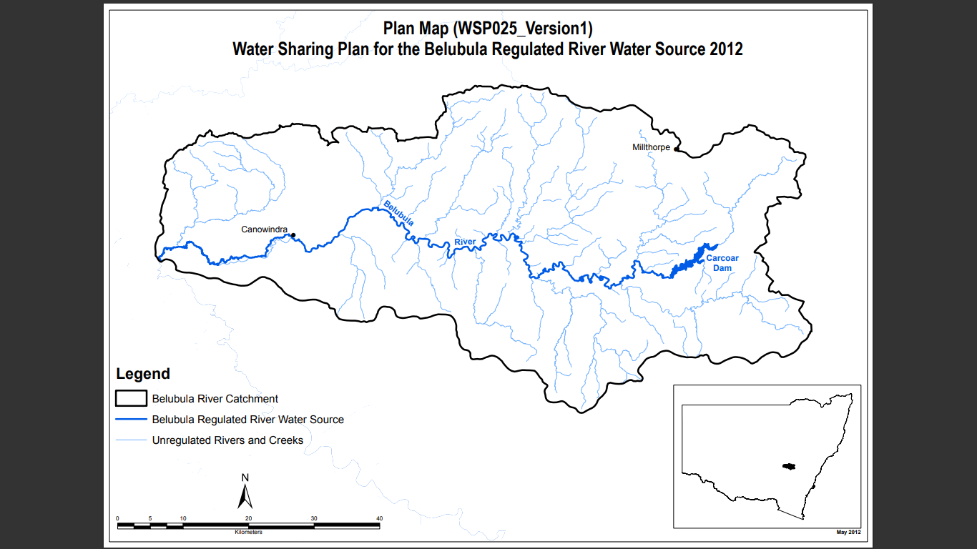
On page 107 of the EIS Appendix J Surface Water Assessment, the following statement about cumulative mining impacts, in the area of the project:
‘There are no other mining developments located in the Carcoar Dam catchment hence there are no cumulative mining impacts expected during operations’

Slide 3
Water quality impacts that could arise as a consequence of the project: (1) The 90 km brine pipeline
Water and / or soil pollution (and contamination of flora, fauna and agriculture) from potential leakage, breakage or malfunction of the Lithgow brine pipeline.
A leak or discharge from the pipeline (average flow of 13 ML/day) for even a short period of time could have very harmful consequences
The average flow rate is 541,660 litres an hour.
9,027 litres a minute.
150 litres a second.
Apart from salt, what contaminants are in the brine?

Slide 4
What is the water quality of the Lithgow brine?

Slide 5
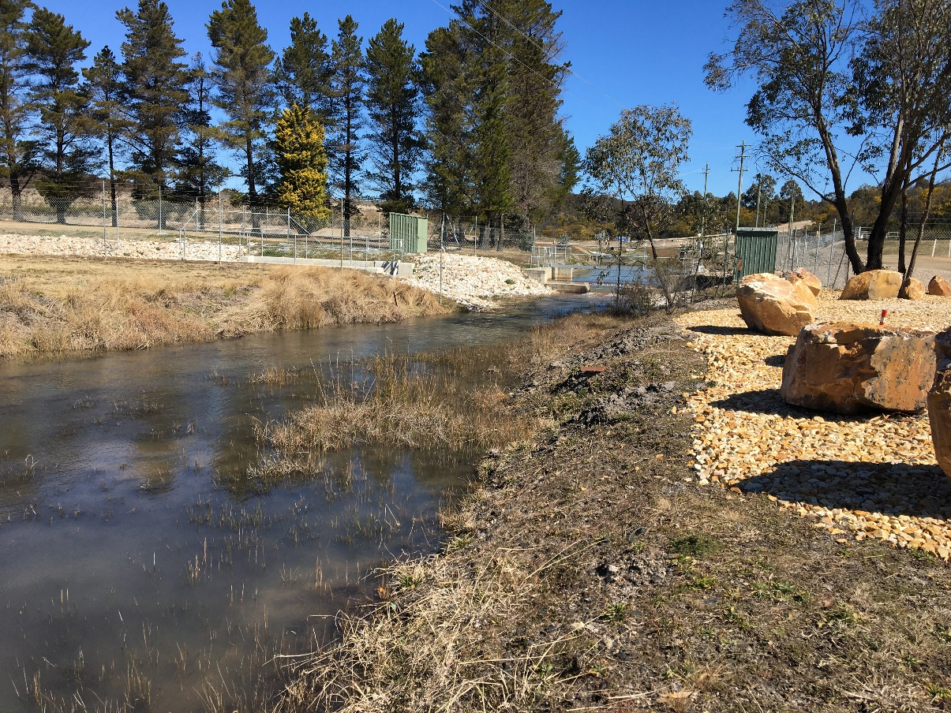
https://www.centennialcoal.com.au/operations/springvale-coal-services/
Water in Lamberts Gully emerging from Western Coal Services. This flow includes wastewater released under EPL 21229 (LDP001) that discharges into Neubecks Creek (sometimes called Wangcol Creek)

Slide 6
ANZECC (2000) Guidelines: 95% species protection
Manganese: <1900 µg/L = <1.9 mg/L
Nickel: <11 µg/L =<0.011
Zinc: <8 µg/L =<0.008

Slide 7
I am very concerned that this statement implies that future assessment of any water quality aspects of this project will use ‘site-specific water quality objectives’ that will potentially allow a higher concentration of key pollutants related to this project (compared to ANZECC water quality guidelines).
It is inappropriate that the exact detail of such ‘site-specific water quality objectives’ are not available at this stage of the project assessment.
It gives me no comfort that the EPA agree with this concept.
As detailed in previous slide, the EPA’s discharge licence for Western Coal Services (EPL 21229) fails to impose any discharge limits on the three most dangerous pollutants (salinity, nickel or zinc).

Slide 8
What are the relevant licence conditions? Will they be similar to EPL 21229?
In the recommended conditions of consent there were no details provided on the future EPA EPL licence (EPA pollution licences: Environment Protection Licences ‘EPLs’) for the mine.
Based on the text above (and section 241 of the DPIE report, previous slide) it appears possible that the EPA water quality licence will use ‘site-specific water quality objectives’ that could provide very weak protection of Belubula River water quality by allowing environmentally hazardous concentrations of pollutants that will potentially be released from the mining operation.
The lack of detail on the range and expected concentrations of pollutants that could be generated within the proposed mine operation is also a major oversight in the EIS documents, the DPIE report and also the ‘Conditions of consent’.

Slide 9
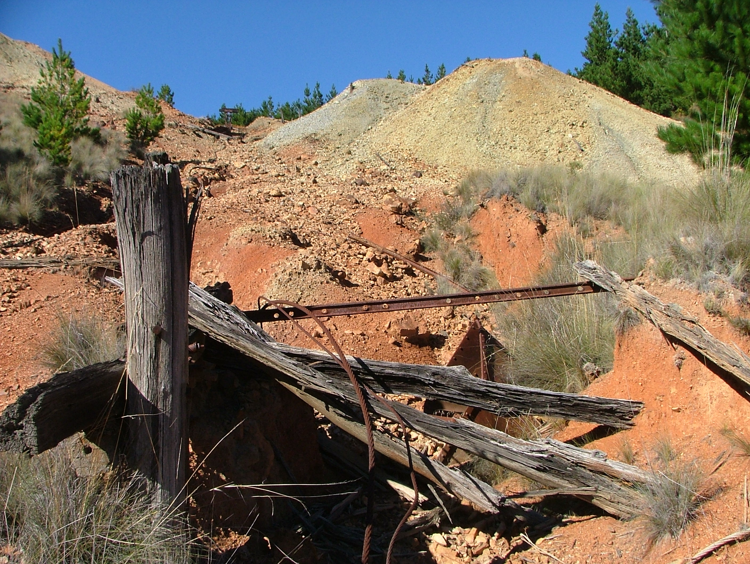
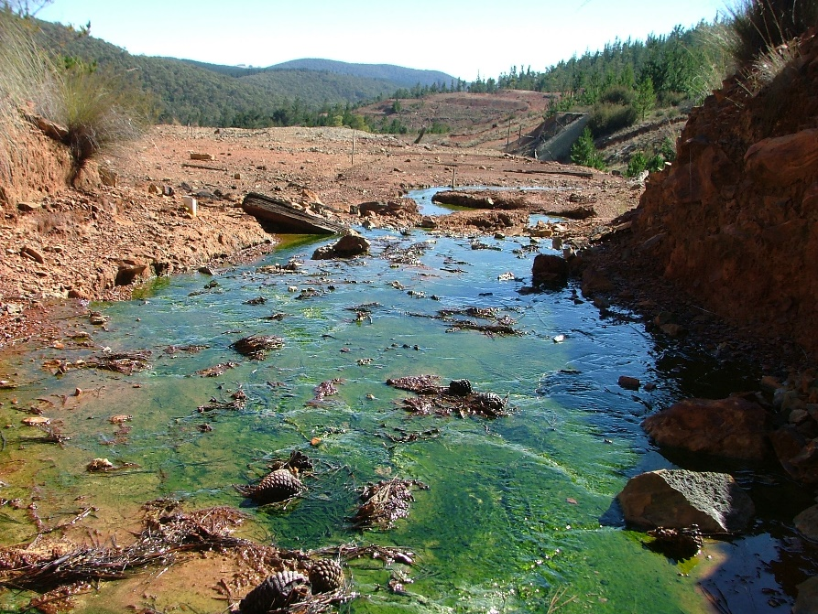

Slide 10
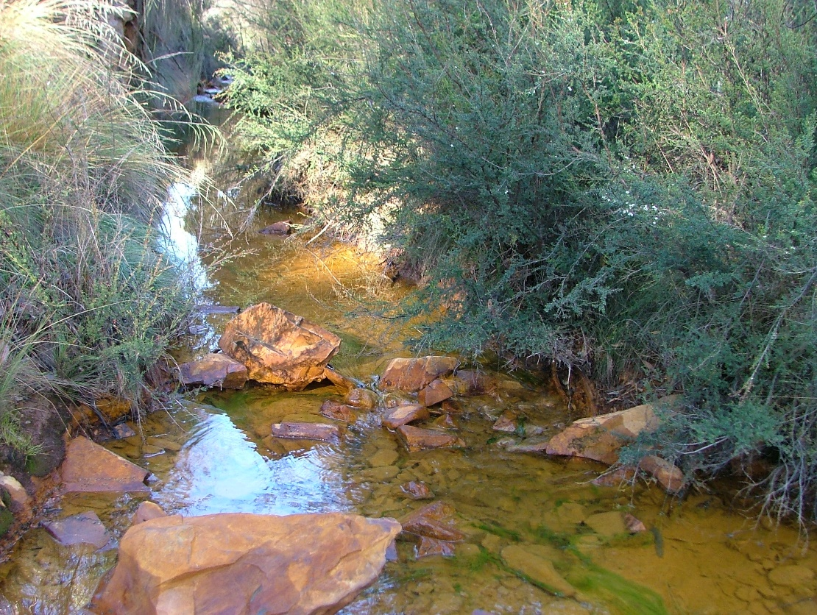
Pollutant | Concentration (µg/L) | ANZECC (2000) Guideline (95% protection) (µg/L) | Exceeded by:
Lead | 1370 | 3.4 | 403 times
Cadmium | 126 | 0.2 | 603 times
Copper | 1420 | 1.4 | 1014 times
Nickel | 273 | 11 | 24.8 times
Zinc | 32600 | 8 | 4075 times
As part of previous research project I sampled water from Daylight Creek. This small creek was 1 km downstream the derelict Sunny Corner gold mines, which continuously release seepage from the mines and associated workings (Wright & Ryan, 2016).
None of the EIS documents, the DPIE report or Conditions of Consent explain what pollutants may be generated by the mining operation, at what concentration they may be at. Even if they remain ‘locked’ in this ‘nil-discharge’ Project such information is needed to assesses risks and inform environment monitoring and EPA licences.
Wright, I.A. and Ryan, M. (2016) Impact of mining and industrial pollution on stream macroinvertebrates: importance of taxonomic resolution, water geochemistry and EPT indices for impact detection. Hydrobiologia. 772, 103-115.

Slide 11
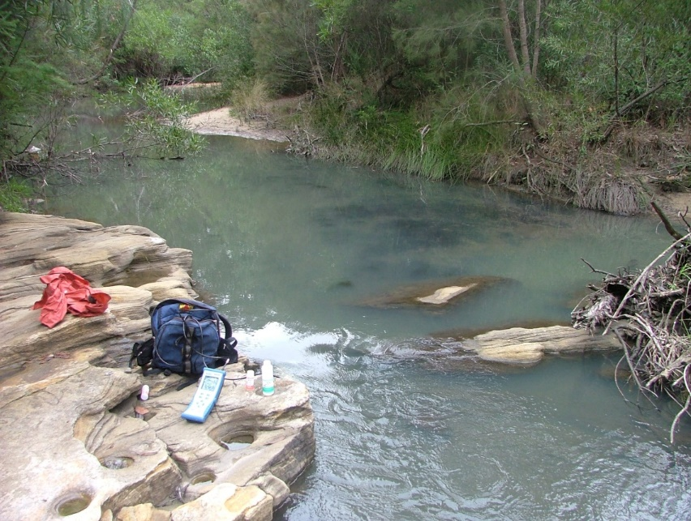
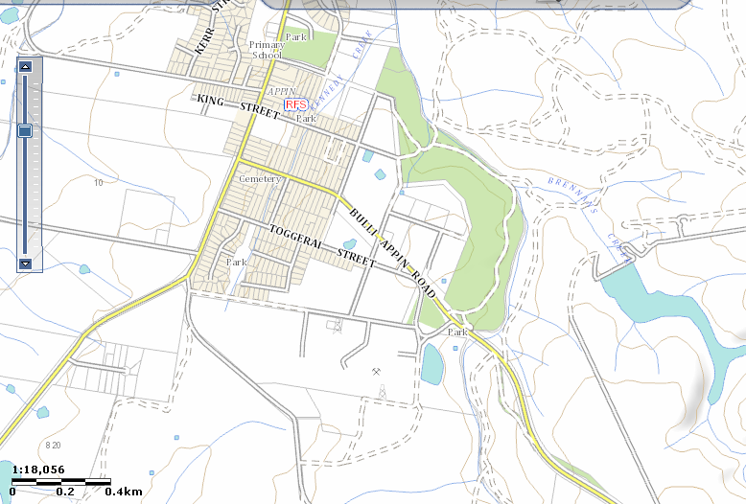
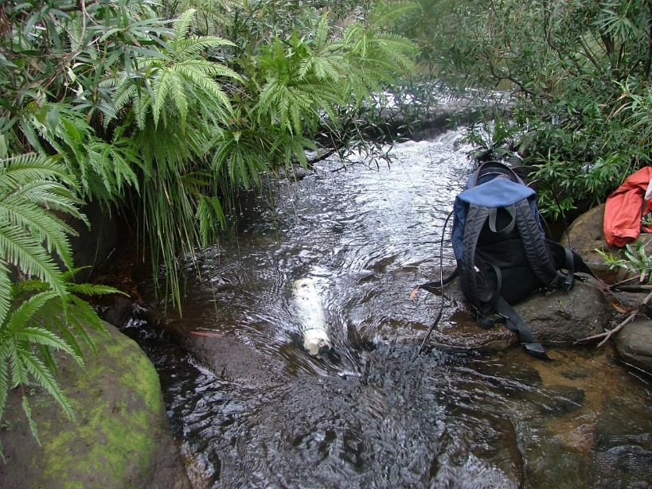
X
West Cliff
Colliery
Waste
Discharge
X

Slide 12
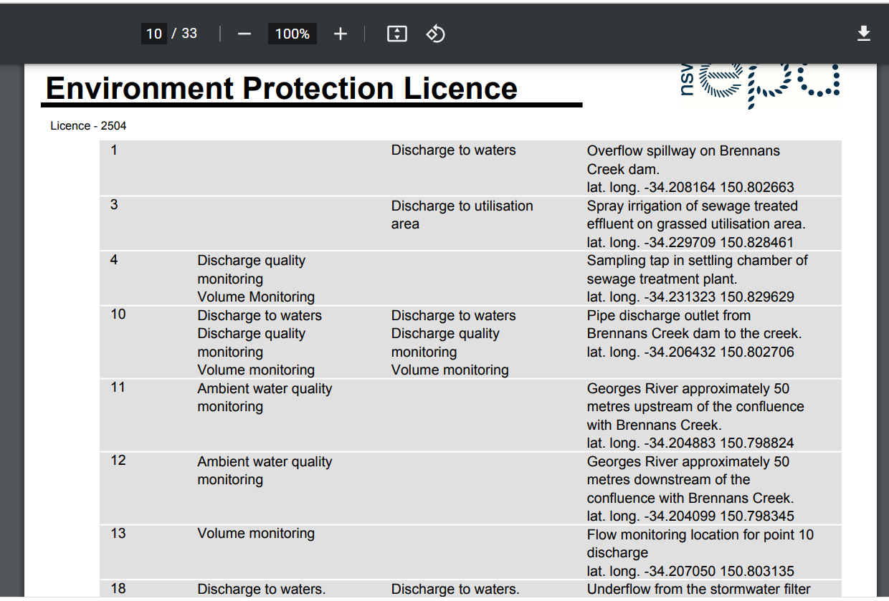

Slide 13
