Slide 1
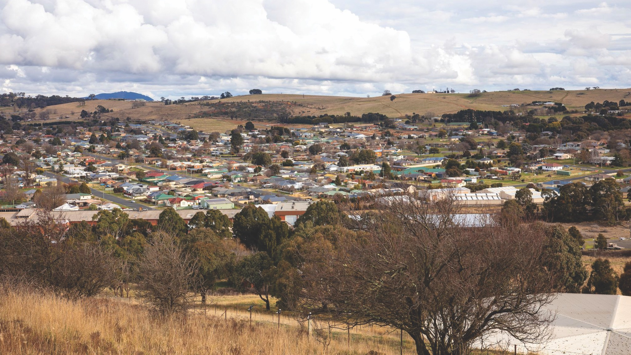
Independent Planning Commission - Public Hearing
Danielle Wallace - Health, Safety & Environment Manager
Tuesday 7th February 2023

Slide 2
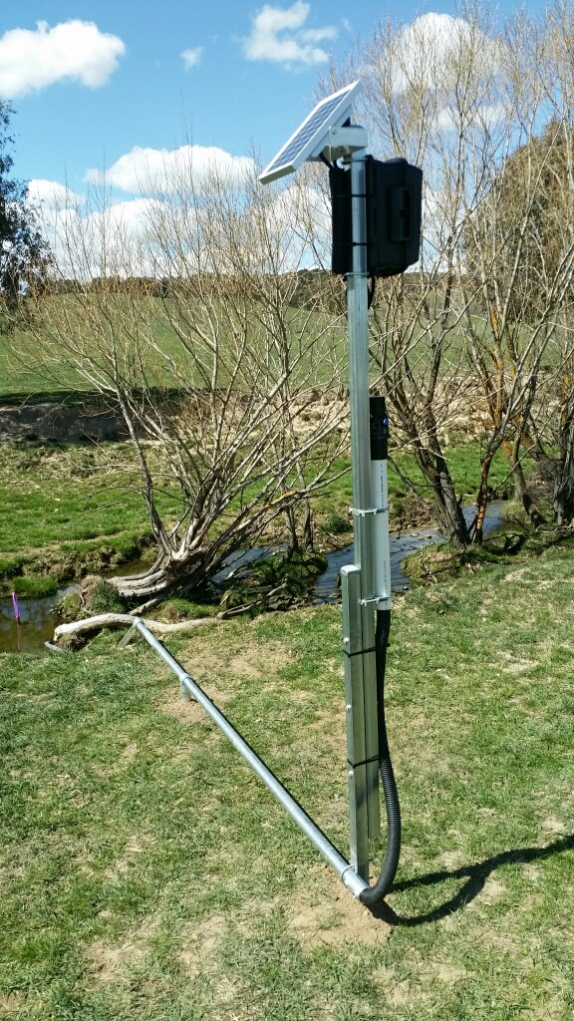
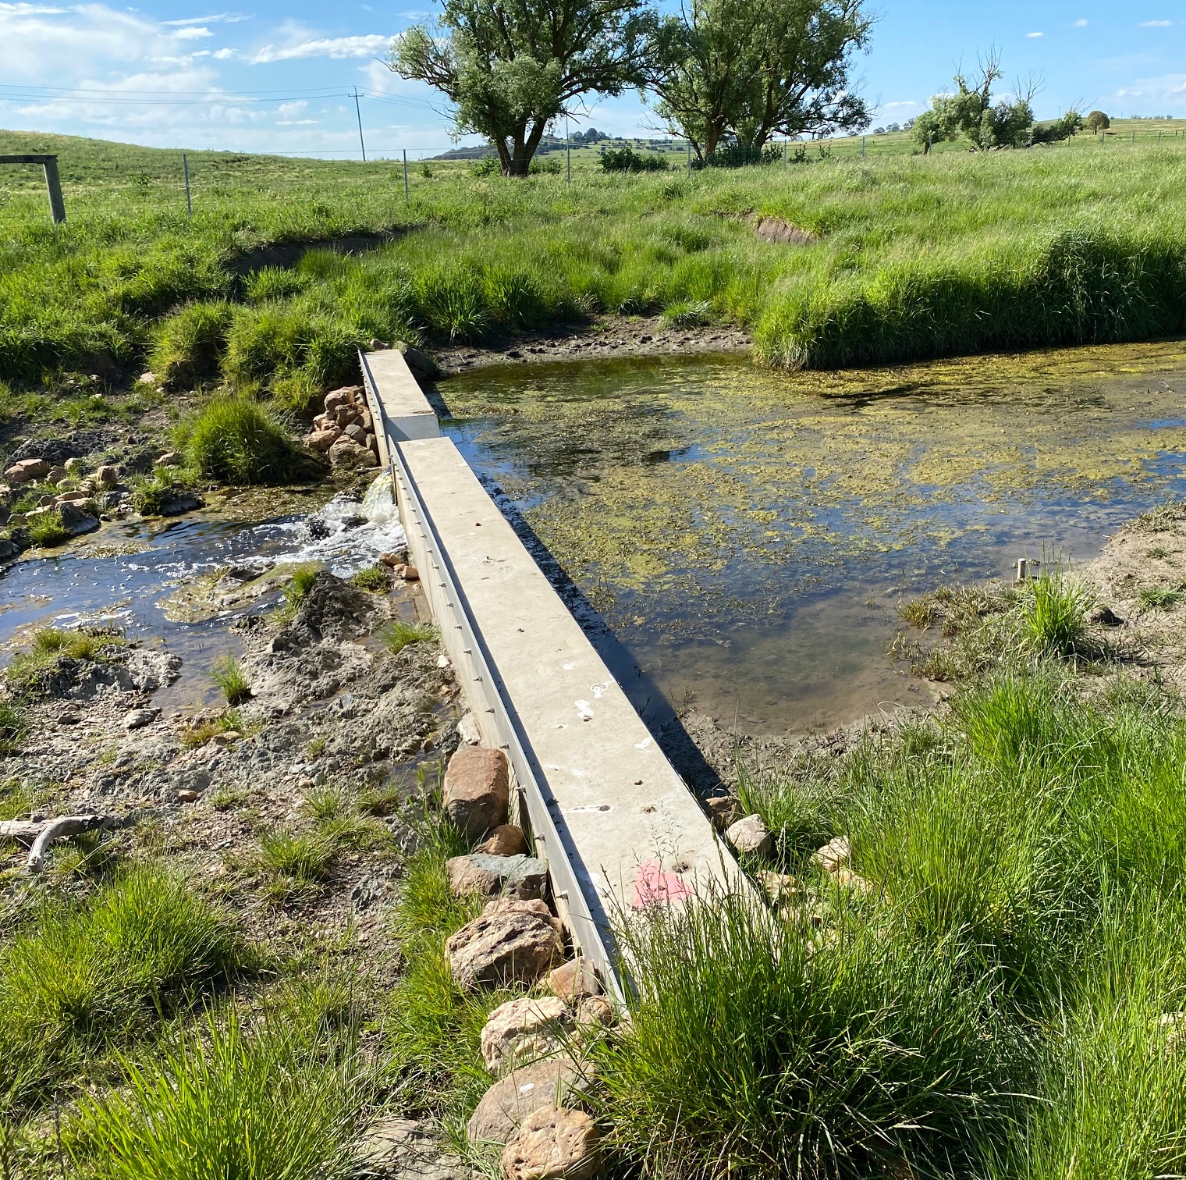
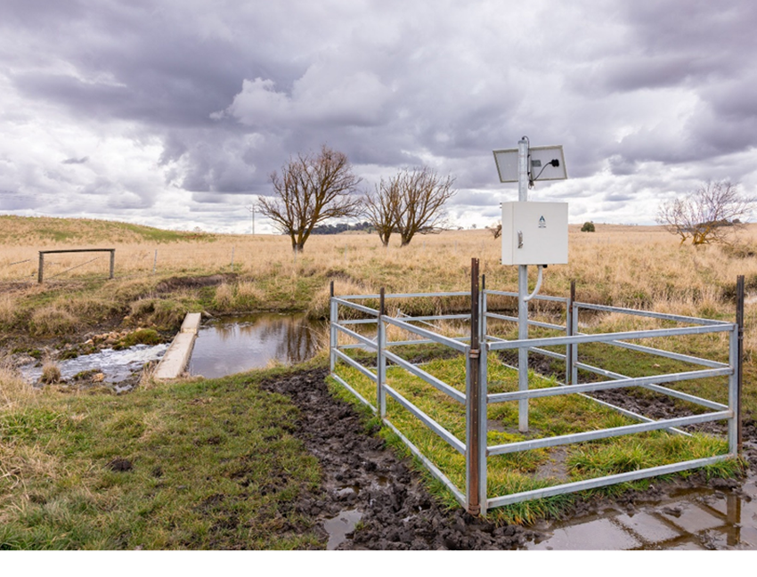
EXISTING MONITORING
2
V-notch weir flow gauging station
Flow gauging station

Slide 3
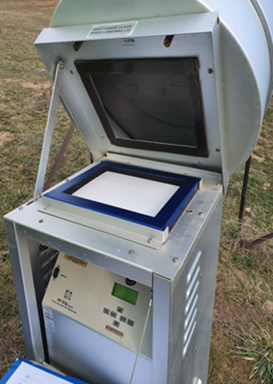
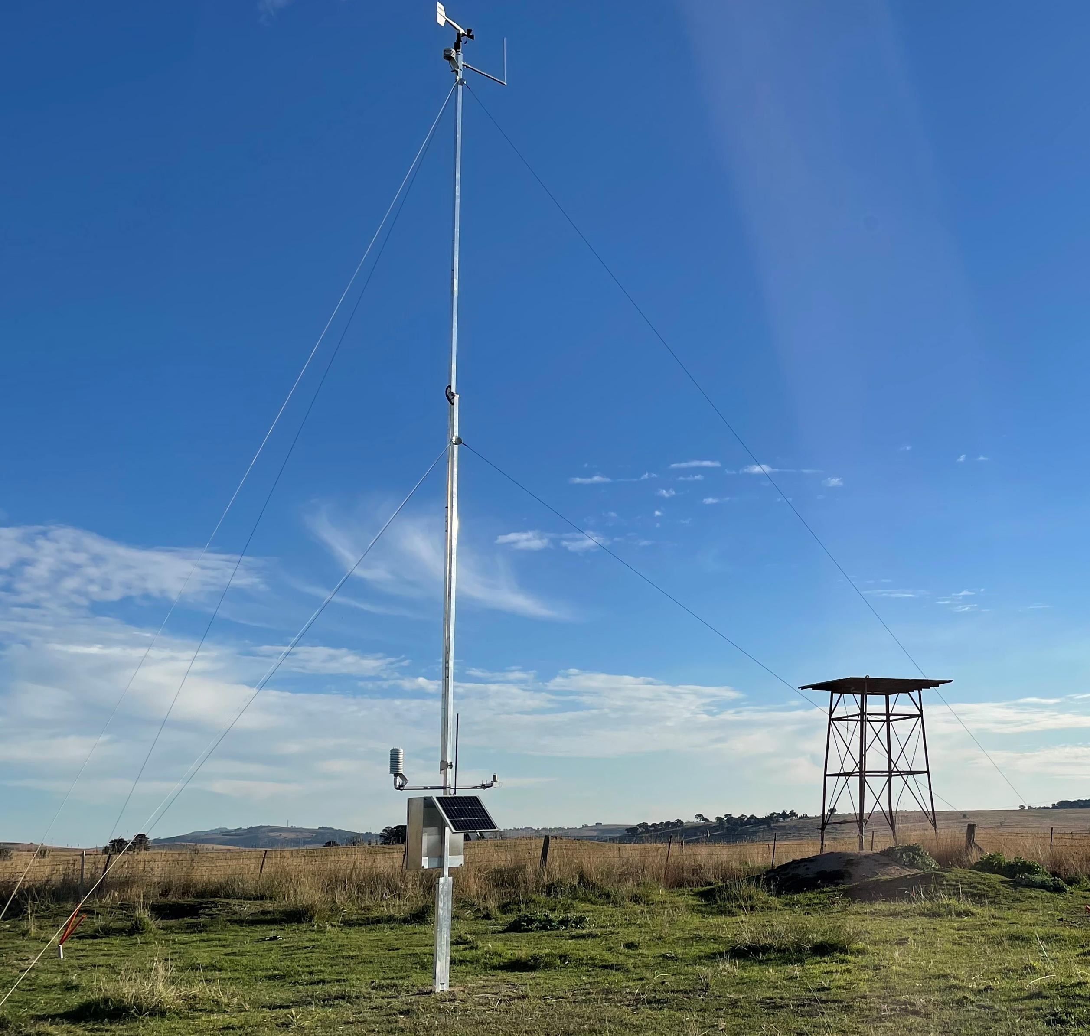
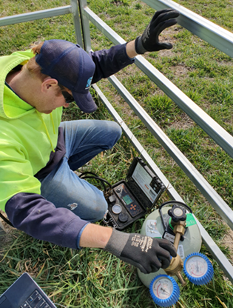
EXISTING MONITORING (EXAMPLES)
3
High Volume Air Sampler
Automatic Weather Station
Groundwater monitoring

Slide 4
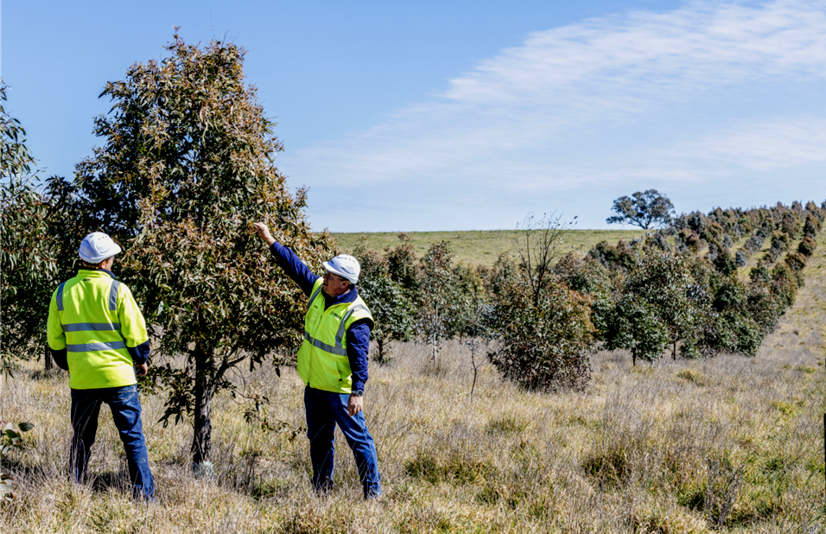
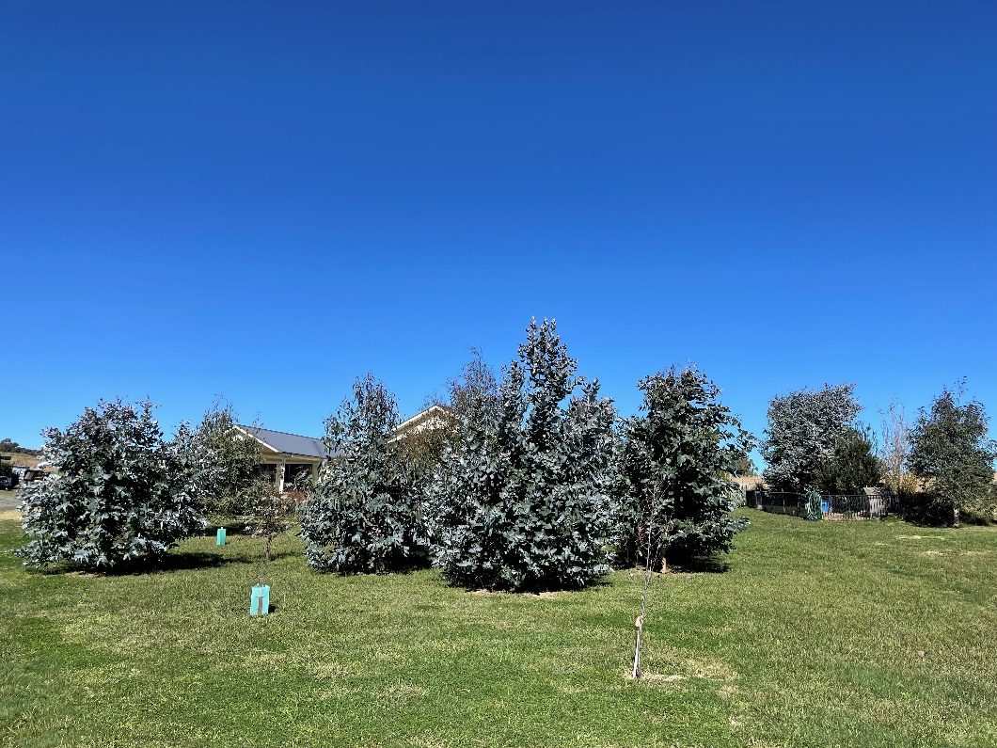
TREE PLANTING AND SCREENING
4
Tree screen planting – visual screening and wildlife corridors

Slide 5
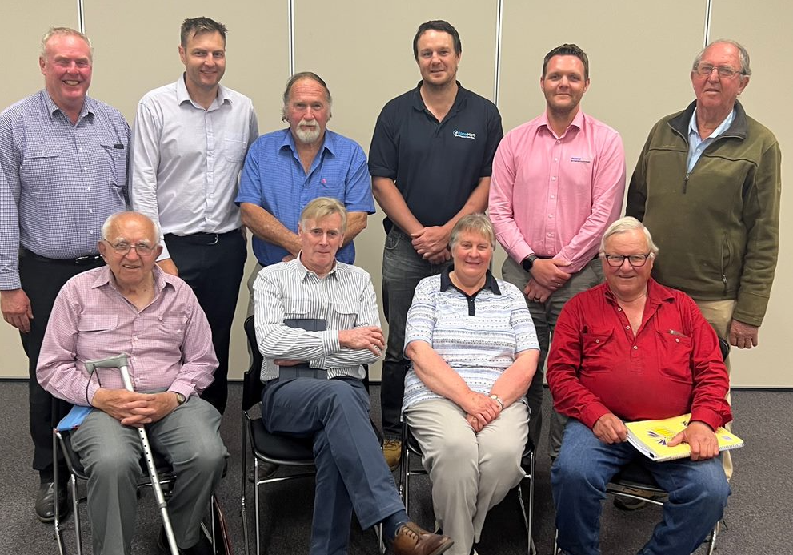
COMMUNITY CONSULTATIVE COMMITTEE
CCC Members:
David Johnson (Independent Chairperson)
Miles Hedge (community member)
Peter Hildenbeutel (community member)
Elizabeth Russ (community member)
Tom (Edward) Williams (community member)
Jordan Butler (community member)
Cyril Smith (Orange and Region Water Security Alliance Inc)
Daniel Sutton (Belubula Headwaters Protection Group)
Robert Taylor (Bathurst Regional Council)
Heather Nicholls (Cabonne Council)
Mark Dicker (Blayney Council
Alternate Representatives:
Bob Russ
Bruce Reynolds
Paul Hancock
Regis Resources Representatives:
Kath Logan
Danielle Wallace
Andrew Wannan
5

