Slide 1
Ulan Continued Operations Project- Modification 4 Longwall Optimisation Project
Independent Planning Commission Presentation

Slide 2
Agenda
Item No | Agenda Item | Party
1 | Proposed Ulan Modification 4 Background | Ulan Coal Mines Ltd (UCML)
2 | Clarification of specific matters requested by the Independent Planning Commission (IPC) | UCML
3 | Impacts resulting from the proposed Modification 4 | UCML
4 | Other matters associated with Modification 4 | UCML
5 | Additional questions | IPC

Slide 3
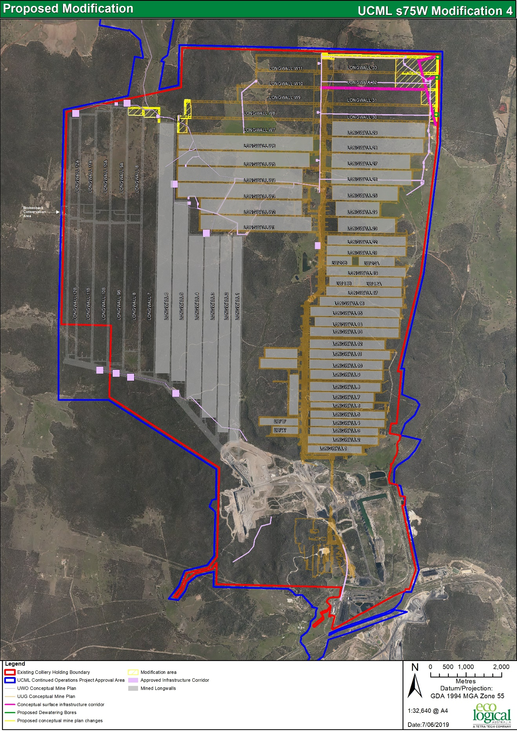
Ulan Complex and Proposed Modification
Ulan Coal Mine is located 45km north of Mudgee and 25km north east of Gulgong, within the Mid-Western Regional Council
Mod 4 would provide access to an additional 6.4 million tonnes of coal
No changes to the maximum workforce, limits on extraction or the approval term
Mod 4 lies wholly within existing approval and Mining Lease boundaries
Commencement of works associated with Modification 4 is scheduled for 1 November 2019
Notes:
Mining undertaken in Ulan Area since the early 1920’s, including the Ulan No. 1 Mine.

Slide 4
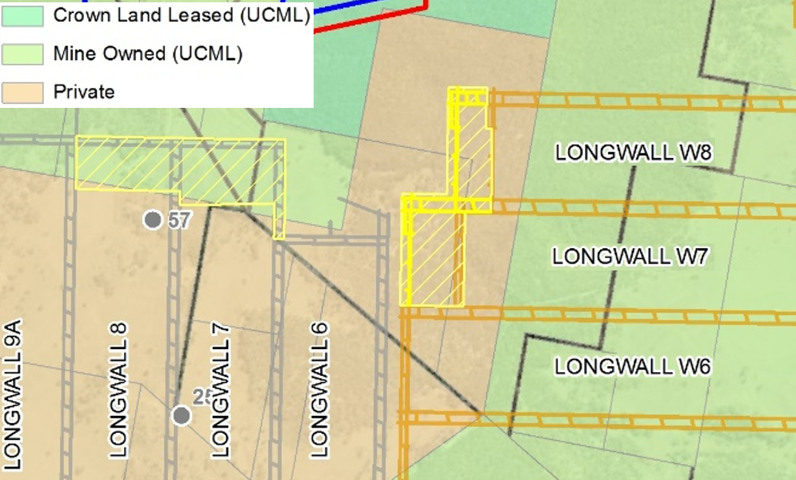
Proposed Modification
Geological information gathered since the project was approved indicates additional minable resource and ventilation can be achieved with extended panels
A coal barrier between LW28 and LW29 in the approved mine plan was removed and LW33 will be widened accordingly
Mod 4 to Project Approval 08_0184 (PA 08_0184) under s75W seeks
Extension of Ulan Underground (UUG) Long Wall’s (LW 30-33)
Extension of UUG LW’s W7-W8
Extension of Ulan West Operations LW7-8 and
Installation of key supporting infrastructure

Slide 5
Proposed Modification
Aspect | Currently Approved | Updated Proposed Modification
Mine Life | 16-year life until 30 August 2033 | No change
Limits on Extraction | 20 Mt of coal per annum (including maximum of 4.1 Mtpa ROM from Open Cut) | No change
Operating Hours | 24 hours per day, 7 days per week | No change
Workforce Numbers | Approximately 931 people (Complex) | No change
Mine Plan | As shown in Figure 9 of Environmental Assessment | Extension of: LWs 30, 31, 32 and 33, and LWW7 and LWW8, at the UUG; and LW7 and LW8 in the UWO. Widening of LW 33 at UUG. Associated development roadways.
Mining Method | Retreat longwall method | No change
Surface Infrastructure | As per Continued Operations Project EA | Revised locations for previously approved surface dewatering facilities provided based upon the changes to the UUG mine plan.
Ulan Complex Coal Handling and Preparation Plant | As per Continued Operations Project EA | No change
Coal Transportation | All coal transported from the site by rail. No more than 10 laden trains leave the site each day. | No change
Conservation Areas | As per Continued Operations Project EA | No change

Slide 6
Project Update
Environmental Assessment
National Parks and Wildlife Service Landowner Ministerial consent granted
Conceptual Infrastructure Design- Dewatering facilities reduced from 5 (approved) to 3
Relinquishment of previously approved infrastructure Corridor (22.05 ha)
MOD 4 Confirmed Not a Controlled Action under Environment Protection and Biodiversity Conservation Act 1999 by Department of Energy and Environment
Response to Submissions
Revised Infrastructure Corridor – further reduction in disturbance by 2.2 ha (net disturbance of 1.42 ha)
Voluntary Biodiversity Offset for 1.42 ha of disturbance
Heritage, Subsidence and Shallow Aquifer Assessments on private property
Ulan Coal Mines Limited (UCML) has since acquired additional Water Licenses for approved and proposed mine life
An Occupation Licence is required to permit operations within Durridgere State Conservation Area (SCA). This is being prepared in consultation with the NPWS

Slide 7
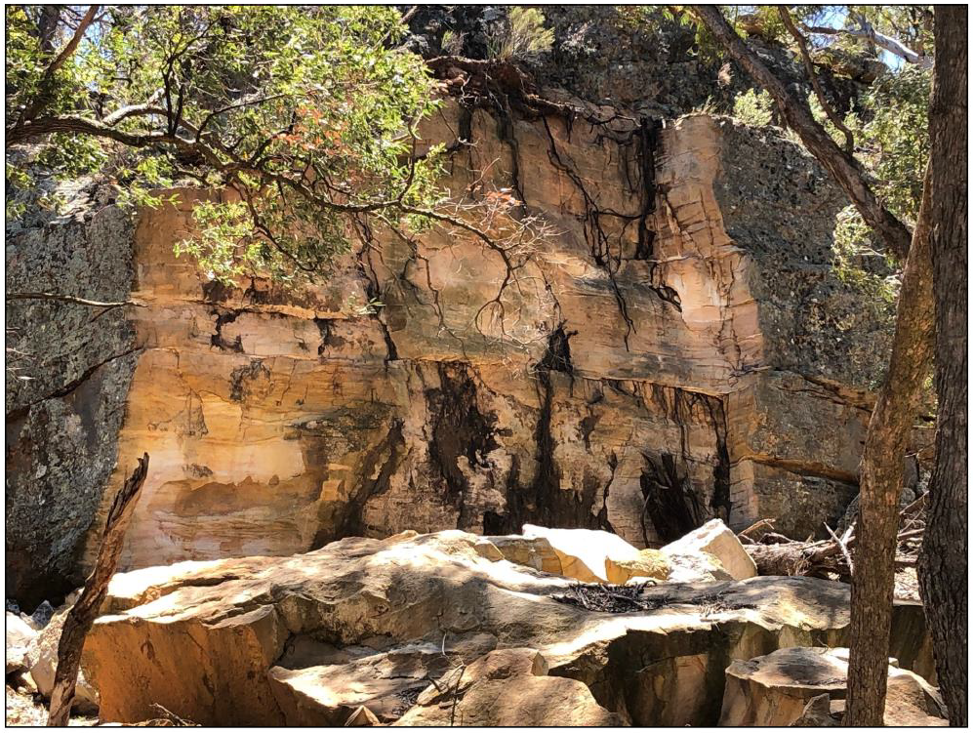
IPC Request- Potential subsidence impact on the Mona Creek rock shelters
The Mod 4 proposal will not increase the potential for cliff instability because mining and subsidence assessments from previous long wall panels indicates that mining can be within 85m of the cliff line without causing any perceptible impacts.
The private landowner raised concerns in relation to potential impacts from subsidence and Aboriginal Heritage. Additional assessments were commissioned to address these concerns
SCT assessed the rock falls that occurred on the Mona Creek cliff line in 2014 and ~1993:
The rock falls occurred due to natural causes and were not mining related
Heritage significance of the Mona Creek sites was reassessed by Southeast Archaeology
The rock fall has not directly impacted the sites
The assessment updates earlier work, finding that 8 sites have low research potential and 2 have moderate to high research potential
Notes:
Subsidence assessments of longwall mining throughout NSW (including Ulan) indicates that impacts to sandstone cliff formations from tensile strain induced by subsidence are limited to approximately 0.4 X depth from the longwall panel edges and a high level of protection for cliff formations can be provided by offsetting the longwall extraction areas and leaving a barrier equal to a distance of greater than 0.5 X depth (= 26.5º angle of draw) or 85m for the Mona Creek cliffline site. The offset in the proposed MOD4 layout is greater than 130m horizontally or 0.7 X depth (35º angle of draw).
The assessment of rock falls that occurred in 2014 by SCT (January 2019) also found that although the rock fall did not involve any of the Mona Creek cultural heritage sites, there remains a low potential for reoccurrence of natural rock falls however, the potential would not be increased by mining subsidence associated with Modification 4.

Slide 8
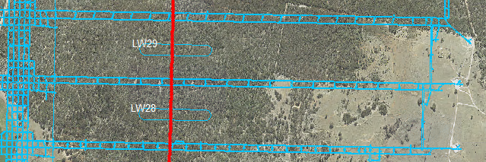
IPC Request- Extent of subsidence observed against predicted subsidence for areas which have already been mined
H Line – LWW3 and LWW4
Ulan Underground | LWW4 - H Line |  | LWW3 - H Line
Subsidence Parameter | Predicted | Actual | Predicted | Actual
Vertical Subsidence (m) | 1.6 | 1.47 | 1.6 | 1.57*
Tilt (mm/m) | 10-20 | 20 | 10-20 | 15
Strain (mm/m) | 7 | 7 | 5-10 | 6
* Reactivation of the goaf post LWW4 resulted in maximum subsidence of 1.62. Considered not to be of any practical significance given the increase in mining height from 2.9m to 3.1 and the recently adapted performance indictor of 2.5m
F Line – LW28 and LW29
Ulan Underground | LW29 - F Line |  | LW28 - F Line
Subsidence Parameter | Predicted | Actual | Predicted | Actual
Vertical Subsidence (m) | 1.6 | 1.39 | 1.6 | 1.49
Tilt (mm/m) | 10-20 | 11 | 10-20 | 15
Strain (mm/m) | 5-10 | 4 | 5-10 | 5

Slide 9
IPC Request- Extent of subsidence observed against predicted subsidence for areas which have already been mined (Continued)
Ulan West | LW1 - Line A |  | LW1 - Line B |  | LW1 - Line C |  | LW1 - Line D
Subsidence Parameter | Predicted | Actual | Predicted | Actual | Predicted | Actual | Predicted | Actual
Vertical Subsidence (m) | 2.1 | 1.91 | 2.1 | 1.82 | 1.9 | 1.2 | 1.6 | 0.62
Tilt (mm/m) | 162 | 62 | 162 | 69 | 68 | 27 | 36 | 8.5
Strain Tensile (mm/m) | 48 | 29 | 48 | 22 | 20 | 4.6 | 11 | 3.2
Strain Compressive (mm/m) | 65 | 52 | 65 | 30 | 27 | 3.9 | 15 | 1.7
Ulan West |  |  |  |  | LW2 - Line C |  | LW2 - Line D |  | LW2 - Line E
Subsidence Parameter |  |  |  |  | Predicted | Actual | Predicted | Actual | Predicted | Actual
Vertical Subsidence (m) |  |  |  |  | 1.9 | 1.36 | 1.6 | 0.97 | 2.1 | 1.5
Tilt (mm/m) |  |  |  |  | 68 | 34 | 36 | 12 | 105 | 43
Strain Tensile (mm/m) |  |  |  |  | 20 | 10 | 11 | 4 | 32 | 10
Strain Compressive (mm/m) |  |  |  |  | 27 | 23 | 15 | 5 | 42 | 11
Ulan West |  |  |  |  | LW3 - Line C |  | LW3 - Line D |  | LW3 - Line E
Subsidence Parameter |  |  |  |  | Predicted | Actual | Predicted | Actual | Predicted | Actual
Vertical Subsidence (m) |  |  |  |  | 1.9 | 1.5 | 1.6 | 1.4 | 2.1 | 1.4
Tilt (mm/m) |  |  |  |  | 68 | 32 | 36 | 20 | 105 | 36
Strain Tensile (mm/m) |  |  |  |  | 20 | 10 | 11 | 7 | 32 | 17
Strain Compressive (mm/m) |  |  |  |  | 27 | 5 | 15 | 9 | 42 | 9
Ulan West |  |  |  |  | LW4 - Line C |  | LW4 - Line D |  | LW4 - Line E
Subsidence Parameter |  |  |  |  | Predicted | Actual | Predicted | Actual | Predicted | Actual
Vertical Subsidence (m) |  |  |  |  | 1.9 | 1.61 | 1.6 | 1.32 | 2.1 | 1.42
Tilt (mm/m) |  |  |  |  | 68 | 57 | 36 | 17 | 105 | 53
Strain Tensile (mm/m) |  |  |  |  | 20 | 18 | 11 | 5 | 32 | 8
Strain Compressive (mm/m) |  |  |  |  | 27 | 21 | 15 | 5 | 42 | 8

Slide 10
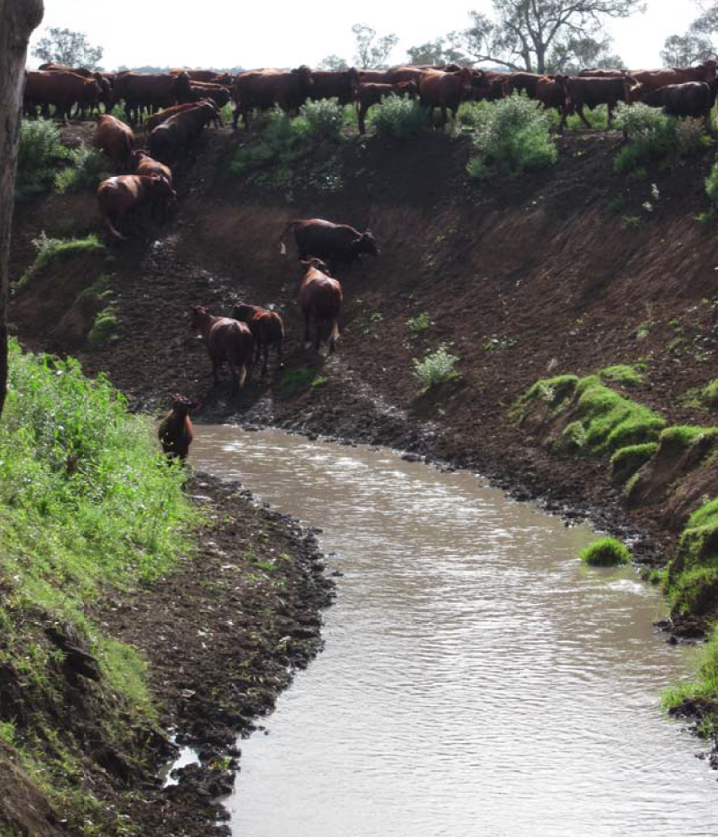
IPC Request- Status and conclusions of the research studies on water discharge to the Talbragar River
UCML does not discharge to the Talbragar River and the studies for Mod 4 showed water can be managed with the current water infrastructure that discharges to Ulan Creek
The following studies assessed the feasibility of discharging to the Talbragar Catchment
Talbragar River Research Study (2012)
Mona Creek Hydraulic Assessment (2013)
Conclusions were included in a 2014 report to the Environment Protection Authority as part of a condition attached to Environment Protection Licence 394
Discharge to the Talbragar River would effect the flow regime for the catchment
This was not considered to have a significant deleterious environmental impact
flow regime impacts are manageable
Current discharge to Ulan Creek will continue within current limits of the existing Environment Protection Licence 394

Slide 11
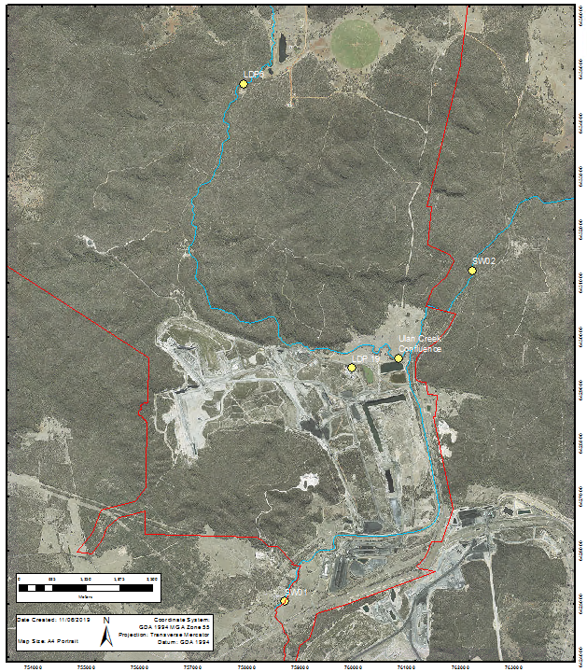
IPC Request- Water ecology monitoring on the Goulburn River and nature of some of the ionic species (e.g. metals) in the discharged water
No changes to the discharge are proposed as a result of Mod 4
A Contaminant Source Study was undertaken as part of a 2014 report to the Environment Protection Authority,
The Contaminant Source Study examined a broad range of constituents and found that contaminants were, either, not detected or below ANZECC guideline trigger limits for 80th percentile of samples
Analysis of mixing zone samples, collected from Ulan Creek, upstream of the confluence with the Goulburn River, indicates that no samples exceed ANZECC guideline trigger limits
Similarly no samples collected from the downstream gauging station exhibit constituents with higher than ANZECC guideline trigger limits
Samples analysis includes metals and other ions each year (selected based on the findings of the 2014 study) as part of the broader water monitoring strategy

Slide 12
IPC Request- Water ecology monitoring on the Goulburn River and nature of some of the ionic species (e.g. metals) in the discharged water
Macro invertebrate sampling has been conducted in the Goulburn River since 2003. All of this data shows that there has not been an impact from the treated water discharge. The sampling since 2011 has been collected in a consistent manner, that does allow direct statistical analysis of impacts. This shows:
The macro invertebrates upstream and downstream of the operations are not statistically different
Fluctuations in the data over time are representative of seasonal fluctuations and not a result of discharges

Slide 13
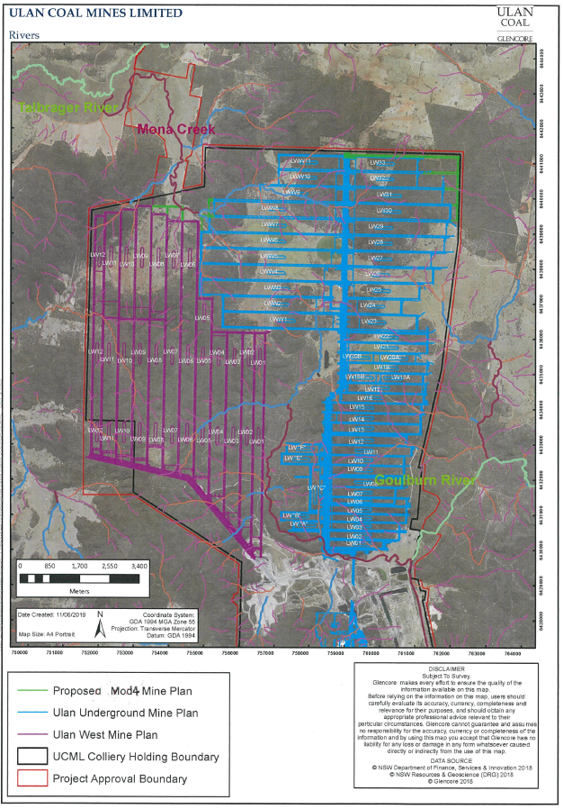
IPC Request- Assurance that the predicted subsidence impacts will not significantly affect the stability of the Goulburn and Talbargar Rivers and Mona Creek
The Goulburn and Talbragar Rivers are ~7.5km and ~3.8km from current mining areas respectively.
Impacts to the stability of watercourses is only applicable within the 45 degree angle of draw from the long wall extraction point, which for the proposed MOD 4 areas is between 160m and 330m.
None of the existing or proposed long wall panels have potential to impact the stability of either the Goulburn or Talbragar Rivers
Mod 4 causes a larger area of Mona Creek to be subject to potential impacts however, no changes are predicted to the nature of impacts
Notes:
An example of this is repairs that were made to cracks in a drainage line over LW 1 at Ulan West, where cracking was more significant due to the low depth of cover (65m)

Slide 14
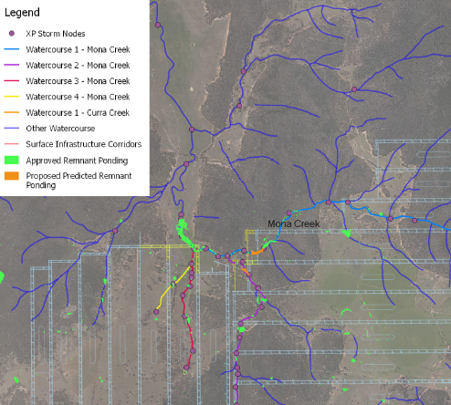
IPC Request- Assurance that the predicted subsidence impacts will not significantly affect the stability of the Goulburn and Talbargar Rivers and Mona Creek (Continued)
Mona Creek is ephemeral in nature, is not a well defined watercourse and does not have defined bed and banks
Mona Creek conveys water for short periods following rainfall
Tensile cracking from subsidence may occur in drainage channels associated with Mona Creek and in the surface generally over LWW7 and LWW8, which may cause some overland flow into the overburden strata, where some portion would report as inflow to the mine
In this respect, the Mod 4 proposal is not different to the approved mine plan
Monthly inspections are conducted and repairs made as necessary to minimise water losses via such pathways

Slide 15
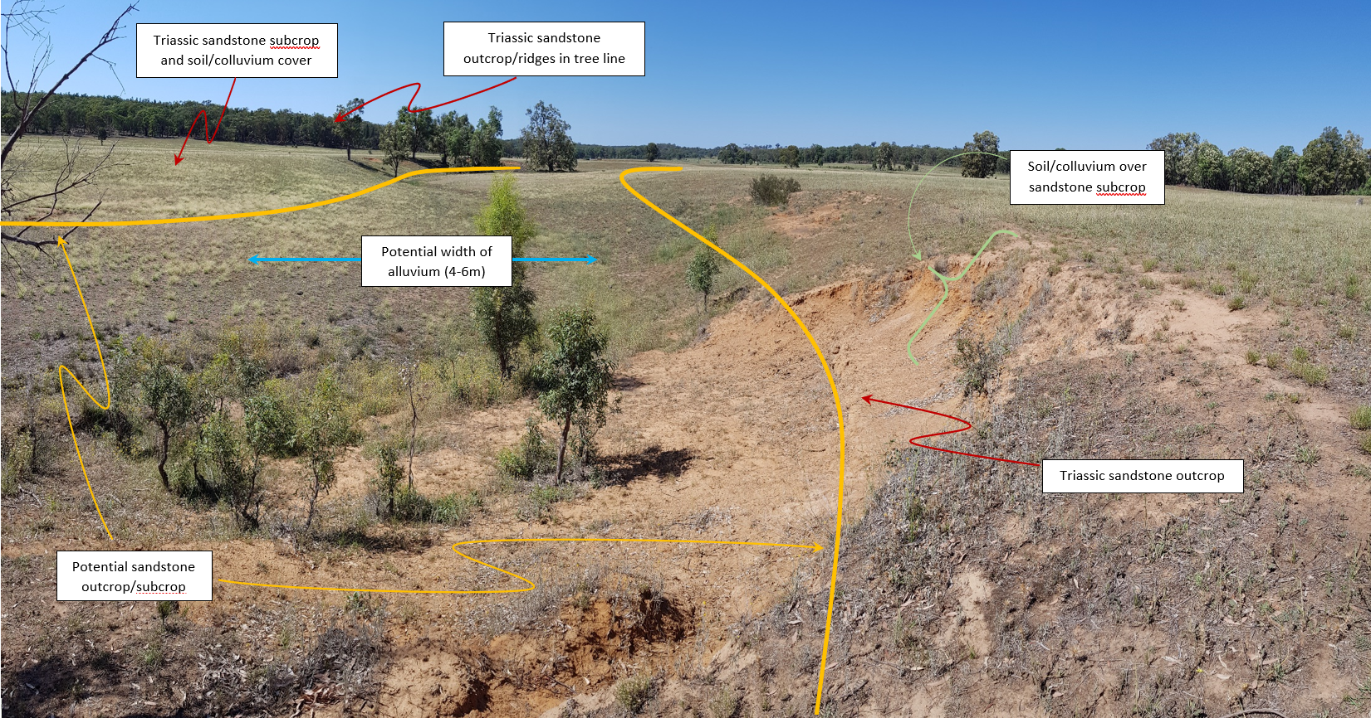
Mona Creek Alluvium
Hydraulic connectivity of the Mona Creek alluvium is being assessed in consultation with the owner. A site visit, walk over inspection, review of available data and preparation of a monitoring design are complete. Set up works for the monitoring program are to be completed by the end of 2019
The lower reaches of Mona Creek contain alluvium which is likely to be 3m to 5m thick and 150m to 500m wide
It is limited in extent to the area ~4.2km upstream of the confluence with the Talbragar River
The alluvium is not a highly productive groundwater source
The soil types present are not associated with significant alluvium
Adjacent slopes are likely to be representative of colluvium
Sandstone ridges host localised bodies of perched groundwater
Notes:
Biophysical Strategic Agricultural Land or low coherence
colluvium not water storing, high rates of transmissivity

Slide 16
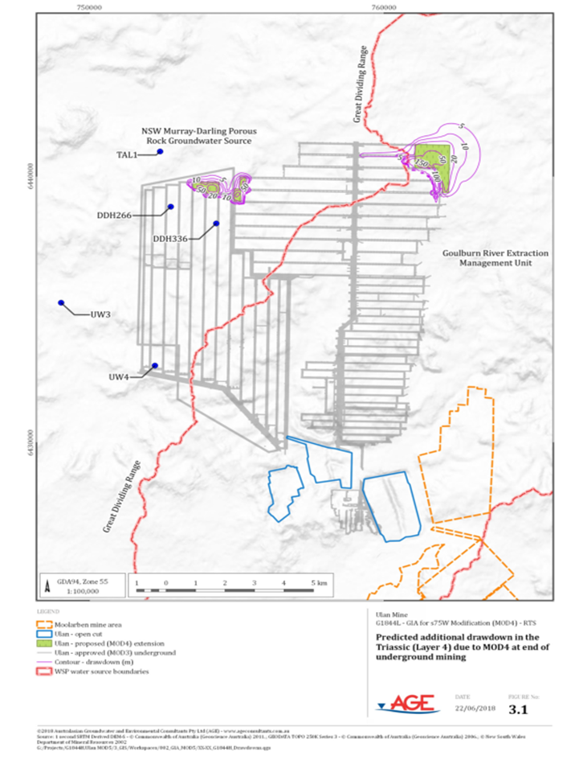
Technical studies – Groundwater (Australasian Groundwater and Environmental Pty Ltd (AGE))
Groundwater assessment concluded:
Increase in base flow losses (~1ML/year in each catchment), not measurable in practical terms
No additional private bores will be affected by groundwater drawdown
Drawdown impacts meet the minimal impact criteria provided in the NSW Aquifer Interference Policy
Peer Review concluded that the hydrogeological description, conceptualisation, model design, simulations and reporting have been conducted in an adequate manner
DoEE determined that project is not a Controlled Action under the Environment Protection and Biodiversity Conservation Act 1999
Licences are held to cover base flow losses and water extraction for the life of the Project
Subsidence Remediation and Alternative Water Supply Agreements are sought with owners of potentially impacted properties prior to impacts occurring
Notes:
Notes on licensing in ML/yr and carryover allowance for relevant water sharing plans
AGE modelling also indicated Baseflow losses modelled to be less than 1 ML/year for the Goulburn River and 1.09ML/ year for the Talbragar River.
For the eleven privately owned bores being subject to a small increase in the extent of depressurisation, one property has now been purchased by UCML and for remaining ten bores the maximum increase in drawdown from previous approvals is 1.37m, which is consistent with the minimal impact considerations provided in the NSW Aquifer Interference Policy (minimal impact is a maximum 2m decline cumulatively at any water supply work).

Slide 17
Technical studies – Groundwater (Continued)
The Drip
Notes:
Add drip location (AGE)

Slide 18
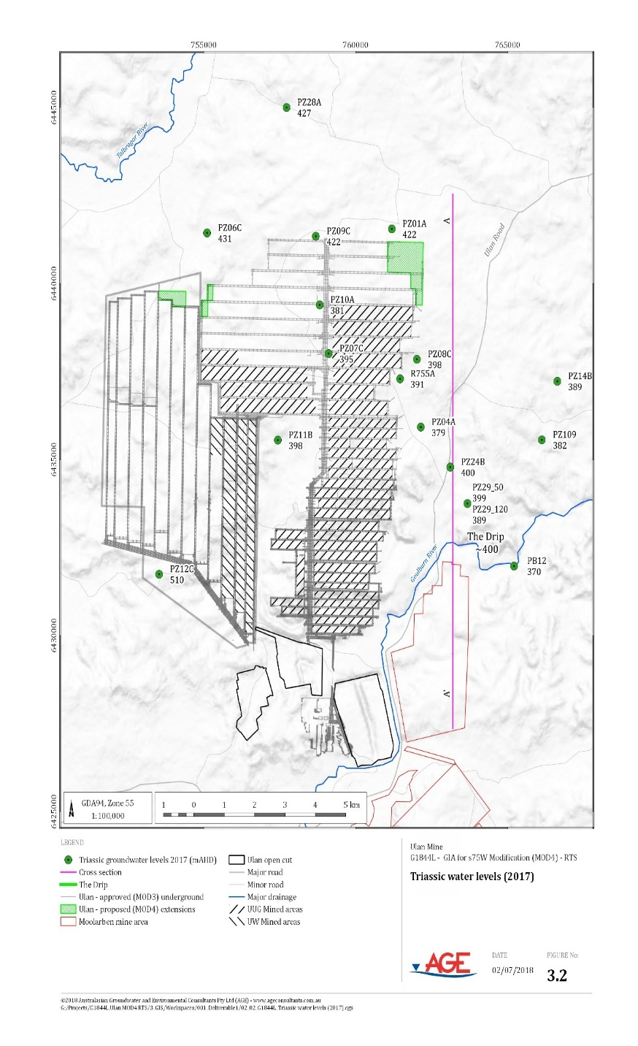
Response to Submissions
The Drip is a natural feature sustained by rainfall recharge
It is located ~7.5km from the current mining area
Ulan Underground mined LW11, 3.15km from the Drip in 1997
The Drip is located in an area of localised groundwater discharge sustained by rainfall recharge to the Triassic units
Monitoring indicates that no adverse impacts at The Drip have been observed to date
Modelling predictions indicate Mod 4 will have no impact on the Drip given:
The Drip is located ~ 7.5km from the proposed MOD 4 area
Hydro-geochemical assessment shows fundamental differences in water quality that indicate a different geological source to the Triassic water that is subject to drawdown as a result of mining activities
Modelling indicates that the only areas that show a change in the predicted drawdown are those areas immediately adjacent the proposed (Mod 4) mine plan
Notes:
Note Depressurisation of the Triassic strata due to mining, nearer the Drip than MOD 4 has occurred previously at Ulan.
Also no impact to the Drip given:
The two areas are within different sections of the geological strata with the MOD 4 application area being down-hydraulic gradient and at least 150 m deeper vertically (Figure 3.4).
“The Drip” is a natural feature that comprises a localised groundwater spring, located ~ 7.5km south, southeast of the proposed MOD 4 area.
Located in an area of localised groundwater discharge sustained by rainfall recharge to the Triassic units that overly the Illawarra Coal Measures.
Modelling predictions indicate MOD 4 will have no impact on the Drip.
Depressurisation of the Triassic strata due to mining, nearer the Drip than MOD 4 has occurred previously at Ulan.
No adverse impacts at The Drip have been observed to date.
The Drip is unlikely to be impacts given:
The Drip and MOD4 areas maintain a significant spatial separation (Figure 3.2);
Source water for the Drip compared to that monitored at the MOD 4 mining area is from a localised groundwater source (Figure 3.3).
The two areas are at significantly different elevations within the geological strata and within a different section of the geological profile, with the MOD 4 application area being down-hydraulic gradient and at least 150 m deeper vertically (Figure 3.4).
The water quality between the two locations is fundamentally different by nature indicating the influence of a different recharge source, likely to be localised.
Modelling indicates that the only areas that show a change in the predicted drawdown are those areas immediately adjacent the proposed (MOD 4) mine plan in the northern limits of UUG and UW (Figures 3.3 and 3.4).

Slide 19
Minimal Disturbance
Disturbance | Original Infrastructure Concept | Revised Infrastructure Concept
Net overall clearing for infrastructure construction | 3.63 ha | 1.42 ha (2.21 ha reduction in total disturbance)
Conceptual surface infrastructure corridor within Durridgere SCA | 40m width- power lines and pipelines above ground | 20m width- power lines and pipelines will be buried
Conceptual dimensions of dewatering infrastructure within Durridgere SCA | 100m x 100m- design would be minimised as part of the detailed design process, defined by the site conditions of the final location | 90m x 90m- locations investigated and further design work undertaken to confirm a smaller footprint can be used in the proposed locations
Relinquishment of previous infrastructure corridor (22.05 ha)
Reduced number of dewatering facilities from 5 to 3
Voluntary Offsets proposed for net vegetation disturbance of 1.42 ha
No direct impacts to State or Federally listed communities
Progressive rehabilitation of disturbed areas
Notes:
Construction Noise mitigation measures will also be implemented to reduce any potential noise impacts.

Slide 20
Technical studies – Subsidence (Strata Control Technologies (SCT) Pty Ltd)
Potential subsidence impacts were assessed as being consistent with the subsidence experienced over previously mined long wall panels. To date 42 long wall panels have been completed at Ulan
Potential remnant ponding increases by approximately 1 ha within the Curra and Mona Creek systems. No other ponding is expected to occur
Existing process to define and manage subsidence impacts:
Under the Project Approval an Extraction Plan is prepared for each long wall panel
Specific surface and subsurface features and the management for each are documented
inspections are conducted and mitigations would be implemented such as in the event that ponding or cracking within flow lines is identified
A Land Management Plan (LMP) is prepared in consultation with relevant landowners
The LMP identifies any surface features and potential impacts and describes management measures relevant to these features
Where this relates to privately owned land a Private Property Subsidence Management Plan is prepared in consultation with the owner. This may involve a written agreement for mitigation and compensation
End of Panel Subsidence reports compare impact assessment criteria and predicted impacts to observed impacts
Notes:
Subsidence impacts were predicted to be:
Vertical subsidence – 1.7 metres;
Tilts – 55 mm/metre;
Compression strains – 25 mm/metre; and
Tensile strains – 20 mm/metre.
Two Aboriginal rock shelter heritage sites (MC22 and MC236) are located above and close to the proposed longwall extension area for longwall W8.
These sites are expected to experience increases in the probability of rock falls and perceptible impacts.
Subsidence is currently managed through avoidance of undermining significant features (eg Brokenback CA), implementation of approved EP’s, PPSMP’s, SR&AWS Agreements and ongoing monitoring.
Monitoring of subsidence impacts upon vegetation is ongoing as documented in the existing UCML BMP.

Slide 21
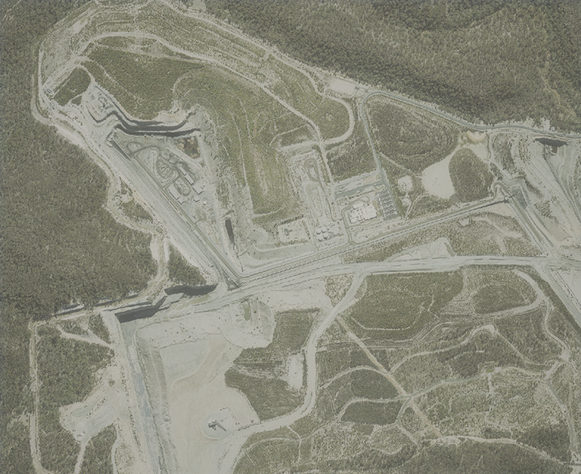
Current Water Management
The Ulan Coal Complex maintains an integrated water management system, which has capacity for the additional water from Mod 4 including:
Bobadeen Irrigation scheme
2 Reverse Osmosis Plants
Treated water is discharged into the Goulburn River in accordance with Environment Protection Licence 394
Clean / Dirty Water Separation system
Extended groundwater monitoring network and
Mine dewatering system supported by real time monitoring system
Recent Controlled Groundwater Allocation and Talbragar baseflow offset purchases have secured sufficient allocation for the current mine life (including MOD 4)
Notes:
Explain why we stopped discharging to the Goulburn River (and why water was temporarily unavailable to downstream users) and that discharge has been reinstated.

Slide 22
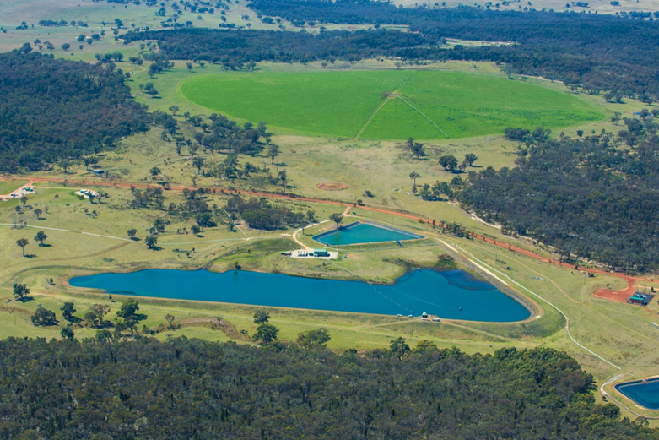
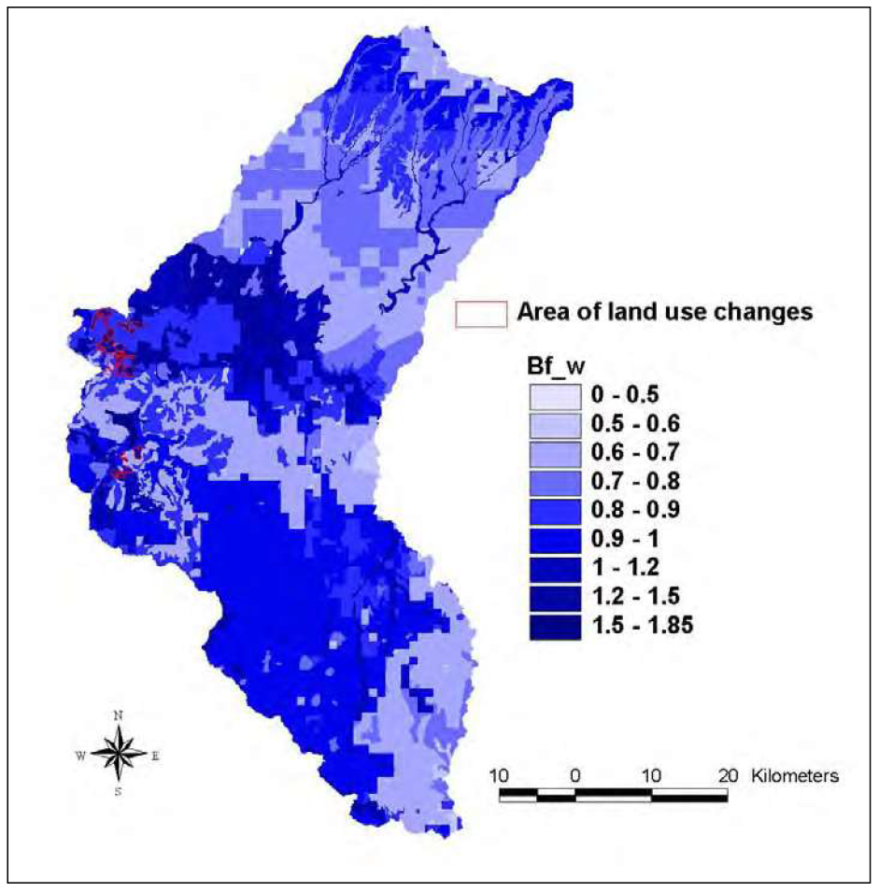
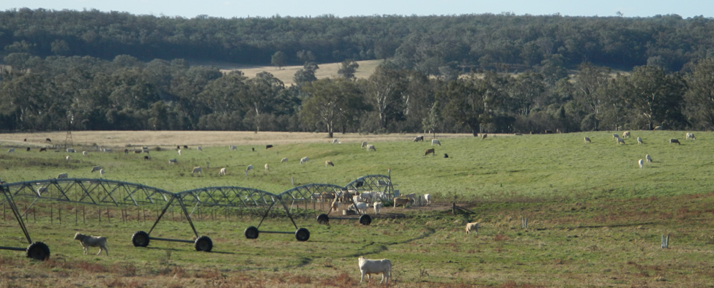
Current Water Management – Bobadeen Irrigation Scheme
Notes:
Add Colinta data

Slide 23
Ulan Coal Mine Life
Notes:
A number of submissions raised objections to an extension of the mining industry and the use of coal.
Mod 4 represents a small extension to existing approved longwall blocks
The impacts are not significantly greater than those already approved
Recovery of coal can be achieved with minimal environmental impacts compared to the approved project whilst meeting the existing demand for thermal coal
If asked for validation: economic modelling was undertaken by Lawrence Consulting (who also do annual economic impact analysis work for NSW Minerals Council & QLD Resources Council). This was reviewed and signed off by Ernest & Young

