Slide 1


Slide 2
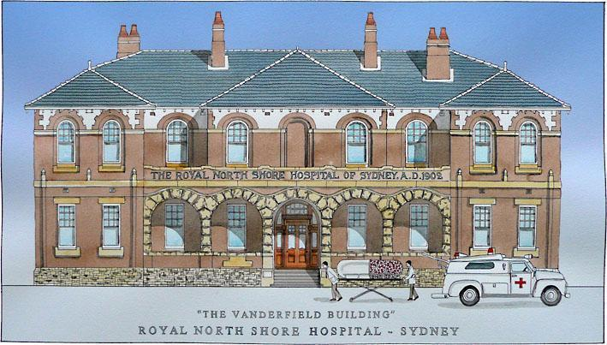

Slide 3
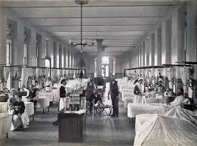

Slide 4
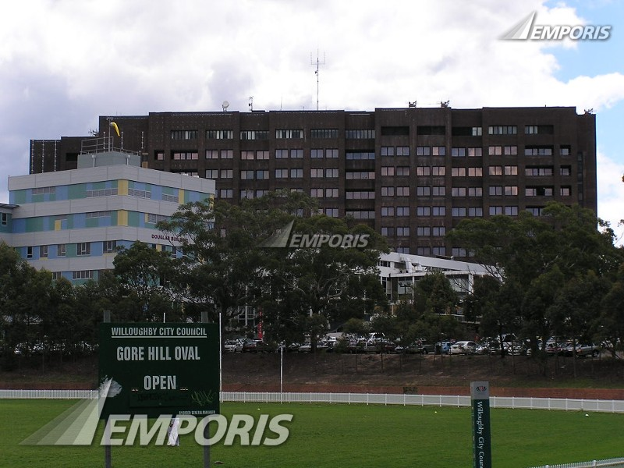

Slide 5
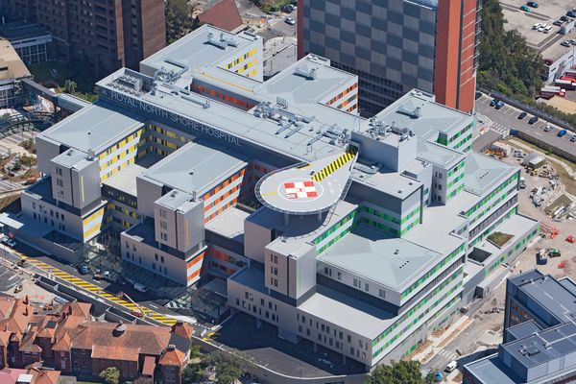

Slide 6
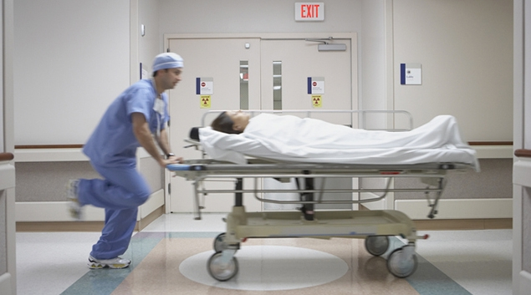

Slide 7
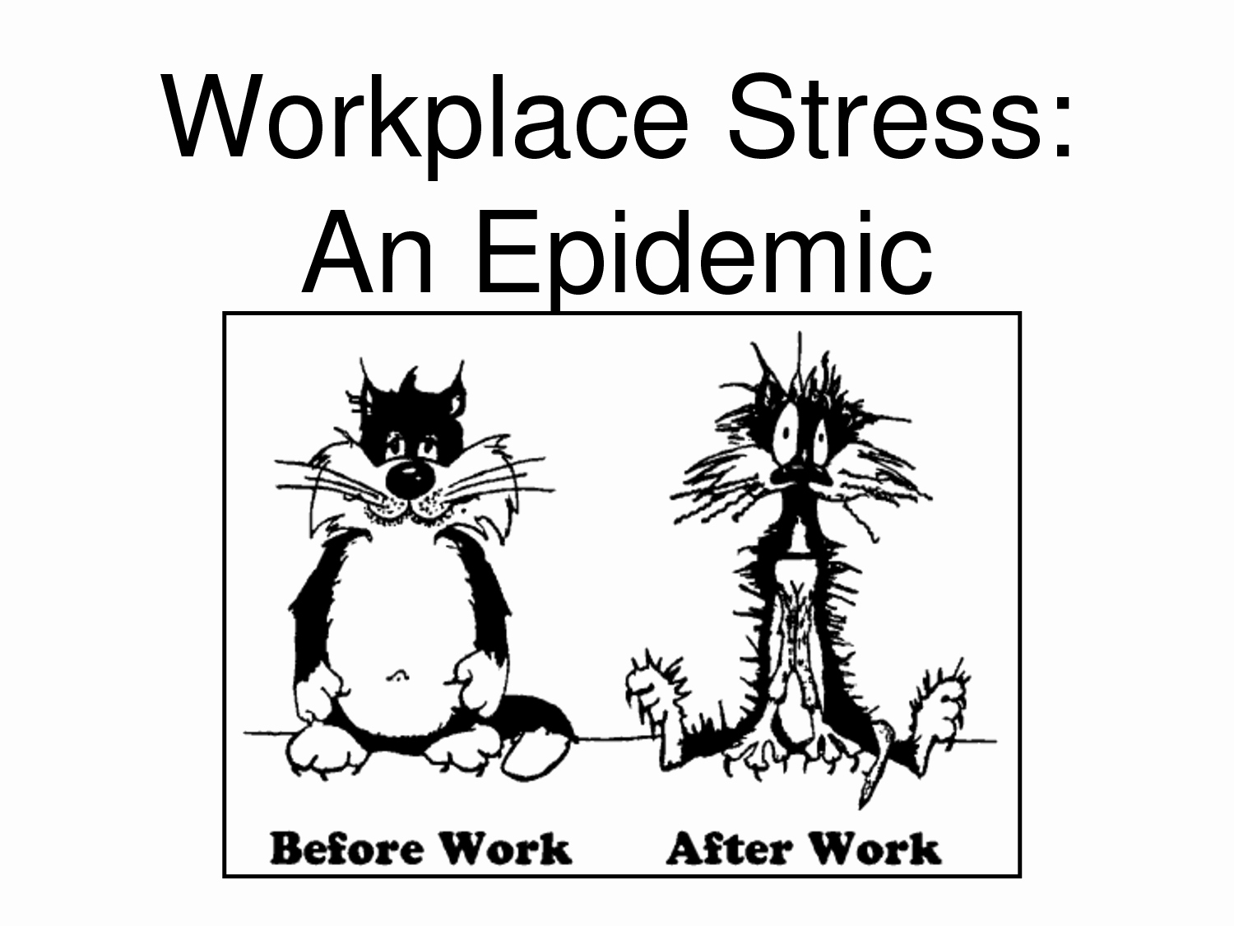

Slide 8
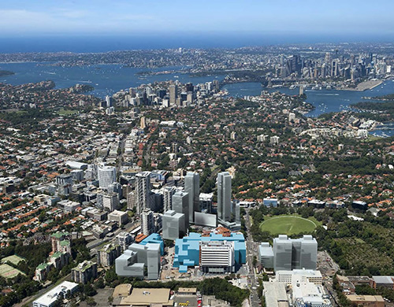

Slide 9
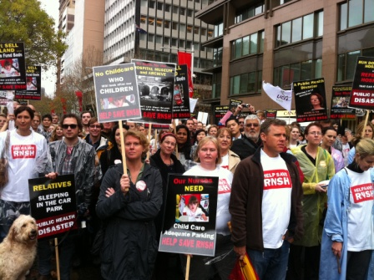

Slide 10
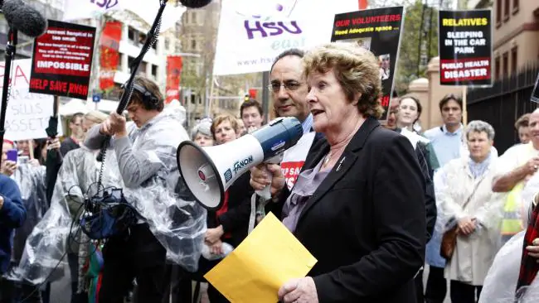

Slide 11
1 | The Royal Melbourne Hospital City Campus | 91.3 | Melbourne | 571
2 | The Alfred | 90.2 | Melbourne | 638
3 | Royal Prince Alfred Hospital | 90.2 | Sydney | 950
4 | St Vincent's Hospital | 89.2 | Melbourne | 880
5 | Royal Brisbane & Women's Hospital | 88.7 | Brisbane | 1,000
6 | Gold Coast University Hospital | 88.0 | Gold Coast | 866
7 | Sir Charles Gairdner Hospital (SCGH) | 87.8 | Perth | 600
8 | Royal Darwin Hospital | 87.7 | Darwin | 360
9 | Monash Medical Centre | 87.5 | Melbourne | 640
10 | St Vincent's Private Hospital Sydney | 87.2 | Sydney | 270
11 | Royal North Shore Hospital (RNSH) | 87.0 | Sydney | 740

Slide 12
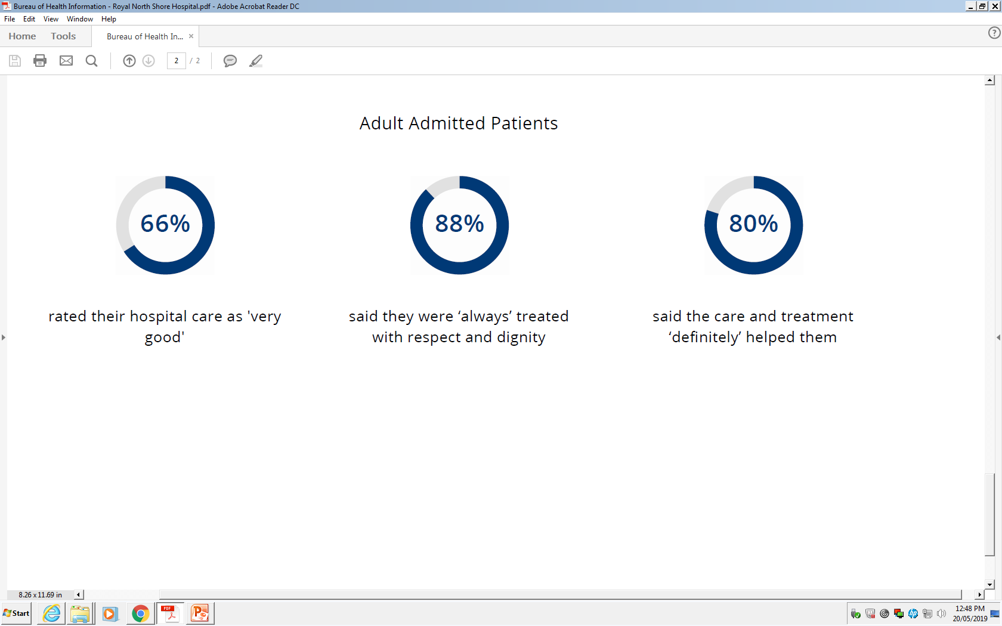

Slide 13
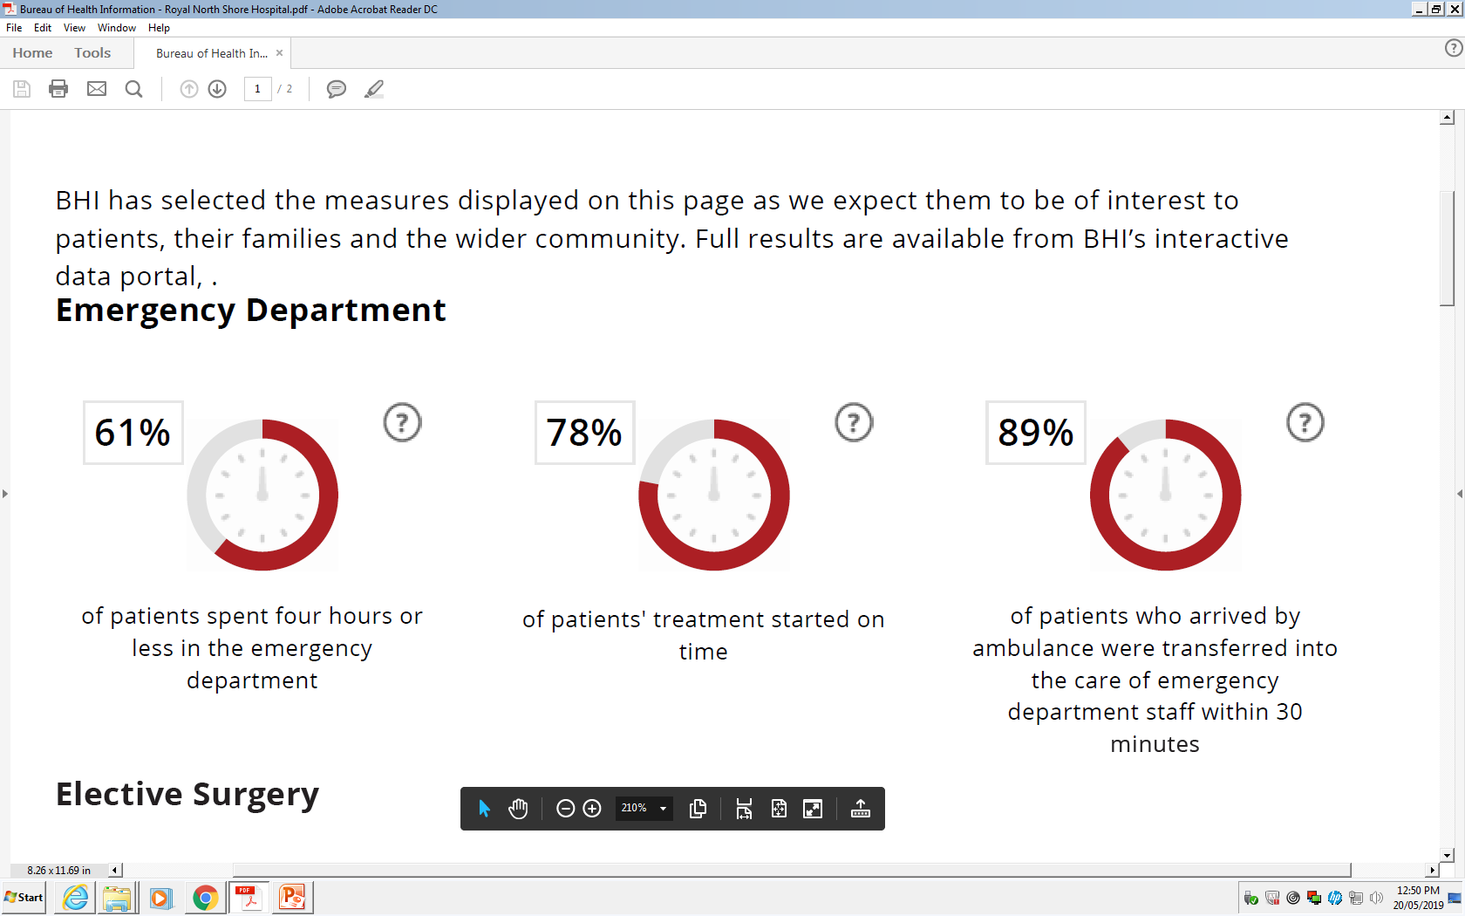

Slide 14
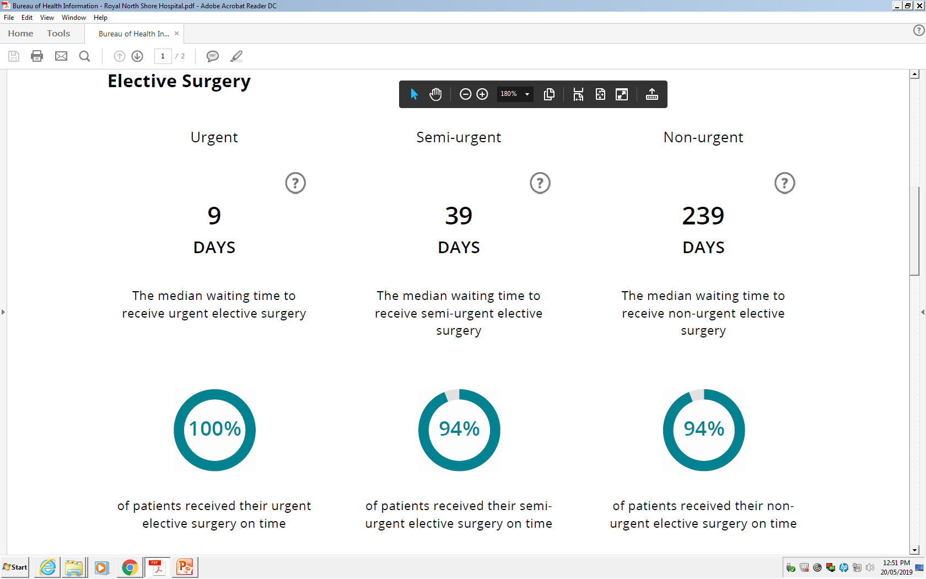

Slide 15
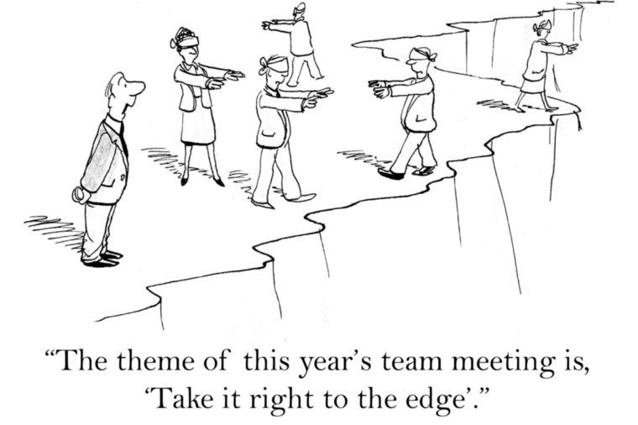

Slide 16
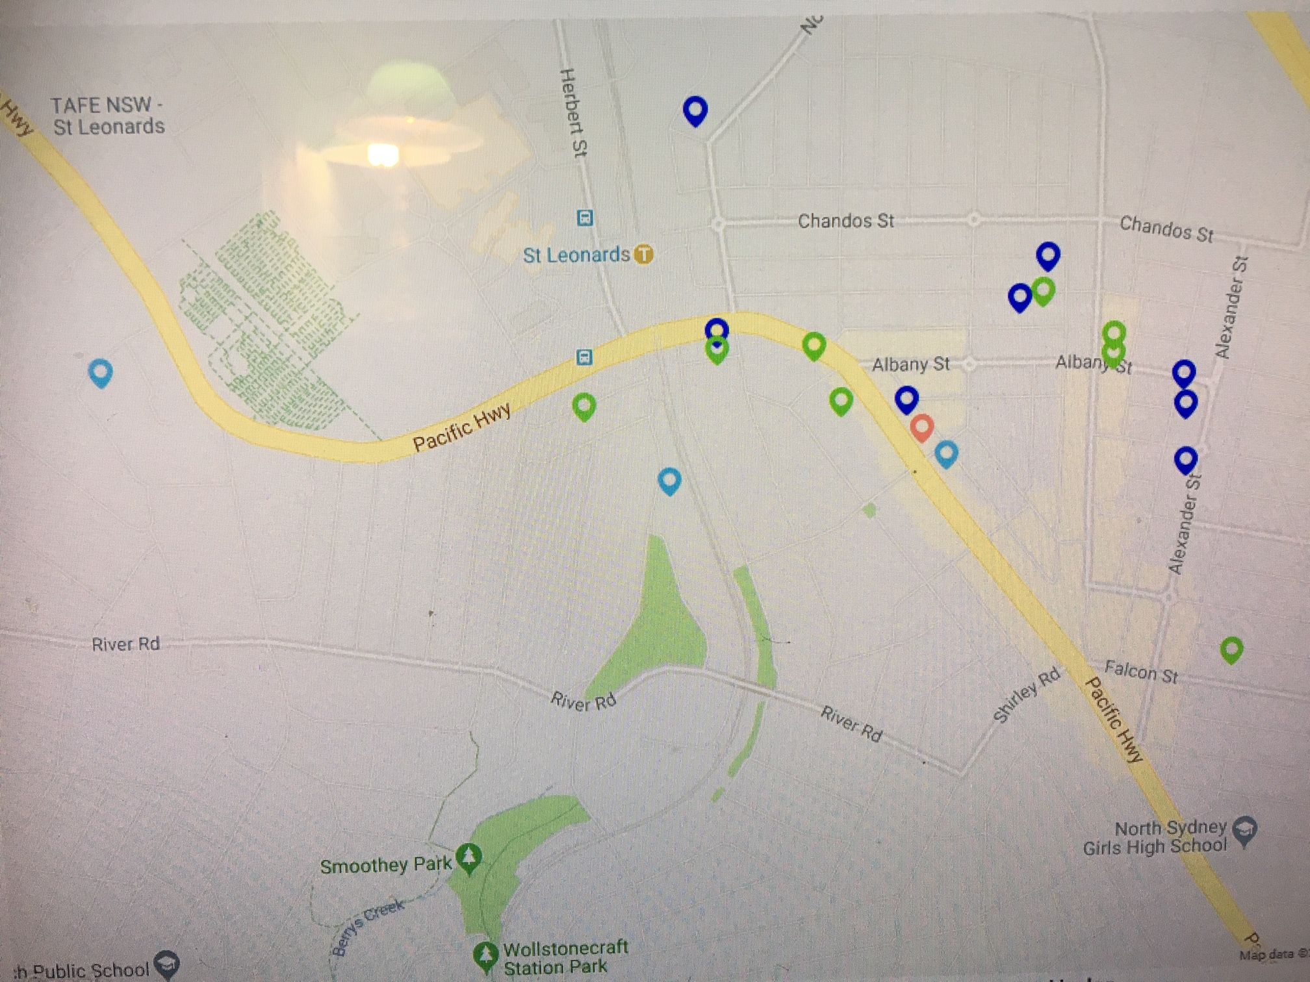

Slide 17
What will happen if the zoning is approved?
Construction of 2,400 units in towers 4-19 stories,
all the way down the slope to River Road.
This will add at a minimum 4,800 new residents,
noting that Greenwich’s current population is just over 5,000.
What infrastructure is planned for the area?
Virtually none.
One community centre and child care centre,
and only if developers are willing to incorporate them
into their plans in exchange for higher buildings.
No shops, no schools, no medical centres, no new roads,
and virtually no open space.
HOSPITALS ???

Slide 18
New skyscrapers set to change St Leonards skyline
By 2031, an additional 2000 new dwellings will be built in St Leonards
almost doubling its current number
with several thousand new residents coming to the area.
Winten’s 38-storey Forum and 25-storey Forum West built more than a decade ago
the skyline is set for three more mixed-use towers:
one 46 levels, (Landmark)
another 26 storeys and a third 28 storeys( St Leonards Sq. Mirvac)
even taller towers mooted for St Leonards.
Property developer Auswin TWT (88…47 storeys, 650 residences)
wants to build a 51-storey 20-metre tall tower there,
We are trying to rezone St Leonards to build up apartment living.
It’s an opportunity which has been coming for quite a long time.
Lane Cove mayor, Deborah Hutchens

Slide 19
A spokesman for Mr Roberts said Sydney was a rapidly growing city with forecasts suggesting 2.2 million people would be added to the population by 2036, requiring more than 725,000 homes.
This is why we have worked closely with councils to identify locations across greater Sydney with good access to existing or planned public transport connections, ……
"These planned precincts focus on providing priority infrastructure, including
schools, parks, transport, hospitals and road upgrades
to support this growth.

Slide 21
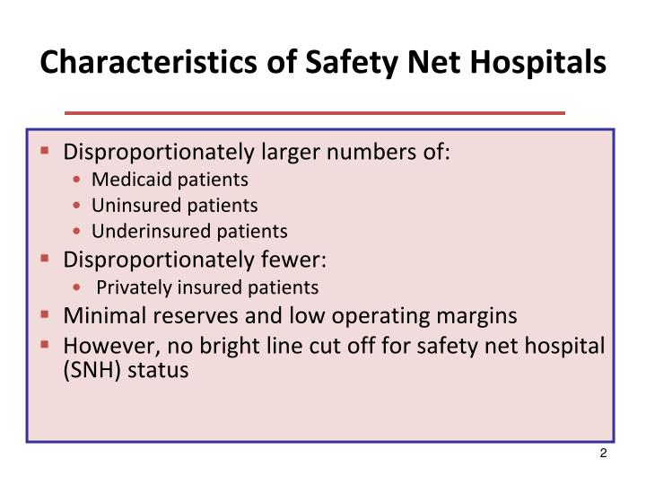

Slide 22
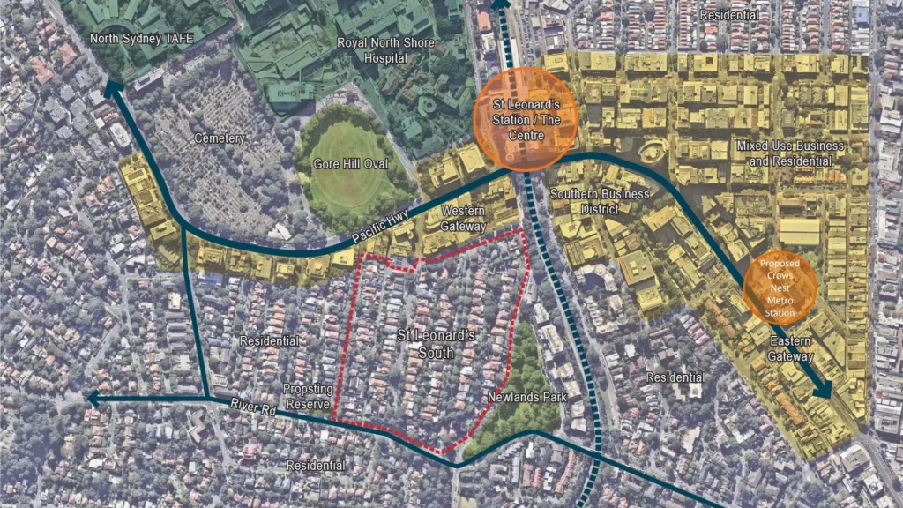

Slide 23
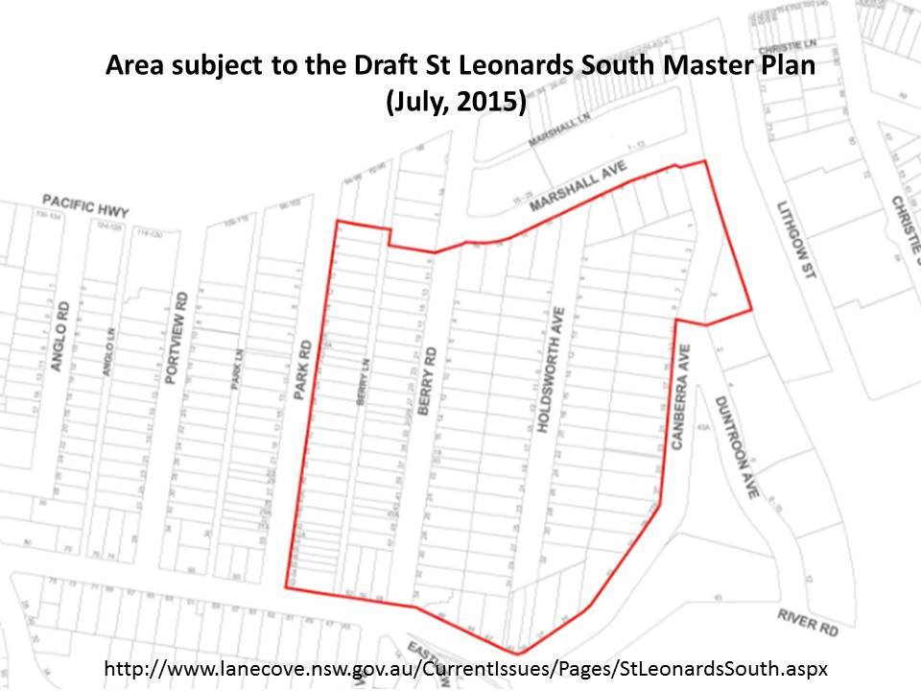

Slide 24
List of forecast land developments and infill assumptions:
Dwelling counts for the period 2011 to 2016 have been adjusted to reflect Census results.
Assumptions concerning development over the forecast period include:
83-89 Chandos Street - 42 dwellings (2017-2018)
Metropolitan Residences (7-11 Albany Street) - 125 dwellings (2017-2018)
67-73 Chandos Street - 30 dwellings (2018)
100 Christie Street - 63 dwellings (2018)
563 Pacific Highway - 17 dwellings (2018)
222 Pacific Highway - 16 dwellings (2019)
Quartz Lumina Ap’ments (567 Pacific Hway) - 27 dwellings (2019)
619 Pacific Highway - 48 dwellings (2019)
28 Clarke Street - 12 dwellings (2019)
621 Pacific Highway - 72 dwellings (2019-2020)
Crows Nest Plaza - 70 dwellings (2019-2020)
20-22 Atchison Street - 93 dwellings (2019-2021)

Slide 25
479 Pacific Highway - 16 dwellings (2020)
63-65 Chandos Street - 30 dwellings (2020)
Aster Residences (139-147 West Street) - 39 dwellings (2020-2021)
St Leonards / Crows Nest Planning Study - Precinct 1 - 301 dwellings (2020-2032)
385-389 Pacific Highway - 23 dwellings (2021)
22-28 Albany Street - 48 dwellings (2021)
70 - 76 Alexander St - 34 dwellings (2021)
49 Falcon Street - 12 dwellings (2021)
5 Albany Street - 40 dwellings (2021-2022)
84-86 Atchison Street - 48 dwellings (2022)
521 Pacific Highway - 128 dwellings (2022-2023)
St Leonards / Crows Nest Planning Study - Precinct 2 - 109 dwellings (2022-2027)
St Leonards / Crows Nest Planning Study - Precinct 3 - 101 dwellings (2023-2028)
St Leonards / Crows Nest Planning Study - Precinct 4 - 130 dwellings (2025-2033)
Low-high level of Infill development (10-55 dwellings per annum)

Slide 26
List of forecast land developments and infill assumptions:
North Sydney
Assumptions concerning development over the forecast period include:
211-223 Pacific Highway - 228 dwellings (2017-2018)
229-235 Pacific Highway - 211 dwellings (2017-2018)
29 Myrtle Street/13 Eden Street - 17 dwellings (2019)
160 Pacific Highway - 40 dwellings (2019)
144-150 Pacific Highway - 218 dwellings (2019-2020)
317 Pacific Highway - 15 dwellings (2020)
52 McLaren Street - 115 dwellings (2020-2021)
17-23 Myrtle Street - 17 dwellings (2021)
221 Miller Street - 173 dwellings (2021-2022)
231 Miller Street - 61 dwellings (2022-2023)
Low-high level of Infill development (8-40 dwellings per annum)

Slide 27
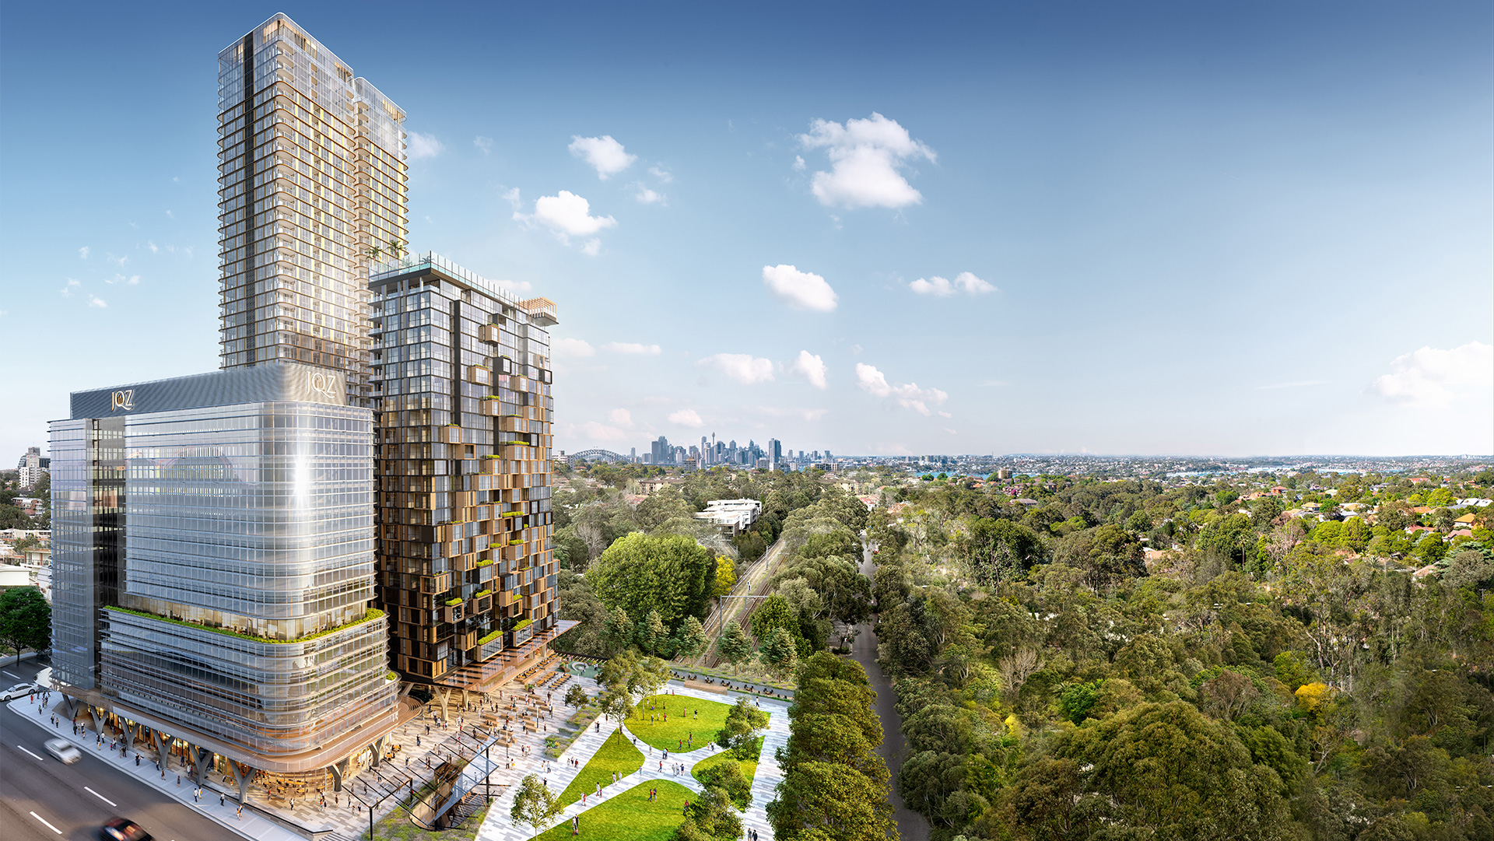

Slide 28
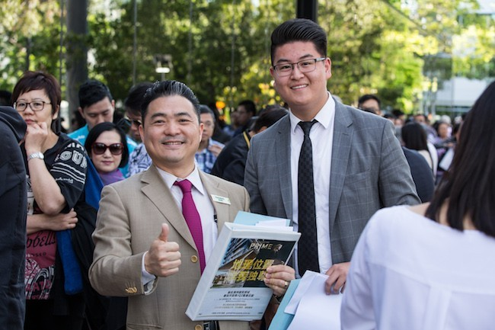
Jian Qiu Zhang, Founder and CEO of JQZ said “today’s sales success has been extremely encouraging.

Slide 29
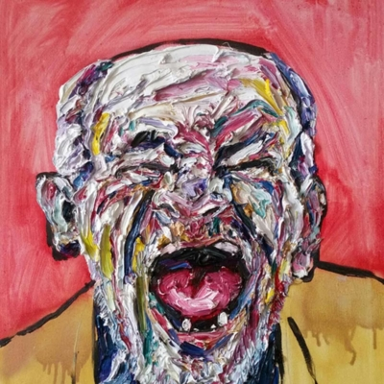

Slide 30
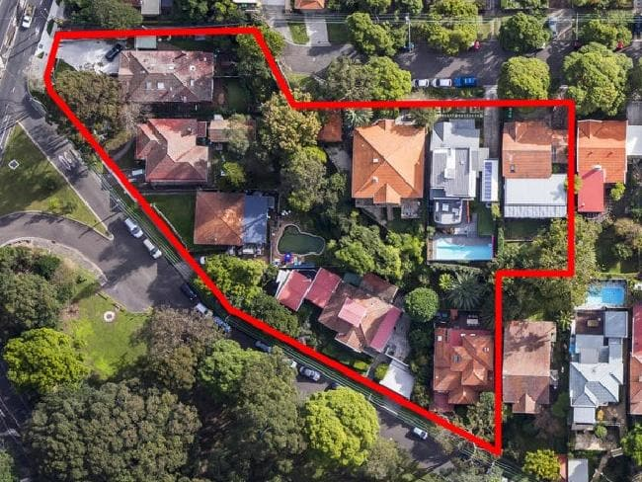

Slide 31
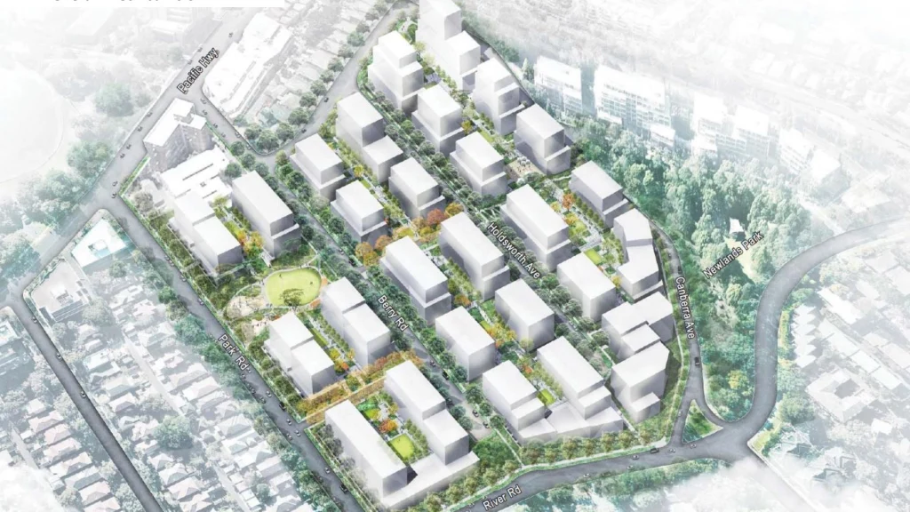

Slide 32
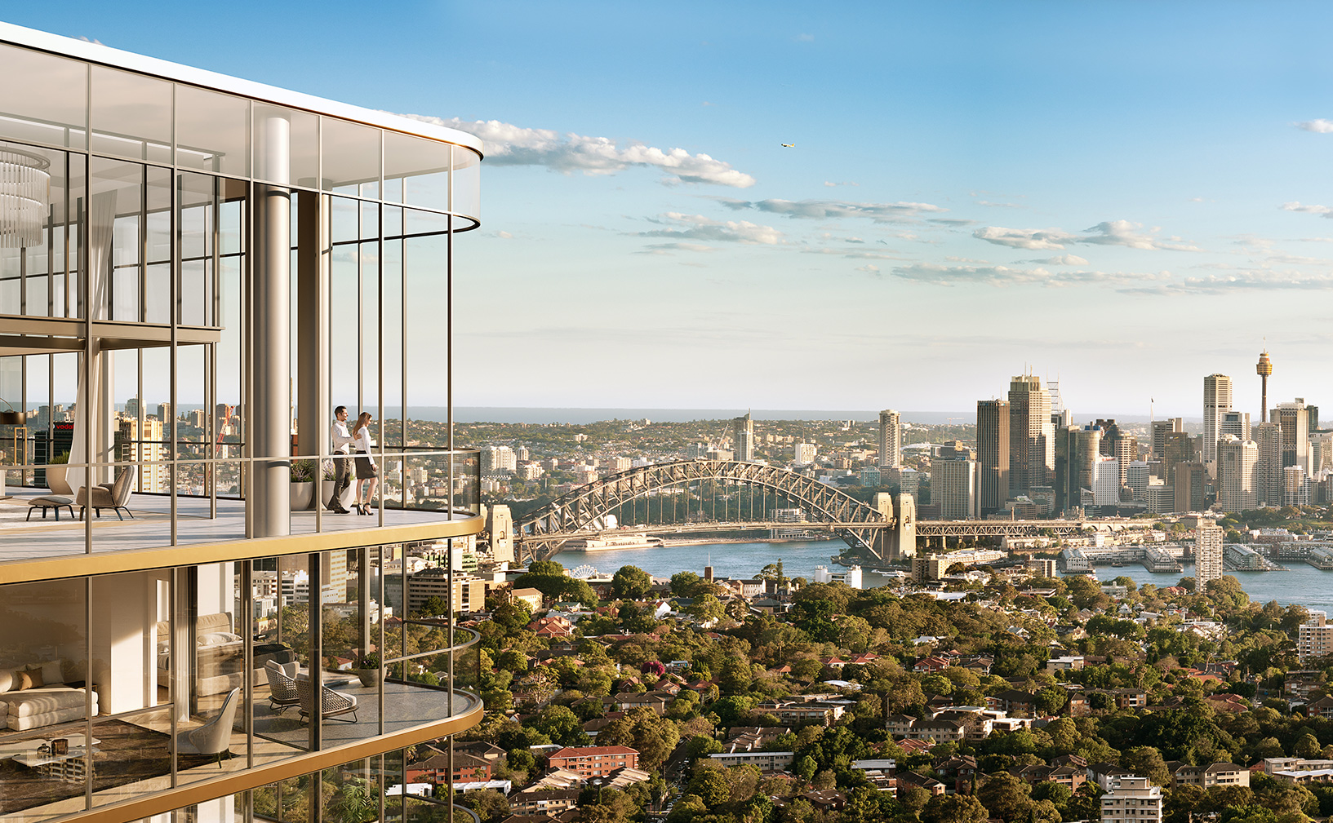

Slide 33
WORLD'S BEST HOSPITALS - TOP 10 GLOBAL
RANK | HOSPITAL | CITY COUNTRY
1 | Mayo Clinic - Rochester | Rochester, MN USA
2 | Cleveland Clinic | Cleveland, OH USA
3 | Singapore General Hospital (SGH) | Singapore Singapore
4 | The Johns Hopkins Hospital | Baltimore, MD USA
5 | Charité – Universitätsmedizin Berlin | Berlin Germany
6 | Massachusetts General Hospital | Boston, MA USA
7 | Toronto General Hospital | Toronto, ON Canada
8 | The University of Tokyo Hospital | Tokyo Japan
9 | CHUV Centre Hospitalier Universitaire Vaudois | Lausanne Switzerland
10 | Sheba Medical Center Tel HaShomer | Ramat Gan Israel

Slide 34
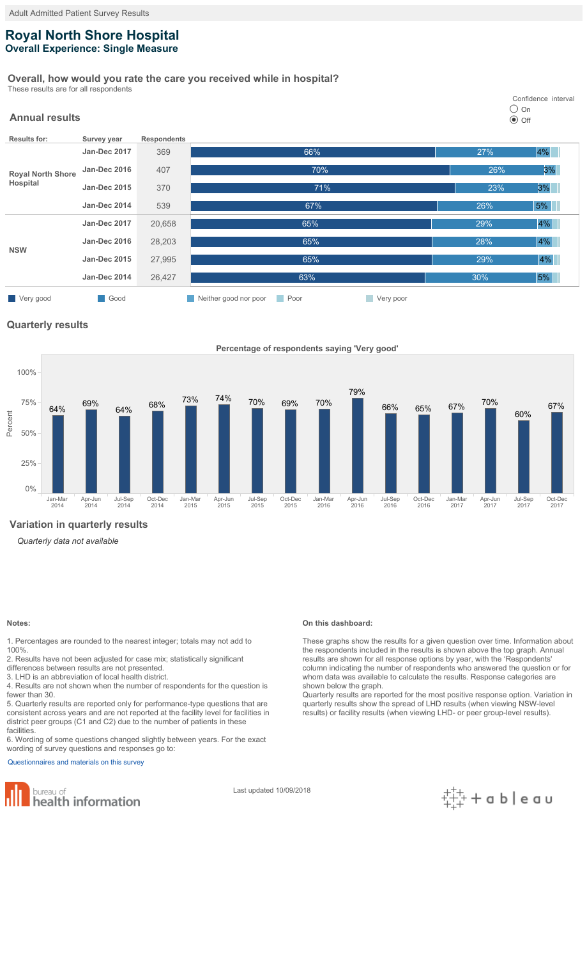

Slide 35
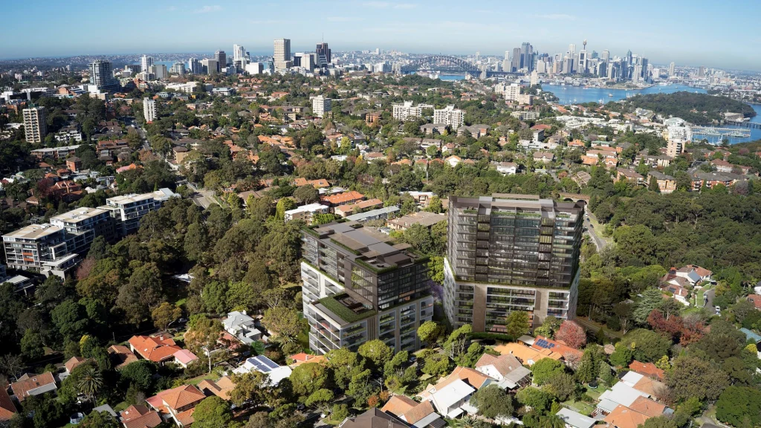

Slide 36
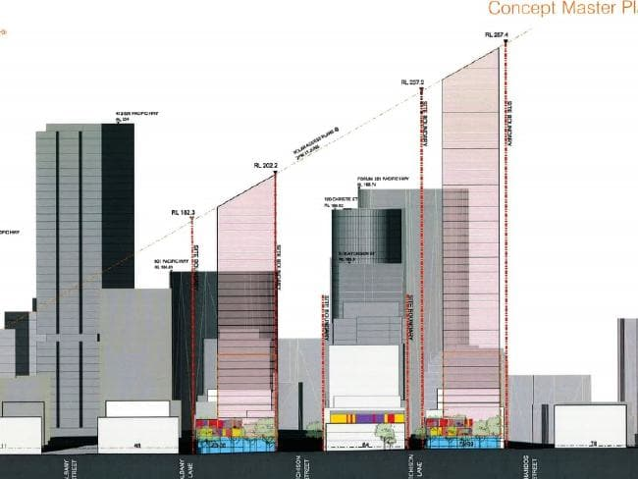

Slide 37
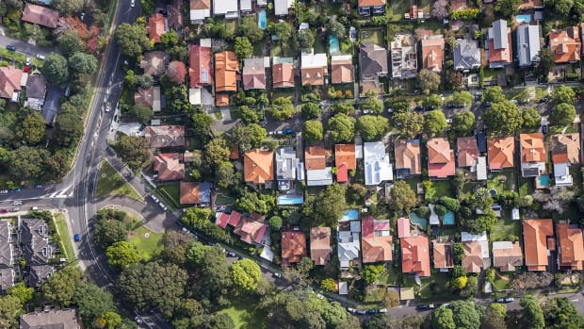

Slide 38
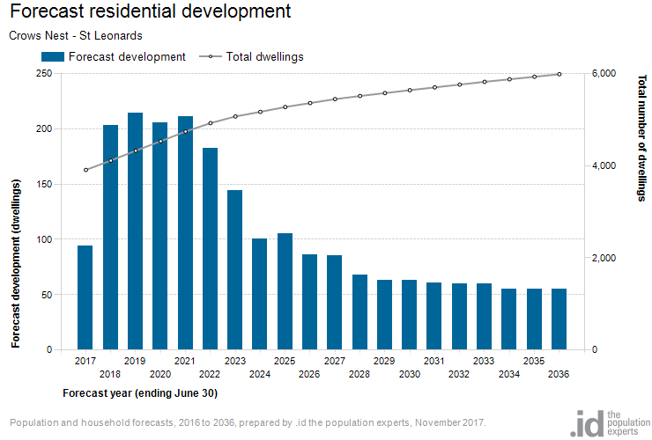

Slide 39
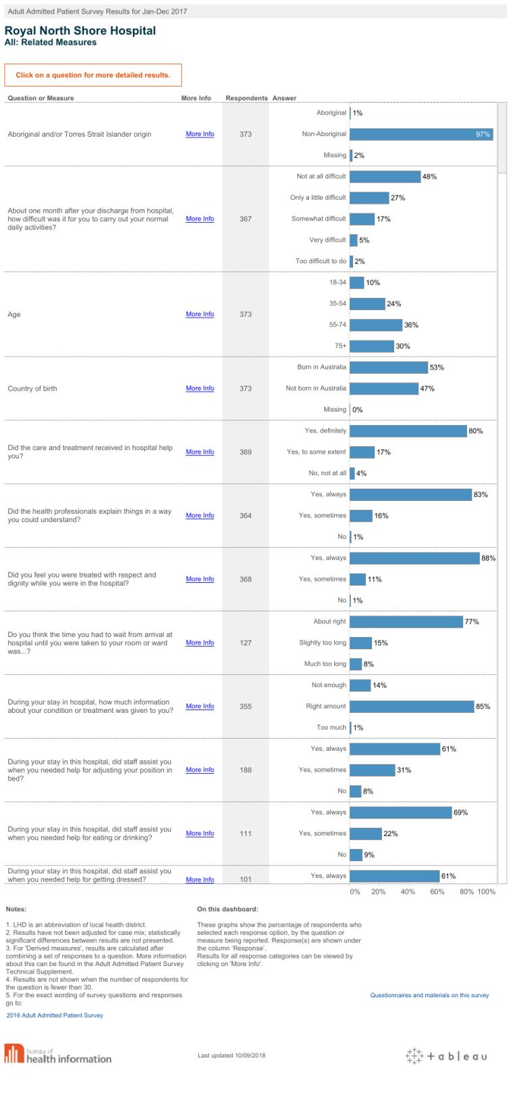

Slide 42
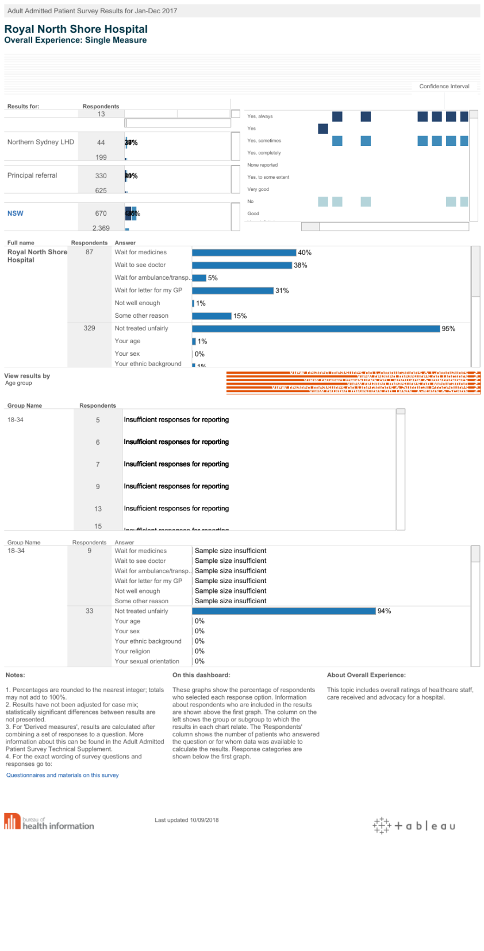

Slide 43
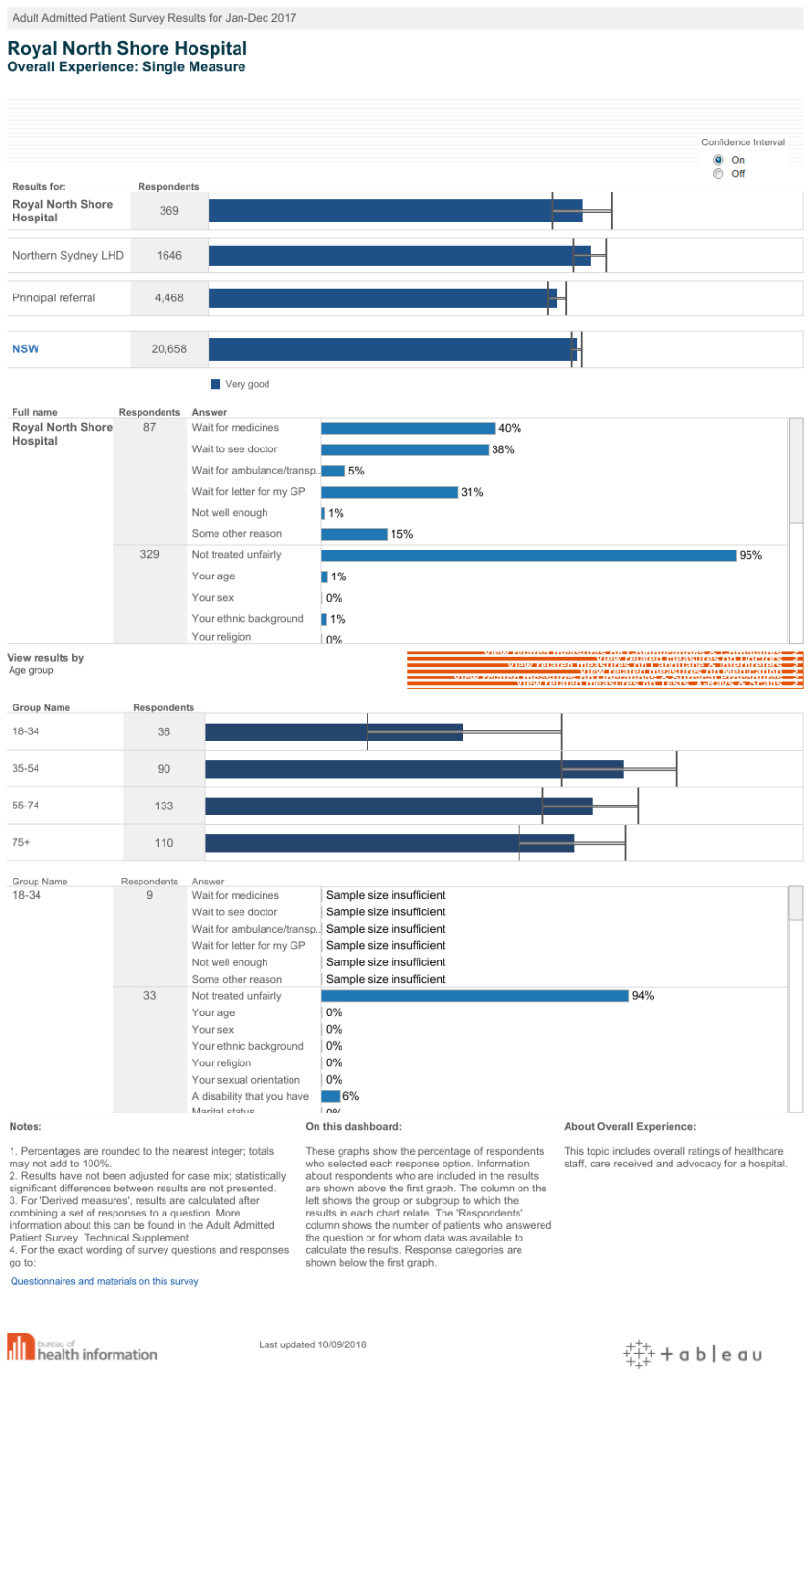

Slide 45
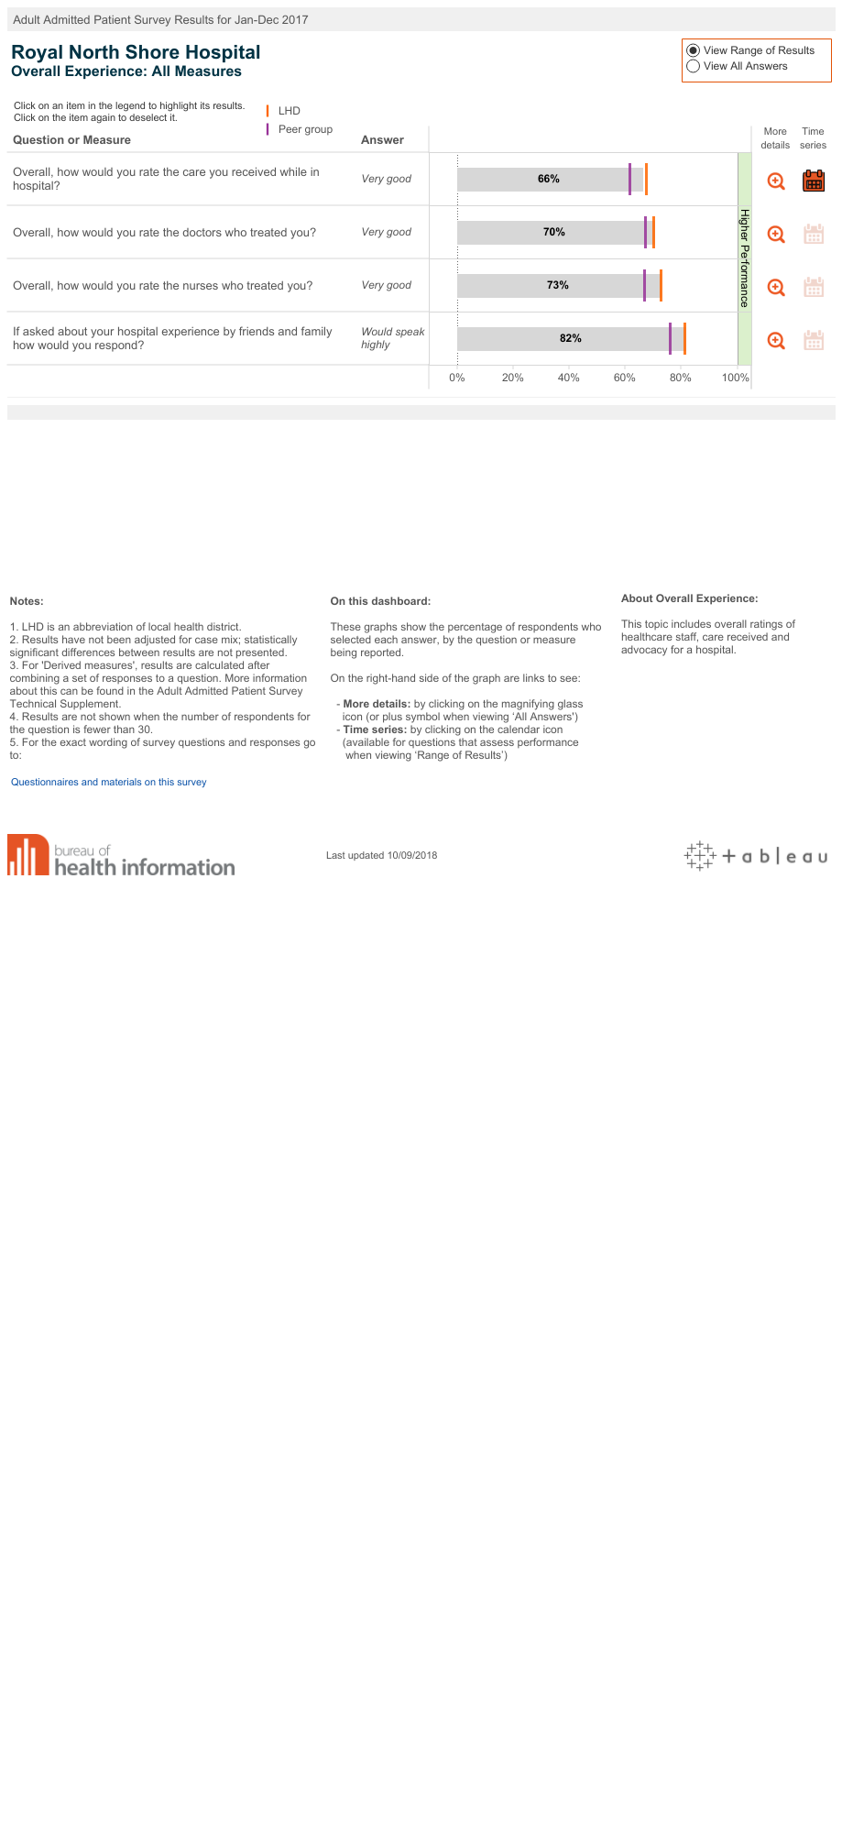

Slide 46
