Slide 1
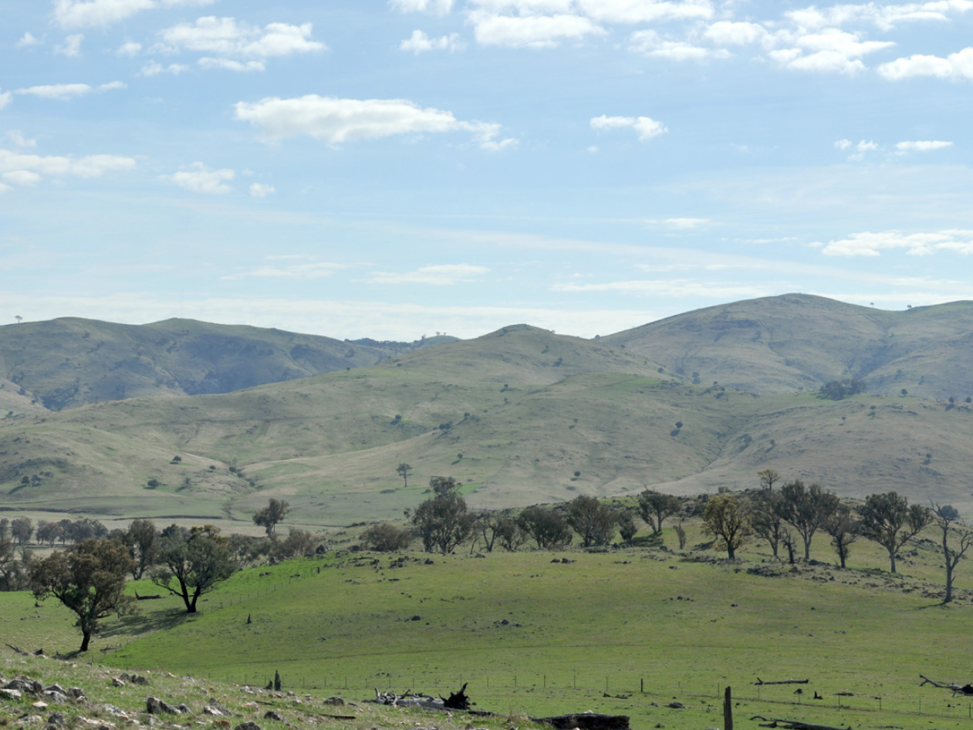
Modification 1 – IPC Meeting 29th October 2018

Slide 2
Contents
Goldwind – Overview
Project overview
Modification 1 details
Key issues considered for modification
Summary of key assessments
Consultation and community
Conclusions
Questions

Slide 3
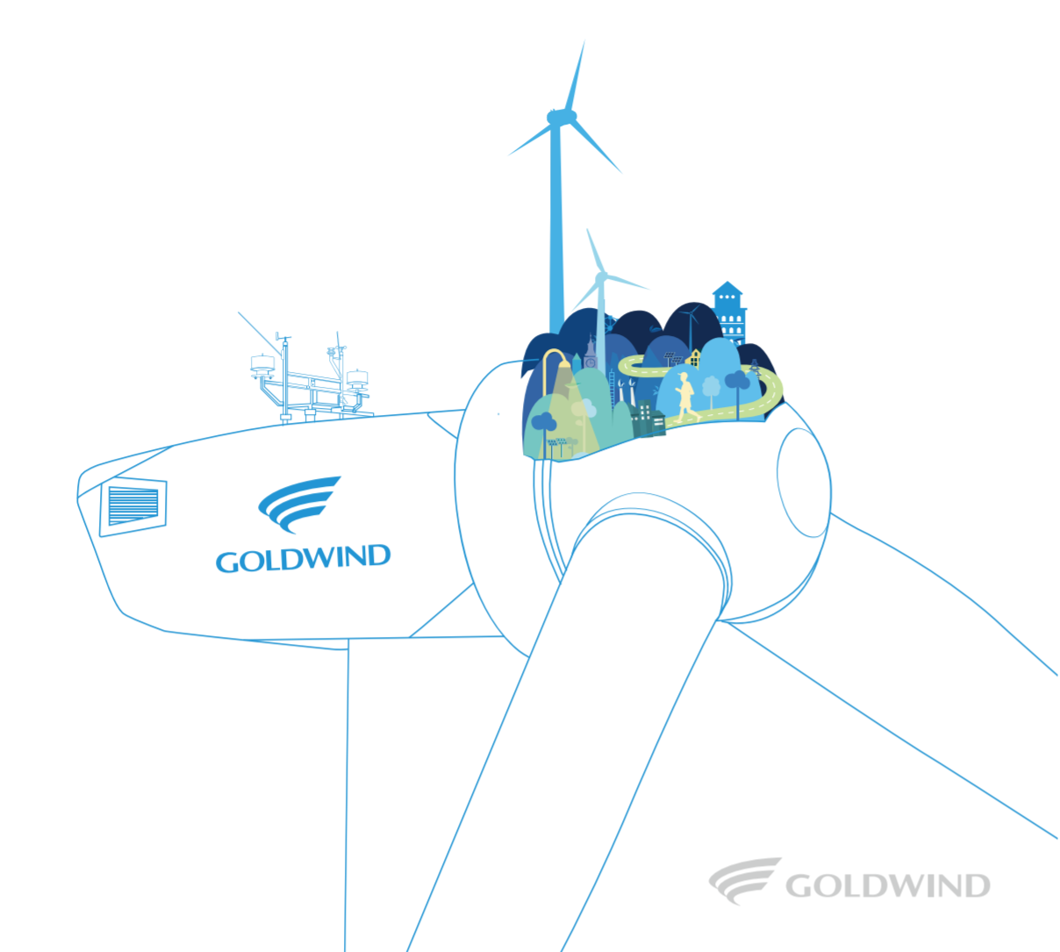
Goldwind Global - Overview
Goldwind is a global leader in manufacturing wind turbines working across six continents.
Strong research and development capabilities.
20 years of experience in the wind industry.
44+ GW of wind power installed with over 28,500 turbines installed worldwide.
Extensive practical experience in siting, construction and operation
Leader in permanent magnet drive wind turbines – no gear box:
Increased efficiency,
Reduced maintenance costs and downtime.

Slide 4
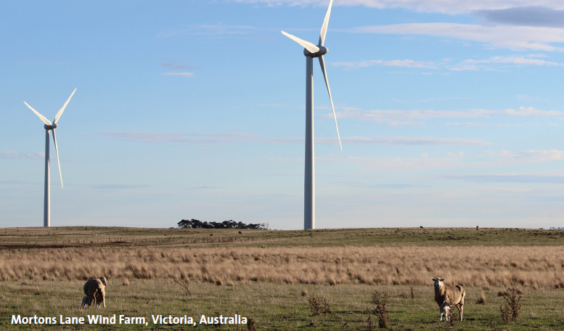
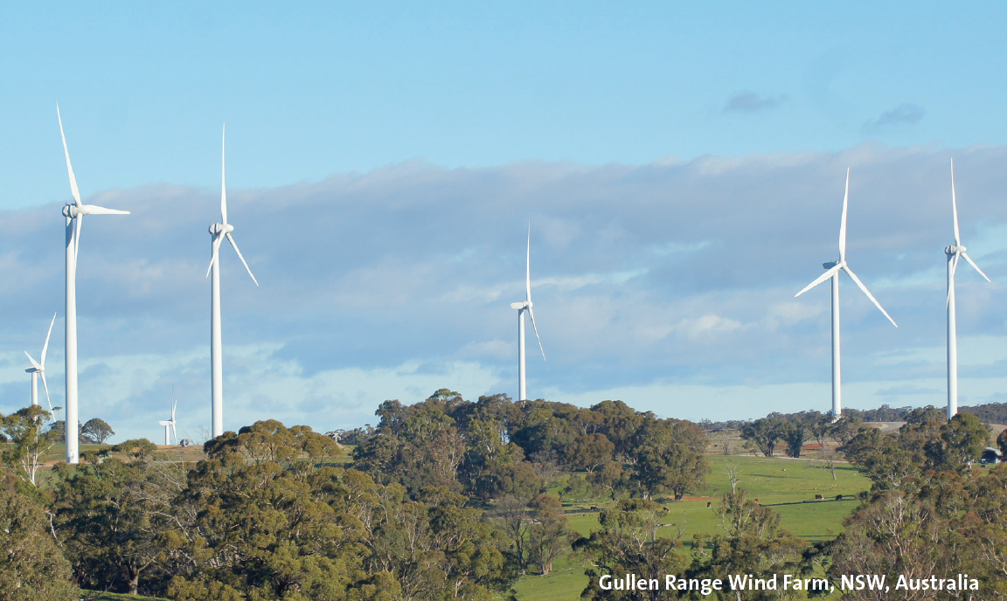
Goldwind Australia - Overview
Established in 2009
Maintains offices in Sydney, Melbourne and multiple Wind Farm Site offices (inc. Binalong)
Has over 160 employees.
Partners with engineering, transport and earthworks contractors for delivery
Goldwind Australia Projects – over 1.7 GW operating, planned or under construction across Australia
Operating
Mortons Lane 20 MW wind farm VIC
Gullen Range 165 MW wind farm NSW
White Rock 175 MW wind farm NSW
Gullen Solar 10 MW solar farm NSW
Under Construction
White Rock Solar 20 MW solar farm NSW
Moorabool 385 MW wind farm VIC
Stockyard Hill 530 MW wind farm VIC
Cattle Hill 148 MW wind farm TAS
Preparing for Construction
Coppabella 290 MW wind farm NSW
Under Development
Various projects >1000 MW

Slide 5
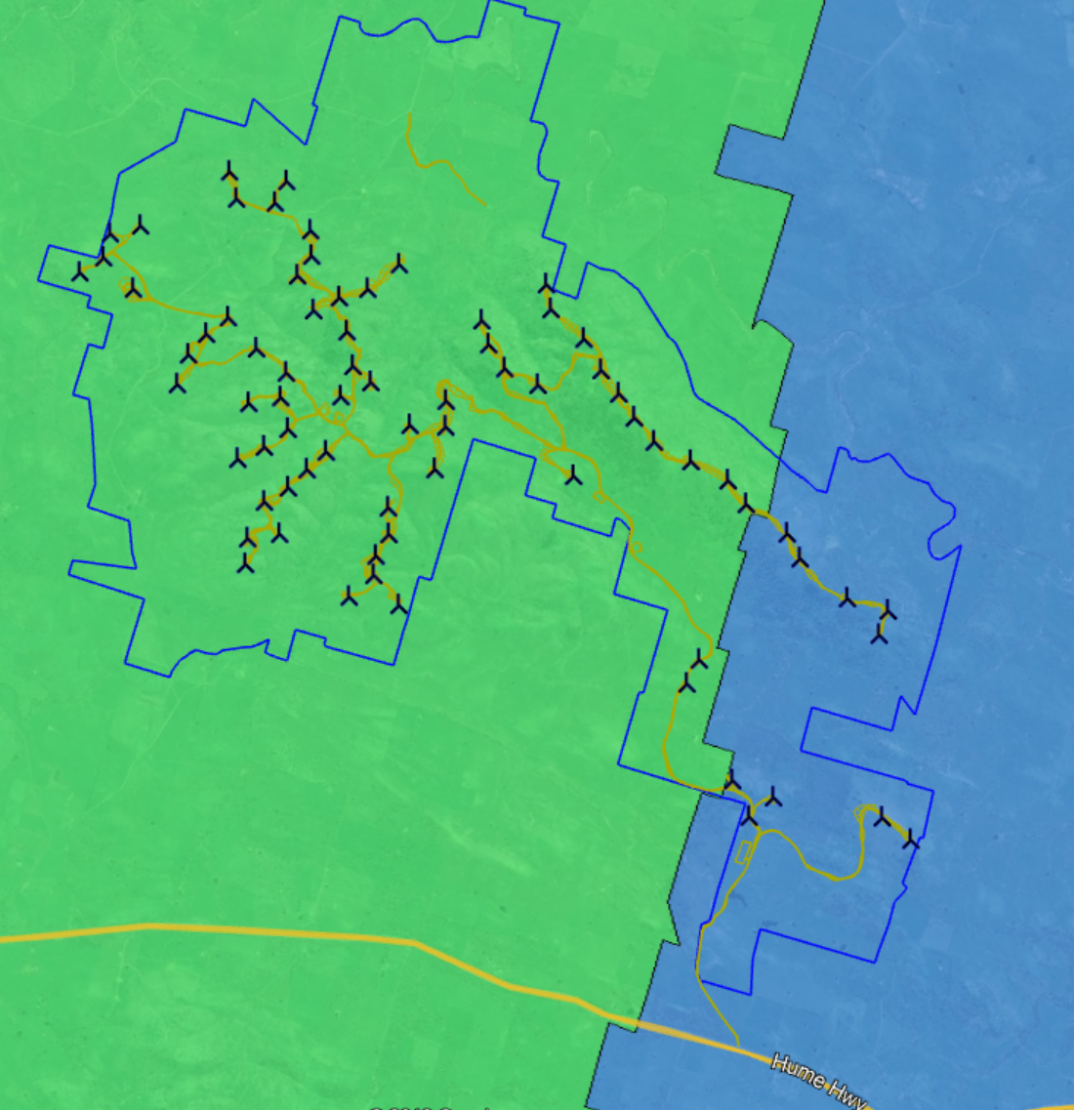
Project History 2009 - 2018
Background
Development Application in 2009 by Epuron
Extensive review/assessment process
Reduced project approved in March 2016
Goldwind acquisition in Feb 2017
NSW Development Consent (SSD 6698)
79 wind turbines & associated infrastructure
Commonwealth EPBC Approval (2013/7002)
Grid Connection
Connection via 132kV TransGrid powerline between Yass & Murrumburrah
Line to be upgraded by TransGrid to allow 280MW
Landowners & Community
11 host landowners
Low density of non-host neighbouring properties:
0 residences within 0-2km
6 residents within 2-3km
13 residents within 3-4km
26 residences within 4-5km (includes Bookham)
Community engagement ongoing
A new industry and opportunity for the area
Construction planned to commence in early 2019 (subject to consent)
Federal: Riverina
State: Cootamundra
Federal: Eden-Monaro
State: Goulburn
Notes:
Consider better map

Slide 6
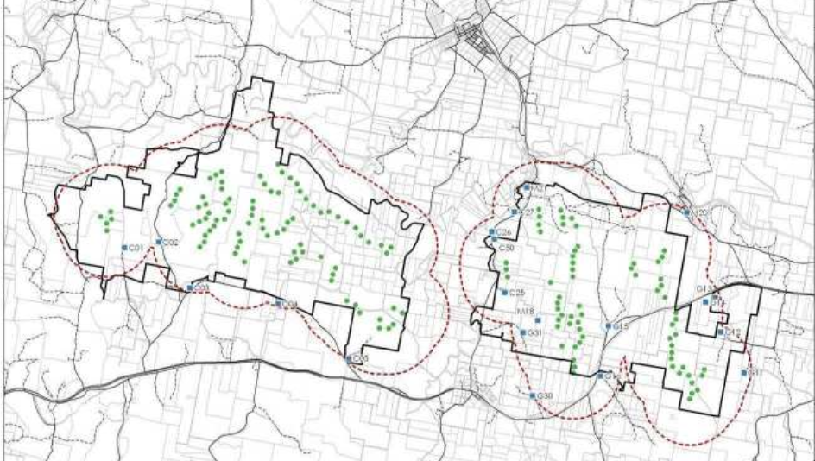
Project Extent Redefined
Coppabella Precinct Approval
The 2009 development application for the Yass Valley Wind Farm involved 152 wind turbines over 2 major precincts.
After significant review and community consultation, Coppabella precinct was approved with 79 turbines.
Binalong
Coppabella Hills Precinct
(Approved)
Project Name Change
The project has changed substantially from original submission and is more condensed.
The new name for the wind farm more accurately reflects the geographic location of the project.
Marilba Hills Precinct
NOT approved
Bookham
Conroy’s Gap
(Approved as separate project)

Slide 7
Mod 1 – Why Required?
Existing Consent (based on EA from 2009) includes constraints:
Vegetation clearing constraints and development corridor preventing realistic constructible design
Restrictions on the ability to build the project with modern wind turbine technology
A sub-optimal development that limits potential for competitive power pricing
Technological developments for modern wind turbines
Significant advances in Wind Turbine technology offer greater output per project and better economies of production to facilitate better pricing and emissions savings
Detailed engineering design and more intensive planning studies have now provided a realistic design and impact assessment
The modified approval is needed for optimum development, efficient operation and competitively priced power using currently available technology
Goldwind seeks to be in a position to commence construction in early 2019

Slide 8
Mod 1 - Layout
36
75
77
76
Notes:
Include original map (this one is just screenshot from Recommendation Report.

Slide 9
Mod 1 – Reasons for Changes
The modification focuses on two main areas:
(1) Internal Roads and Hardstands
Realistic design for steep terrain
Increased vegetation impact allowance to enable the realistic design (68.3 Ha to 179.8 Ha)
(2) Increased Turbine Tip Height
Improved turbine technology since 2009 and imperatives of competitive pricing
Increase of overall tip height (from 150m to 171m) and rotor diameter (from 121m to 142m) is sought. Minimal change to turbine locations. No change to hub height
Removal of 4 approved turbines.
Other modifications
Additional locations for ancillary infrastructure
Development Corridor for infrastructure micrositing allowance
Replace approved overhead 33kV lines with underground 33kV cabling
Minor changes to Conditions of Consent as required
Notes:
Check biodiversity numbers are consistent with DPE Recommendation Report (currently different)

Slide 10
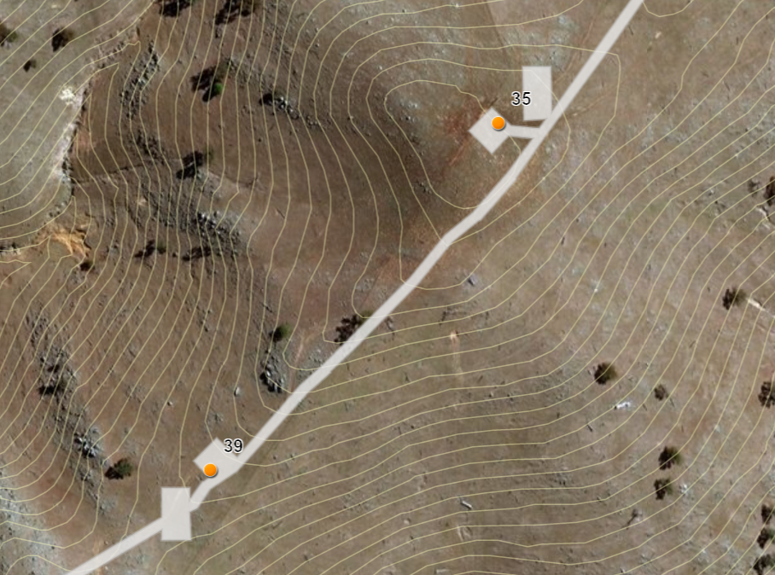
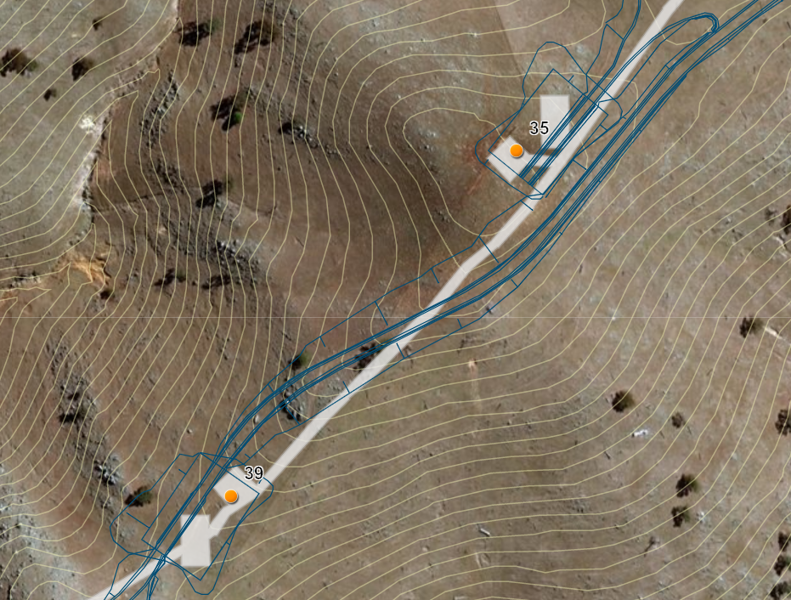
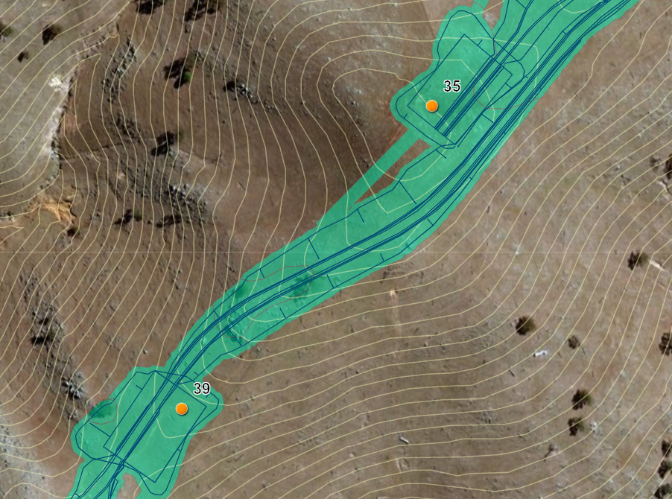
Mod 1 – Internal Road and Hardstands
Approved Vegetation Footprint
Updated Vegetation Limit Required
The vegetation limit for the original approval was based on an 8m wide road footprint with minimal consideration for interfaces with wind turbine hardstands and foundations. This design did not consider the engineering or construction impacts that are required to build these roads and hardstands, particularly with respect to the complex terrain.
The modified footprint is based on:
Detailed engineering design for required cut and fill across the site, based on new 0.5m LIDAR contour data
Consideration for specific wind turbine component lengths and weights
Optimised routes where approved route was not feasible (i.e. extreme gradients, acute angles, etc.)
5.5m road width, 1.5m shoulders, 1m drains (10.5m)
Increased road width on road bends
Separate underground cable routes where feasible
5m temporary construction impact area around all infrastructure (accounts for approx. 30 ha of limit)
5m contours
Mod 1 Vegetation Footprint
Underground cable
Road
5m construction buffer
FILL
CUT
Notes:
Check biodiversity numbers are consistent with DPE Recommendation Report (currently different)

Slide 11
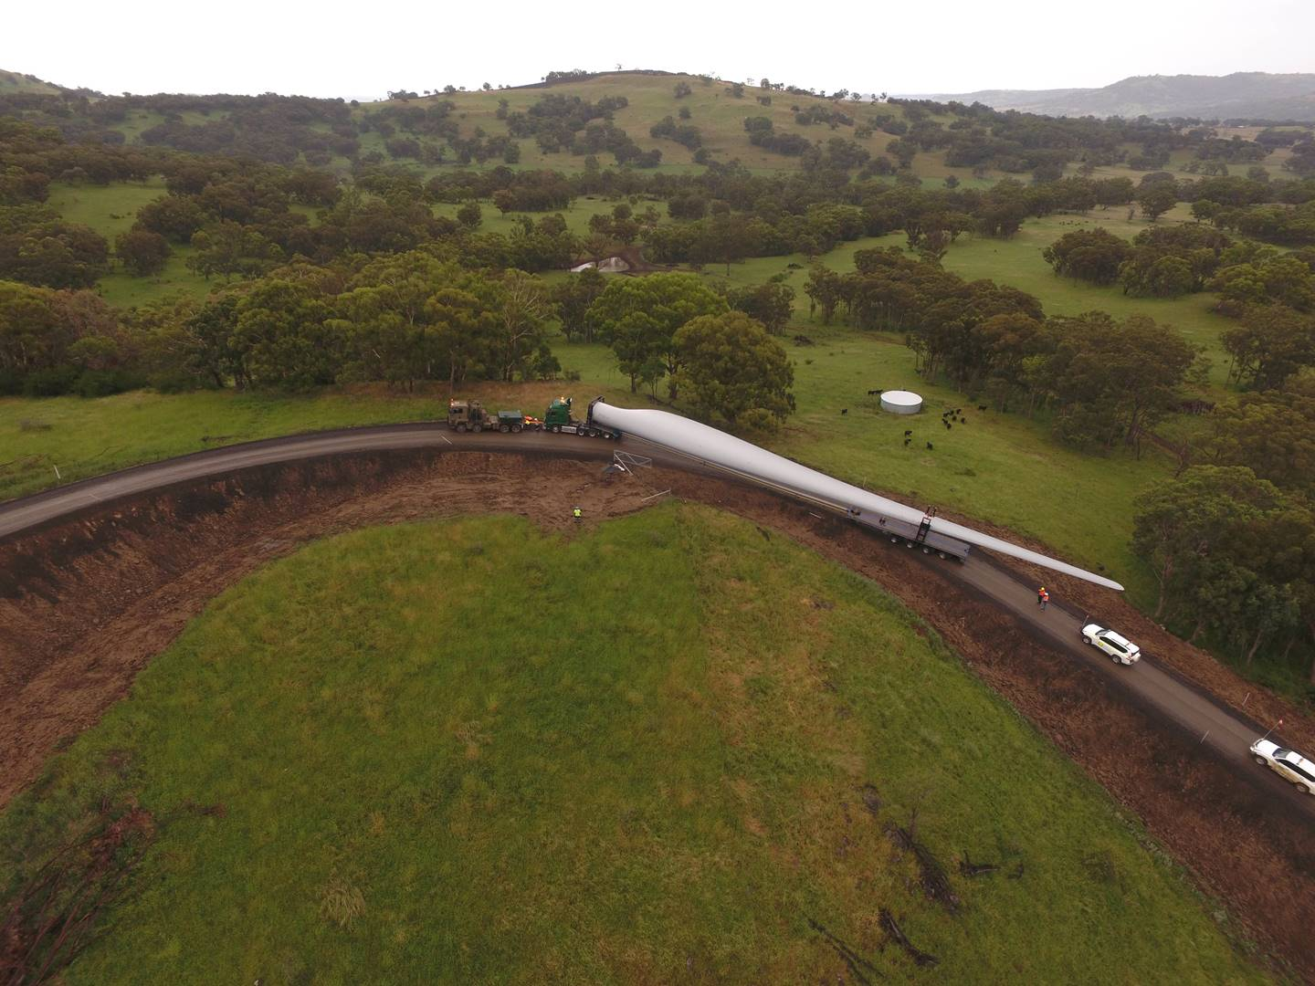
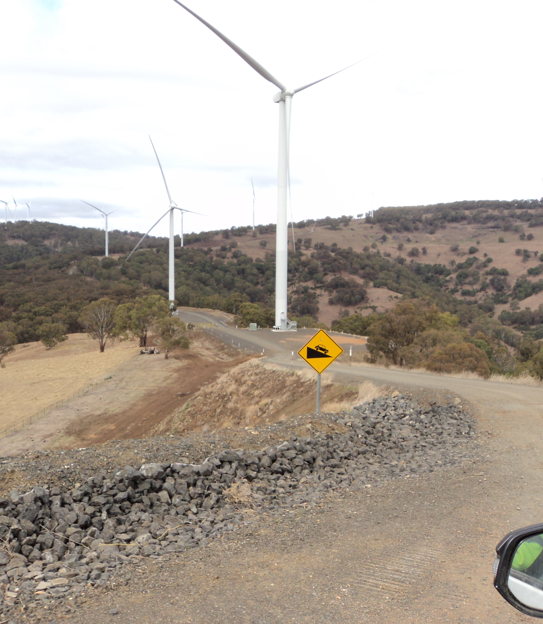
Mod 1 – Internal Road and Hardstands
Example: White Rock Wind Farm Civil Works
Notes:
Check biodiversity numbers are consistent with DPE Recommendation Report (currently different)

Slide 12
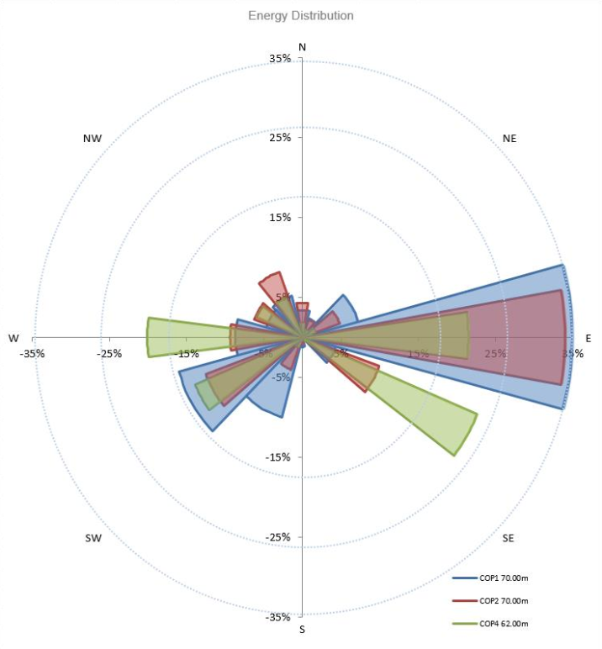
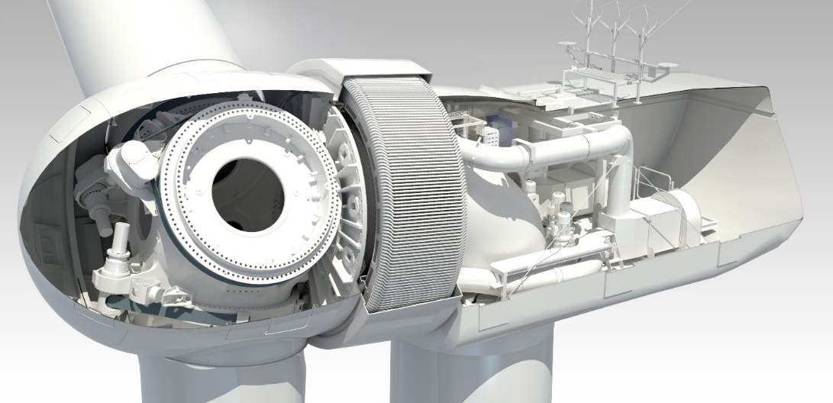
Mod 1 – Wind Turbines
Energy Assessment - Key Stats
7.5m/s (27 km/h):
Ave. wind speed at hub height across the site
> 35% capacity factor with 69 x GW136/4.2
900 GWh:
Annual energy production
Assuming 280MW base case
Approx. 120,000 NSW homes energy needs*
25 year life
GW4.2 Wind Turbine
The GW136/4.2MW is currently being assessed as ideal for the site:
Permanent magnet direct drive design
No high-speed gearbox
High efficiency
Low RPM = reduced noise levels
*based on 7.3MWh annual electricity consumption as per the NSW Wind Farm Greenhouse Gas Savings Tool (http://www.environment.nsw.gov.au)

Slide 13
Mod 1 - Key Issues
Biodiversity – multiple additional surveys for flora and fauna
Visual – additional assessment, including wireframes and photomontages
Heritage – additional surveys
Noise – revised modelling
Aviation – updated assessment
Other considerations, e.g. telecommunications
Project benefits optimised

Slide 14
Mod 1 – Biodiversity Changes
Increased impact to EEC from 68.3 ha to 179.8 ha
Increased impact to hollow bearing trees (HBTs) from 251 to 282
Offset requirements updated accordingly
Extensive consultation and requests from OEH
New EPBC referral for Mod 1 Project – In final stages of DoEE review
Conclusions for Mod 1 changes:
Would not result in significant impact (State or Federal) to Threatened Species or Endangered Ecological Communities
Would not pose an unacceptable level of risk to bird and bat species
Conditions of consent strengthened including increased offset provision

Slide 15
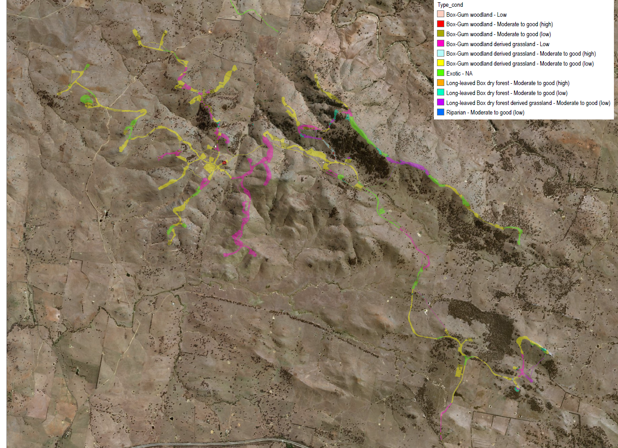
Mod 1 – Biodiversity Mapping

Slide 16
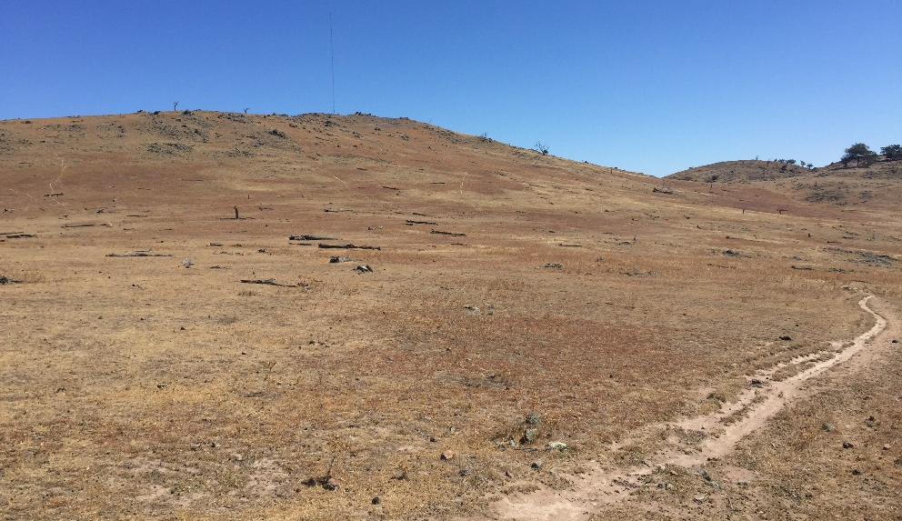
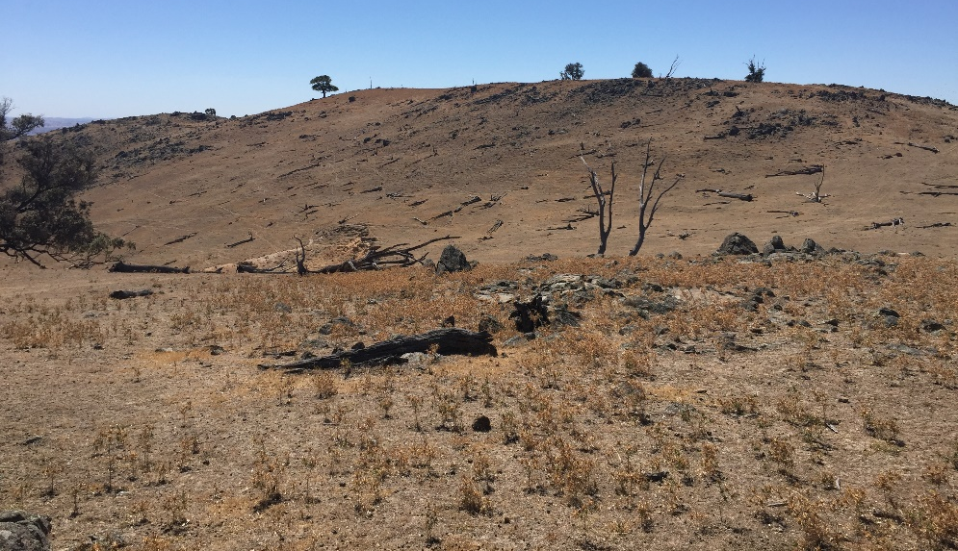
Biodiversity - EEC
Box Gum Woodland Derived Grasslands:
80% of the impact allowance is considered derived grasslands.
Typical Box Gum Woodland Derived Grassland areas onsite:

Slide 17
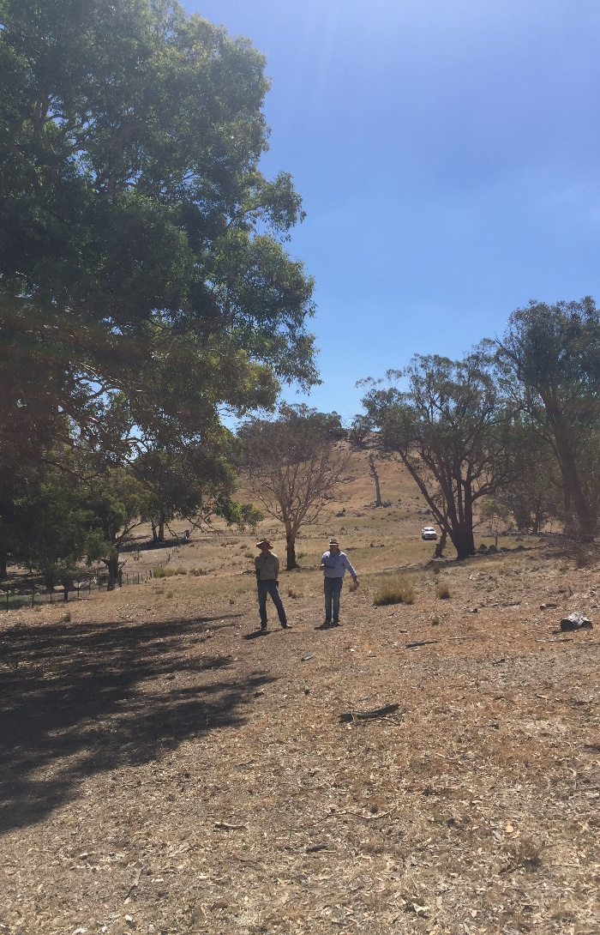
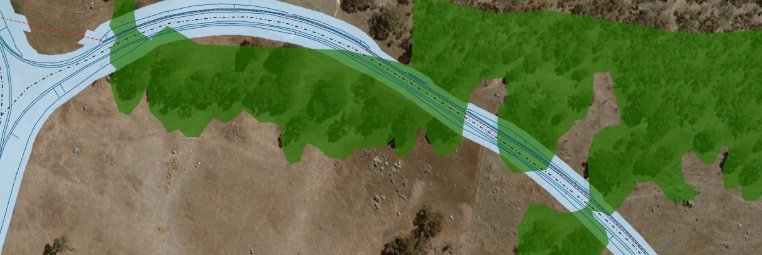
Biodiversity - EEC
Box Gum Woodland:
20% of the impact allowance being sought is considered woodlands.
This includes impact to grassland areas between trees (trees can be up to 100m apart).
CEEC (under EPBC)
A total of 3.2 Ha is considered Critically Endangered Ecological Communities (CEEC). Impacts to trees have been sought to be avoided through the design.
CEEC Box Gum Woodland (EPBC)
Design Footprint (incl. 5m buffer)
Notes:
Reconsider statement in this slide now that a Development Corridor has been accepted.

Slide 18
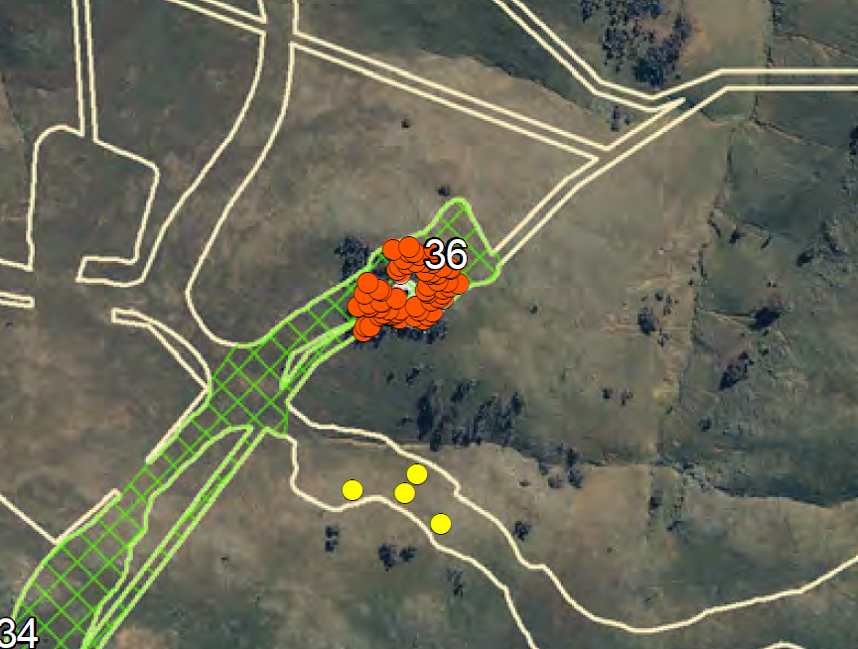
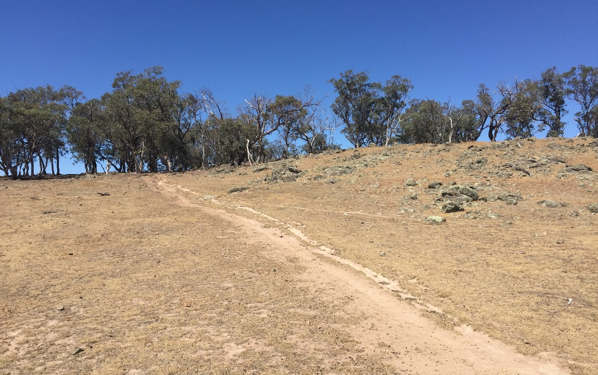
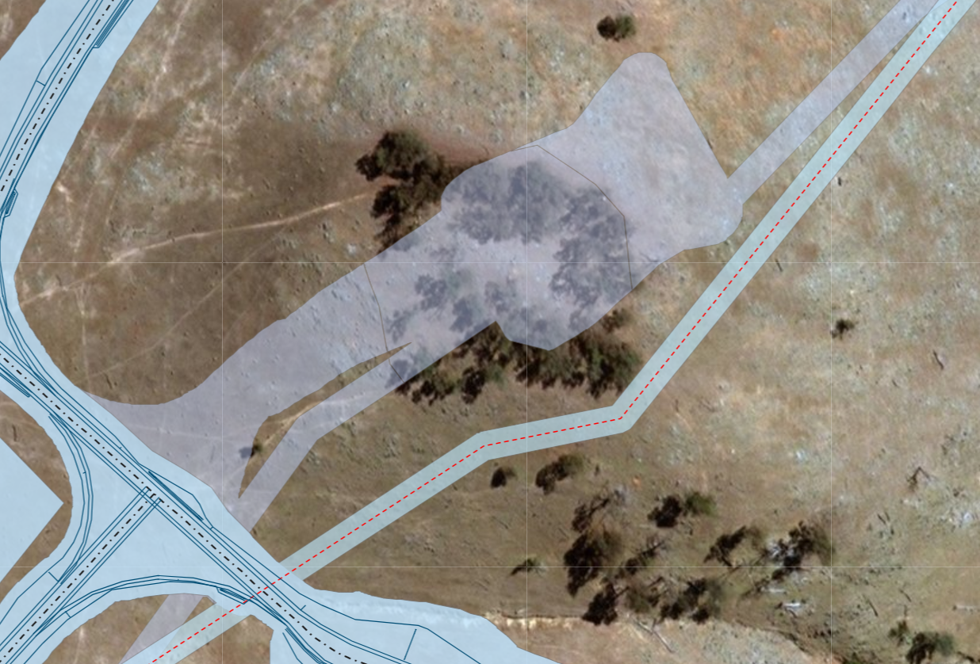
Removal of Turbine 36
58 hollow bearing trees confirmed at T36 location. Much more than any other wind turbine location.
These trees are one of 2 locations considered BGW Mod-Good (high).
This area will now be protected from direct impacts under the new Development corridor.

Slide 19
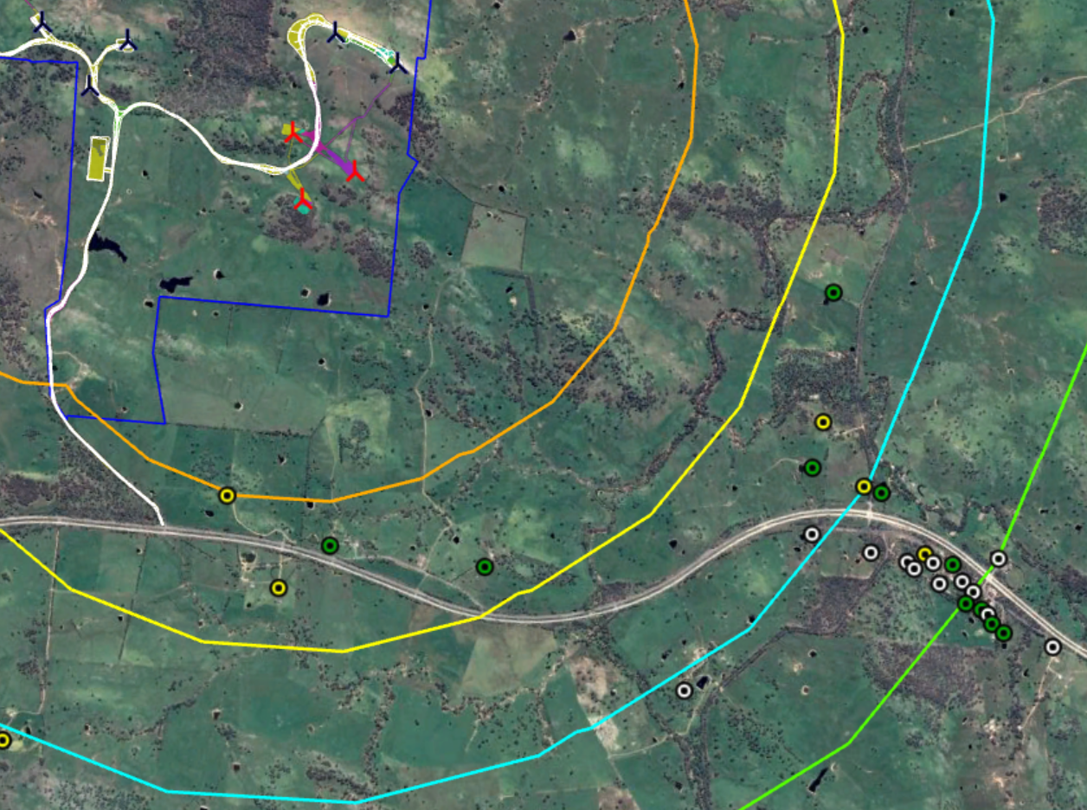
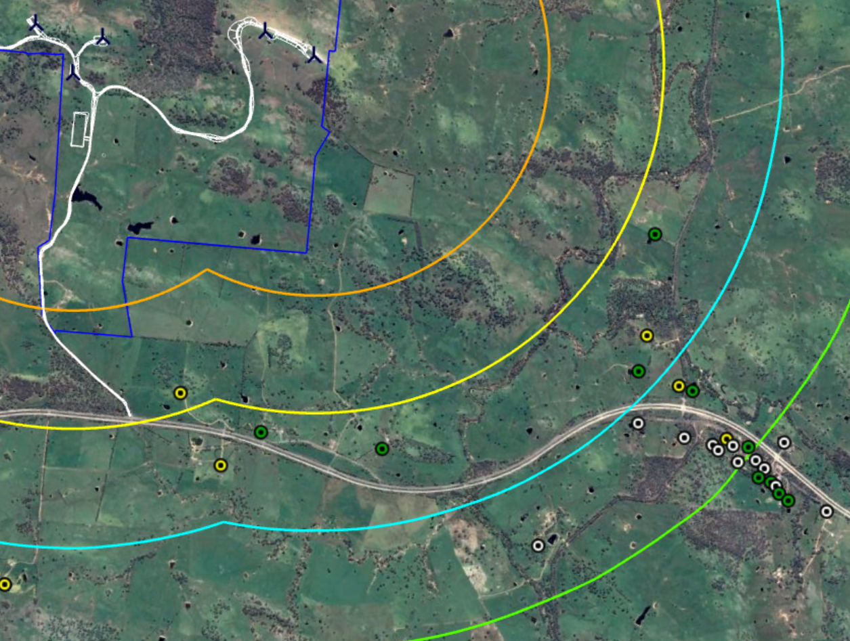
Removal of 3 Turbines – 75, 76 & 77
Concerns were raised in submissions from nearby community regarding visual impacts of specific wind turbines in the southeast of the site.
After review and consultation, three turbines are now removed from Mod 1 layout
Removal of the 3 turbines
reduces visual impacts for residences along the Hume Highway,
Increases distance to the nearest non-associated residence (C06) from 2.0km to 2.8km
VIA Concludes that no residence would have a higher visual impact rating as a result of Mod 1
80
78
80
78
73
73
79
75
74
79
74
77
76
2km
2km
3km
C06
3km
C06
C60
4km
C60
4km
5km
5km
Neighbour Agreements:
Signed
Offered
Drafted/Intend to Offer

Slide 20
Photomontages - C06 & C60
C06 at 2.0km (distance to closest turbine extended to 2.8km with removal of WTGs 75, 76, 77)
WTG-77
C60 at 2.56km (distance to closest turbine extended to 3.5km with removal of WTGs 75, 76, 77)
WTG-75
WTG-77

Slide 21
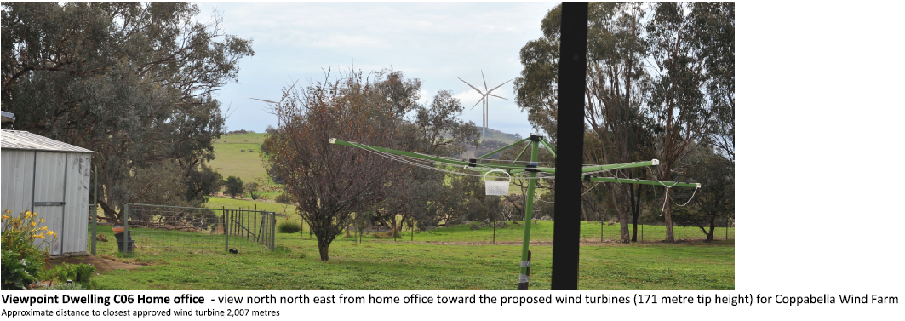
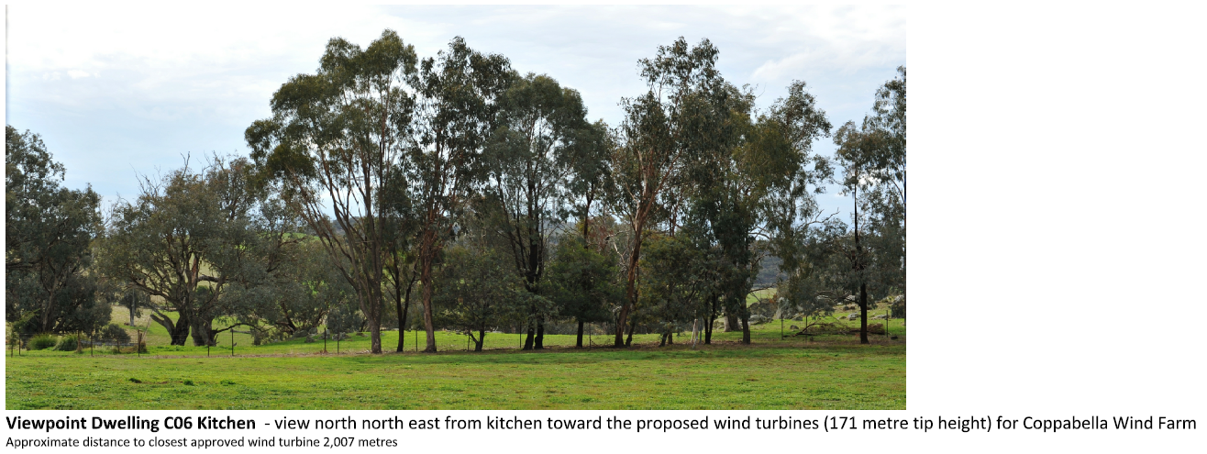
Photomontages - C06
WTG-75
WTG-74
WTG-76

Slide 22
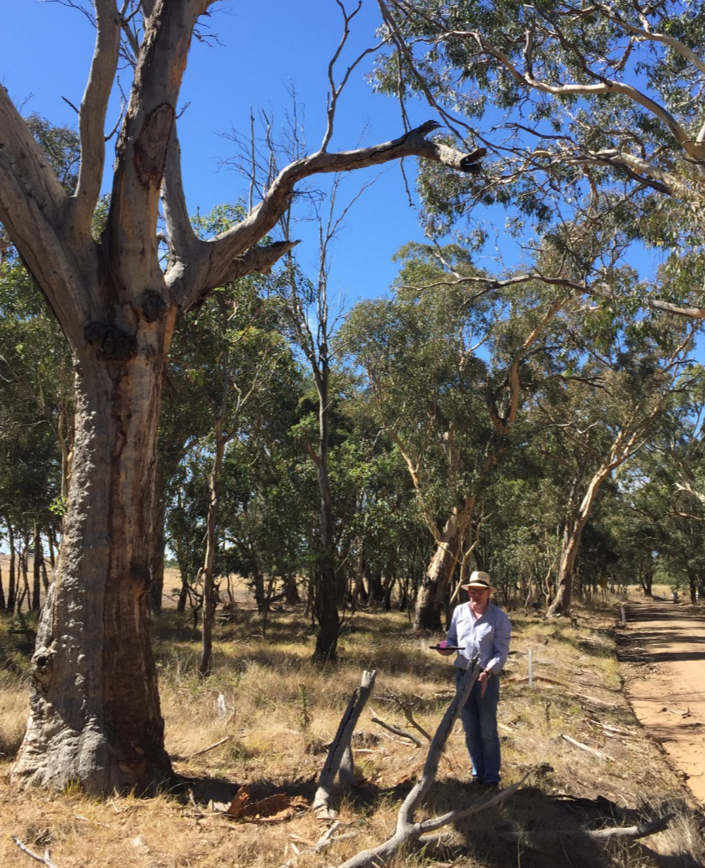
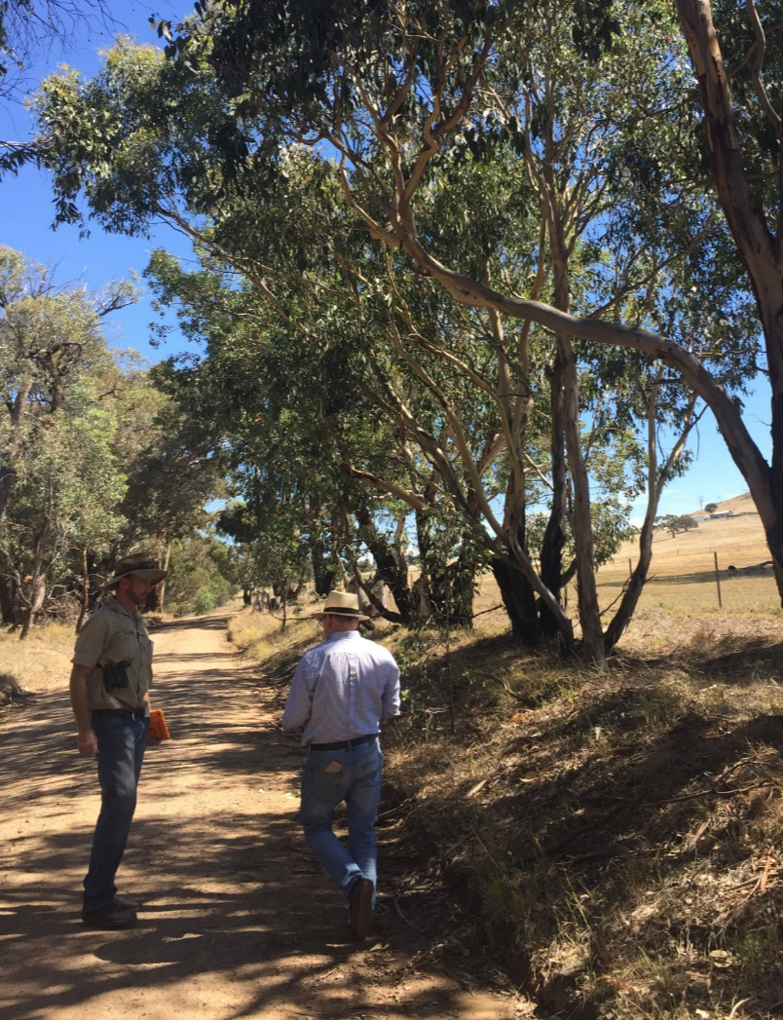
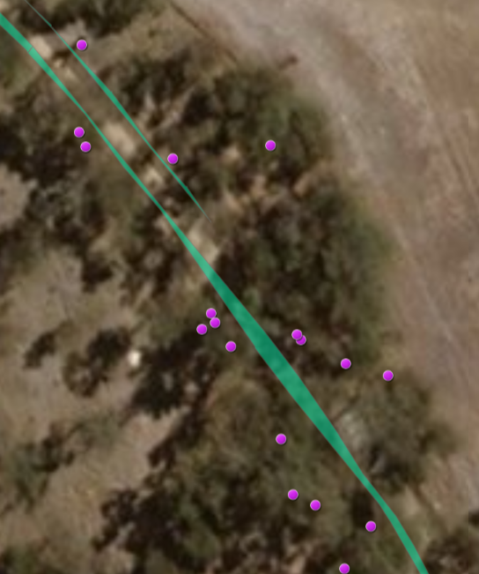
Traffic and Access
Whitefields Road
Only approved primary access route for Over-Dimensional (OD) vehicles
1.1km section of Council Road - requires upgrade
Mod 1 has not altered this approved route
Design work has reduced environmental impacts
Impacts of upgrade reduced to removal of only 4 hollow bearing trees (of 70+ HBTs in road corridor)
DPE revised condition for upgrade works to limit the impacts to the 4 HBTs
Road Upgrade Plan and Landscaping Plan in preparation
Revised DPE Condition requires road to be sealed as per agreement with Council
RMS currently designing intersection upgrade with Hume Hwy
Coppabella Road
Not approved for OD vehicles. Liaising with Hilltops Council to allow limited construction traffic (as per Council’s submission)
2km section to be upgraded for inter-project traffic
Not suitable for OD deliveries due to:
Extensive upgrade works, including creek crossings
Proximity of routes to neighbouring residences and use by locals
Notes:
Suggest alternative visuals/map

Slide 23
Other Considerations
Heritage
Additional sites identified in new areas inspected (similar to surrounding context). Table of potential sites within Development Corridor has been updated. Detailed design will seek to minimise the number of sites to be impacted.
Conclusion – Mod would not result in significant impact. Salvage will occur for sites within the impact footprint
Grid Connection
TransGrid upgrading 99M to allow direct connection to the Yass Substation
Approvals being performed by TransGrid through a Review of Environmental Factors (REF) process.
Telecommunications
Liaising with Hilltops Council to relocate existing on site communications services
Noise
Updated background noise monitoring will be established prior to construction
Construction Water Supply
Water Access Licences are currently being registered. Working with water broker to source necessary allocations

Slide 24
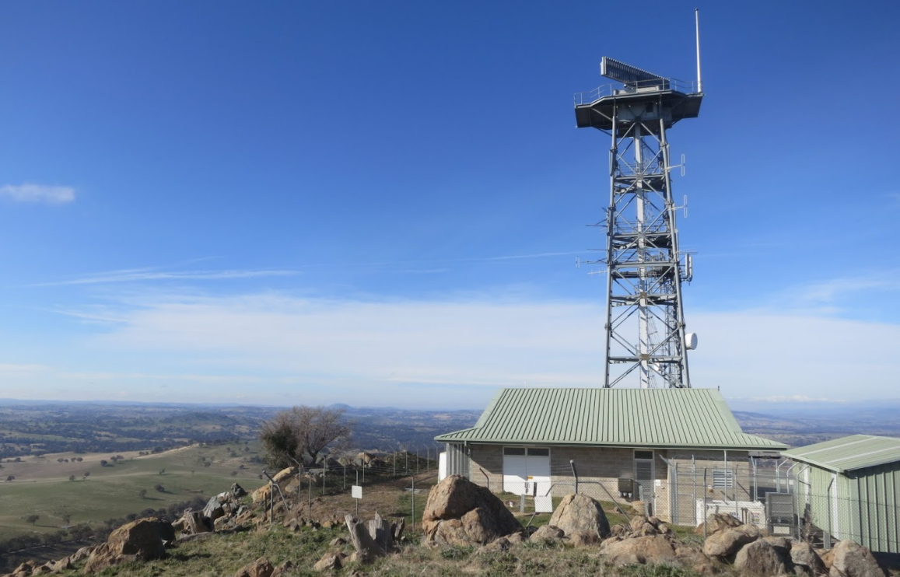
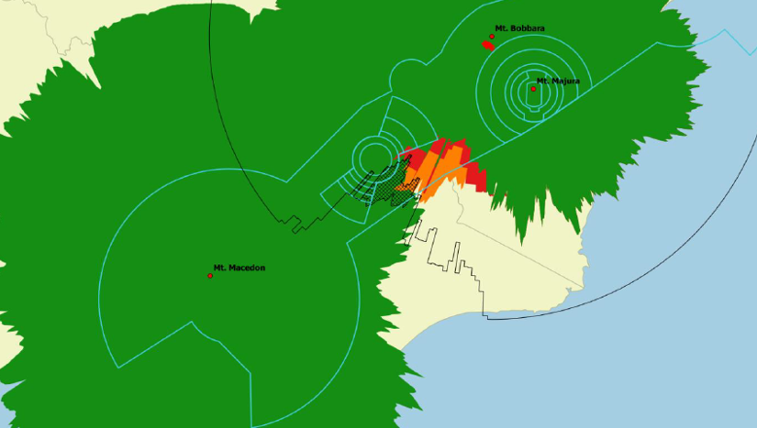
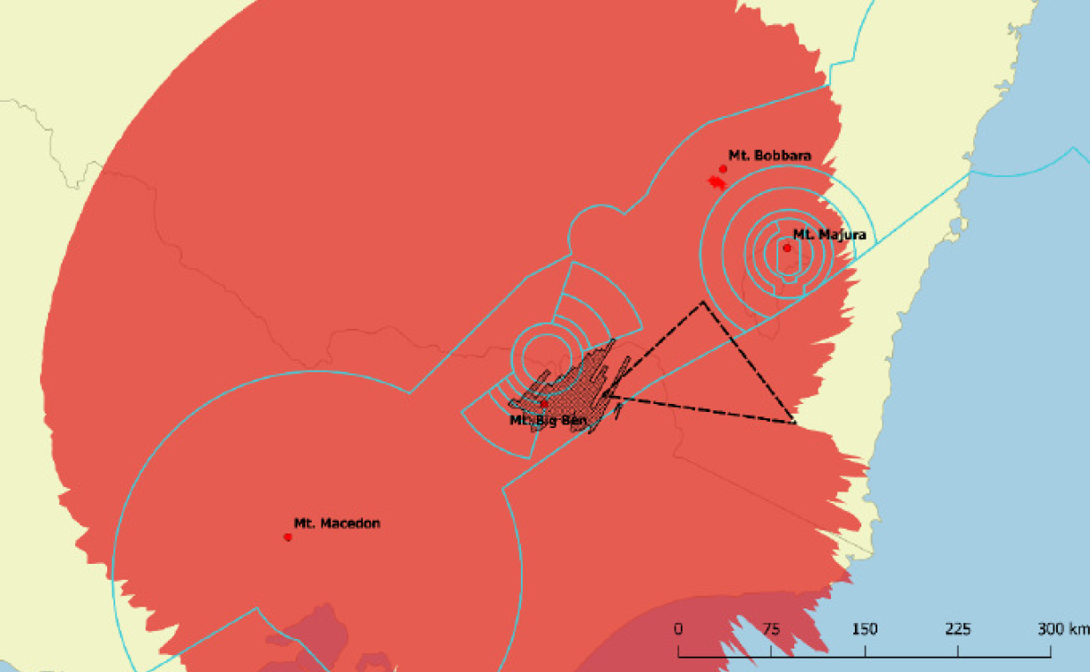
Other Considerations
Aviation – Radar Assessment
From 2016-2018, extensive studies were performed on the potential radar impact of the wind farm to the Mt Bobbara Radar station.
These studies were updated for the larger wind turbine rotors in Mod 1.
Potential secondary impacts were identified for the airspace near Albury Airport.
The mitigation to address these potential impacts has now been achieved through an new ADS-B facility at Mt Dederang, Victoria, with surveillance system measures incorporated which address impacts to the Mt Bobbara radar.
Airservices Australia have is satisfied with the with the Aviation Impact Management Plan.
The Department of Planning & Environment have confirmed that Conditions 34(a) and (b) of the Conditions of Consent have been met.
Mt Bobbara Radar Station
Secondary radar coverage gap
New ADS-B coverage

Slide 25
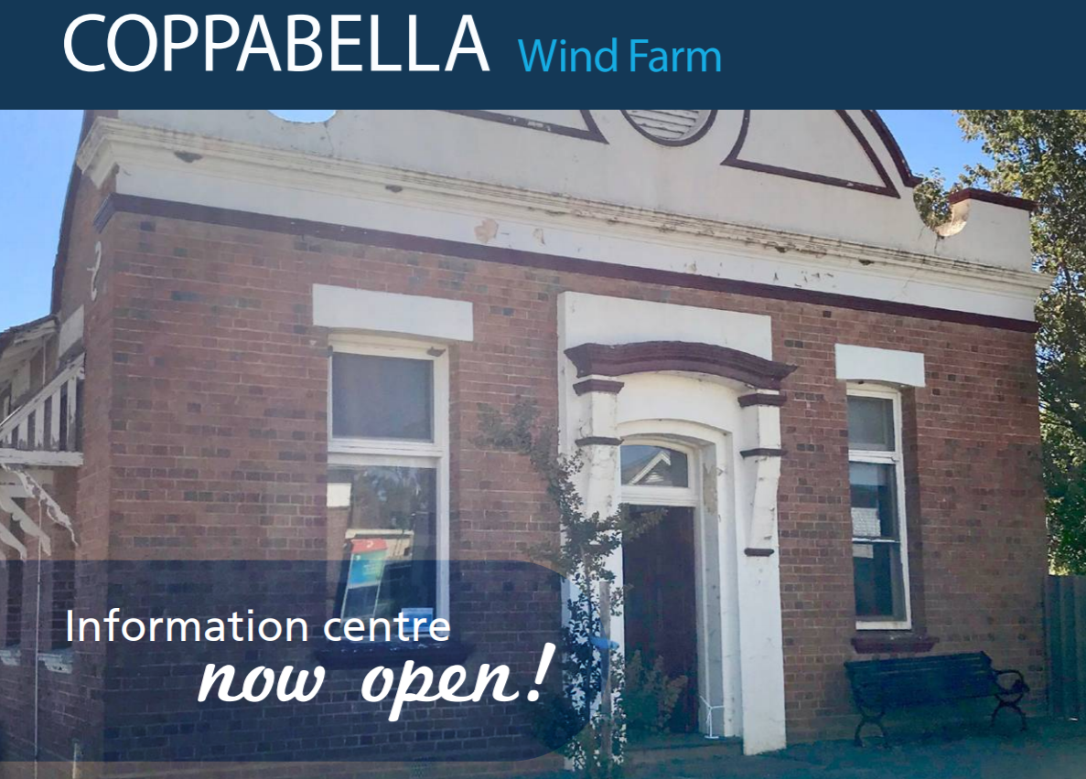
Community Engagement
Tailored Stakeholder and Community Engagement Plan established to ensure proactive information sharing and long-term contributions in the local area.
Information sharing:
Targeted neighbour engagement as part of the neighbour benefit sharing strategy
Over 50 face‐to‐face meetings with near neighbours to date
Establishment of local Information Centre
Managed by local community relations officer
Opened March 2018 (open 11 hours per week)
Over 160 visitors to date
Attendance at local community events
Community Consultative Committee
3 meetings since appointment by DPE in August 2018
Website, 1800 and email
Notes:
Tom to confirm details / numbers.

Slide 26
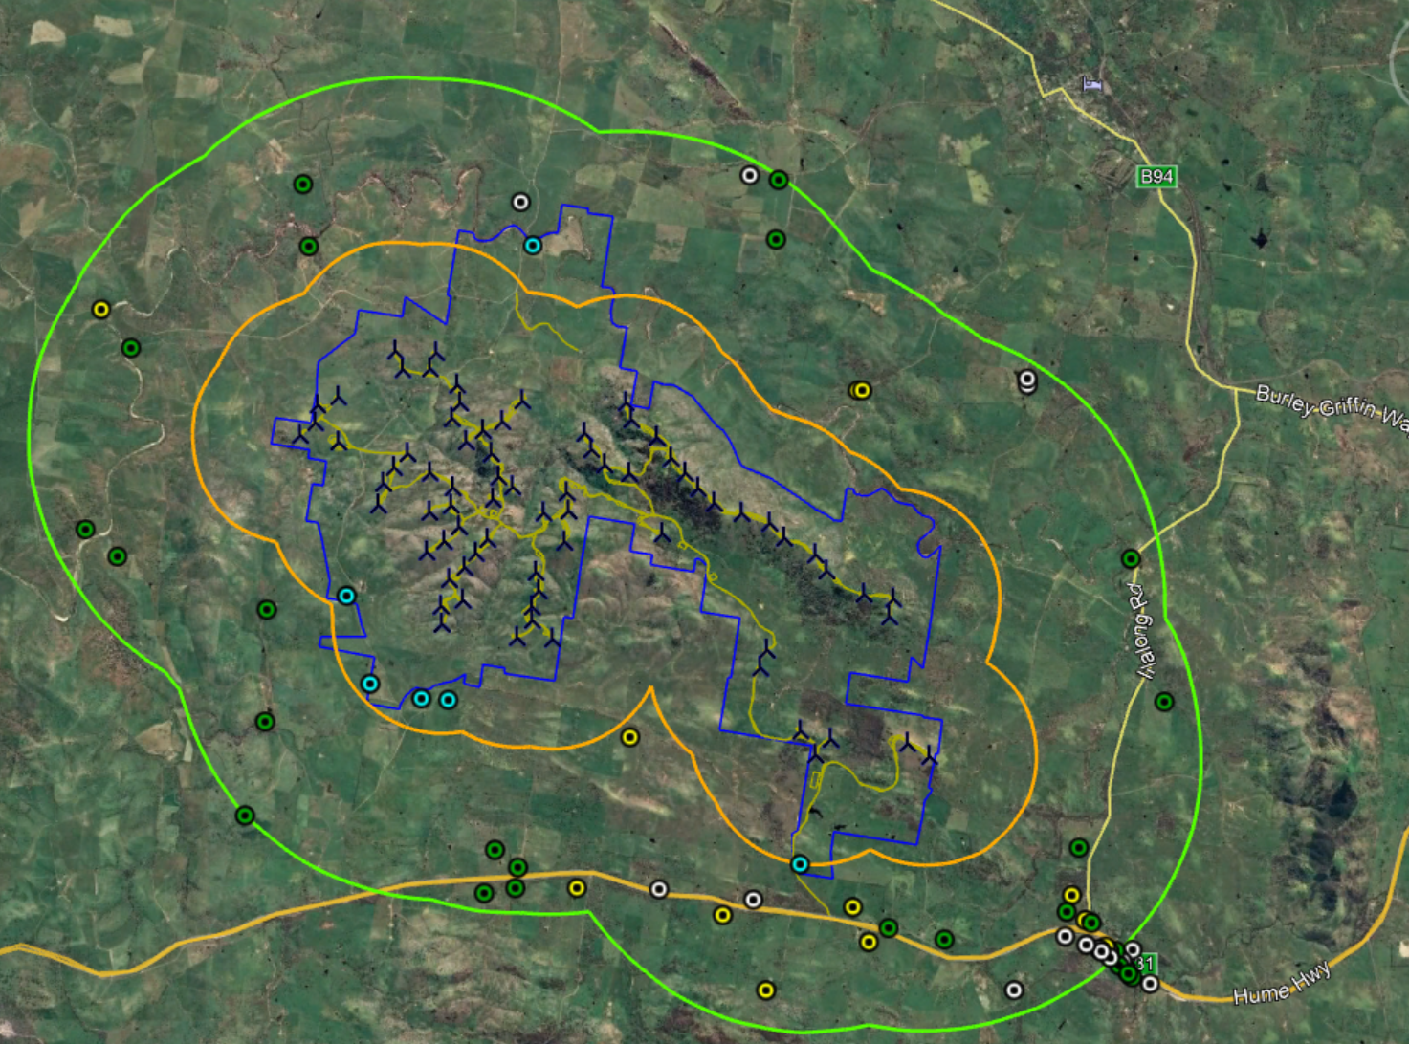
Coppabella Neighbour Agreements
(October 2018)
5km
2km
Status of
Agreements
30 Signed
(incl 4 adjoining properties)
12 Offered
19 Intend to Offer
Host Landowners

Slide 27
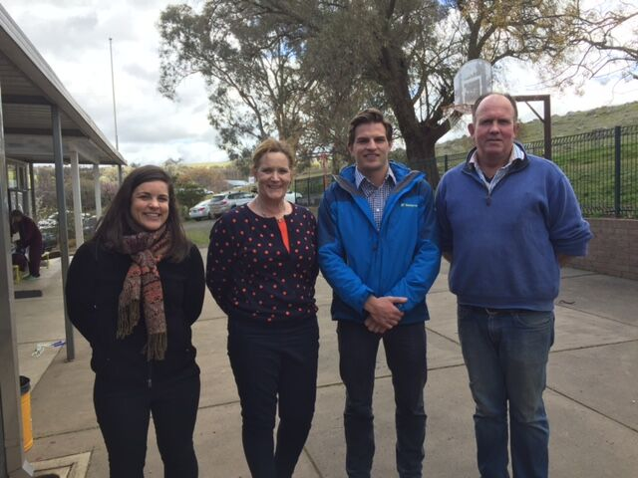
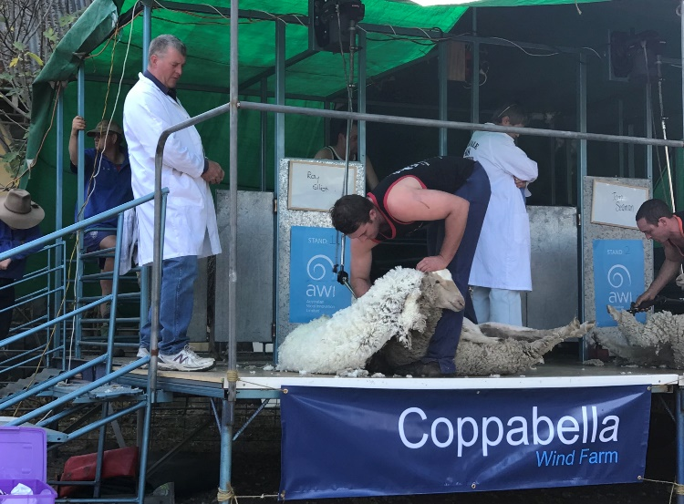
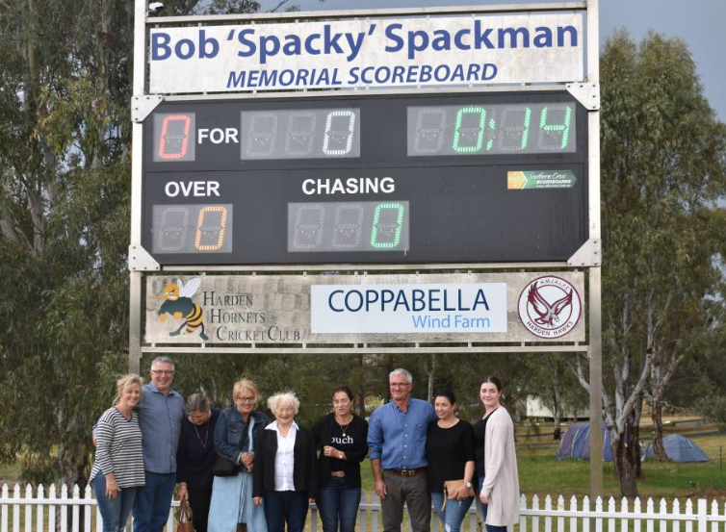
Community Benefit Sharing
Sponsorship of initiatives and events in the local area during the pre-construction and construction period.
Sponsored 28 initiatives/community groups to date (cumulative total of ~$80k)
Community Enhancement Fund (Voluntary Planning Agreement with relevant local Council).
$2,500 per installed turbine per annum for the life cycle of the project (CPI adjusted annually).
Supplementary community investment model, to invest a further $100,000 per annum (CPI adjusted annually) into the local area over the life of the project (separate and additional to the Community Enhancement Fund), i.e. up to $287,500 p/a

Slide 28
Local Investment and Jobs
Local Business Participation Program underway - designed to identify capability and capacity in the local community and maximise opportunities for local participation in the project. i.e. local suppliers (fencers, concrete works, labour etc.) during the construction period.
Project listing on Industry Capability Network (ICN) Gateway.
Local Industry Briefing – Goldwind and major contractors share further details supply and employment opportunities during construction.
Up to 200 jobs expected on site during construction peaks.
Secondary local industry participation through accommodation, construction support services and consumables. Secondary economic injection through use of local facilities e.g. motel, pub, cafe etc.
Approx. 10 permanent staff during operations. Opportunities for ongoing supply and service contracts.

Slide 29
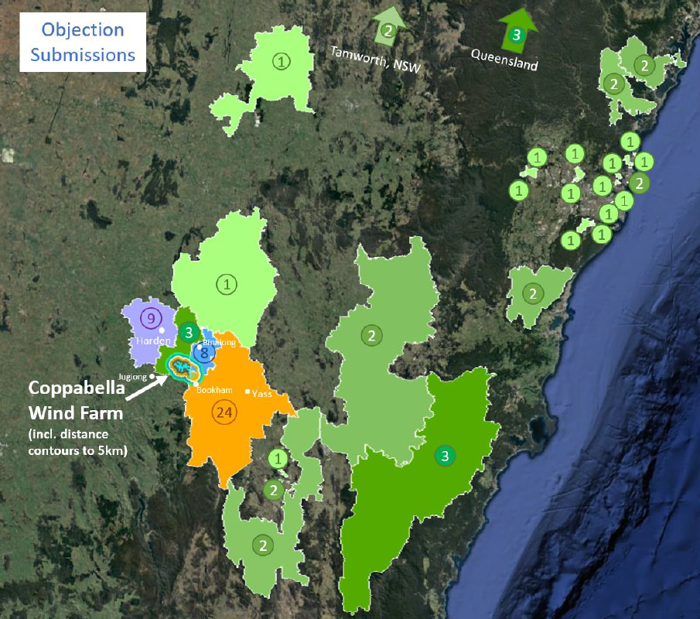
Modification Application
Submissions
105 total submissions were received by DPE from 98 submitters:
10 from Govt agencies
All provided comment
on the application
5 from special interest groups
84 from the public
Of this, there were
(a) 81 total submitters in objection
This included 31 template submissions
(b) 2 submitters provided comments
(c) 2 submitters in support

Slide 30
Response to Submissions
Outcome following RTS & Additional Information
Committed to removing the 4 approved turbines (visual + ecological benefits)
Committed to a supplementary community investment model
Committed to resurveying and mapping biodiversity within impact footprint (conditioned)
Vegetation impact limits now applies to sub-categories of EEC
Offset requirements increased and may need to offset for additional species (e.g. Regent Honey Eater)
Committed to sealing Whitefields Rd and reducing impacts on hollow bearing trees in the Whitefields Road corridor (now conditioned)
May need to install Aviation Detection Hazard Lighting System (conditioned for the first time on a project)
Conditions of Consent have been strengthened by DPE

Slide 31
Mod 1 Conclusions
Goldwind has genuinely sought to engage with surrounding residents, relevant stakeholders and the nearby community
Goldwind has gone to great lengths to address stakeholder concerns and as part of its response to submissions, has made further concessions in the interest of progressing the project
The Mod 1 project as varied, achieves an appropriate balance for a viable development of the local wind resource while also minimizing the potential impacts on the local community and environment
A substantial biodiversity offset is required in the revised conditions with the revised conditions also providing incentive to reduce impacts
The proposed modification and associated conditions allow for the full benefits of the project to be realized in an acceptable manner
The project supports the Commonwealth’s Renewable Energy Target and the NSW Climate Change Policy Framework
Goldwind agrees with the DPE’s recommendation that the project is approvable

Slide 32
Questions?

