Slide 1
Parkes Shire Council’s response to MOD4: CLEANTEQ SUNRISE Tuesday 16 October 2018

Slide 3
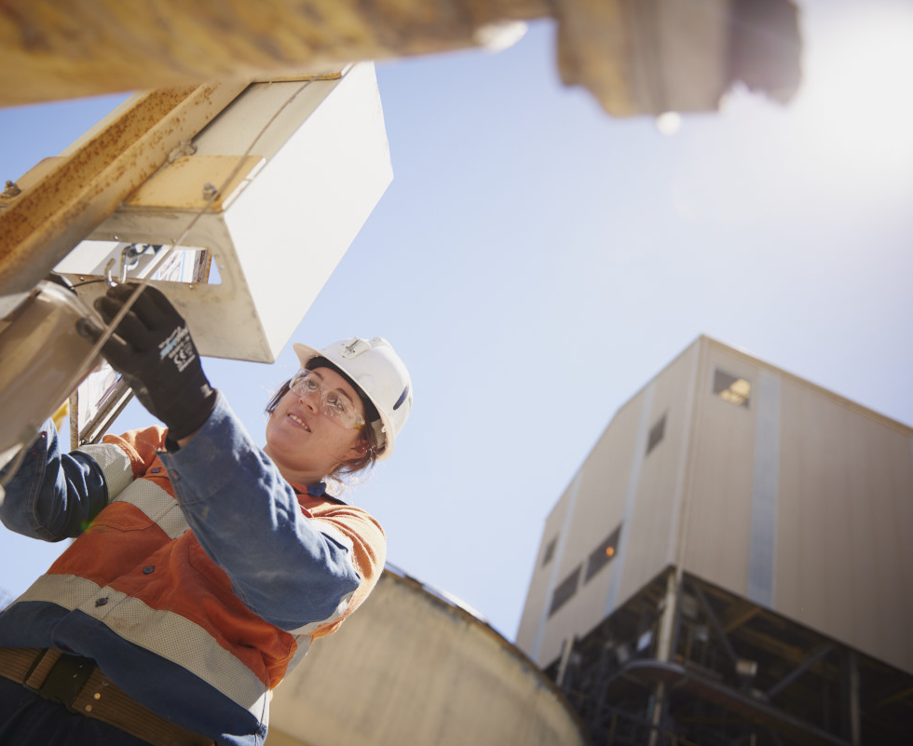
PARKES:
A HUB FOR MINING
The Parkes Community has a long history of mining
We continue to embrace mining into the 21st century
key cornerstone of the Parkes economy
Employs 6% of the workforce
Mining represents 30% of GRP
Several mines located within 100km of Parkes

Slide 5
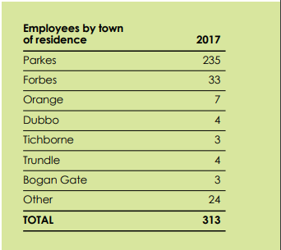
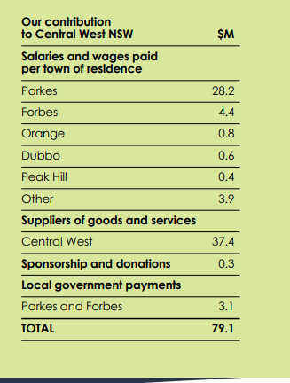
Northparkes Mines Economic Contribution

Slide 6
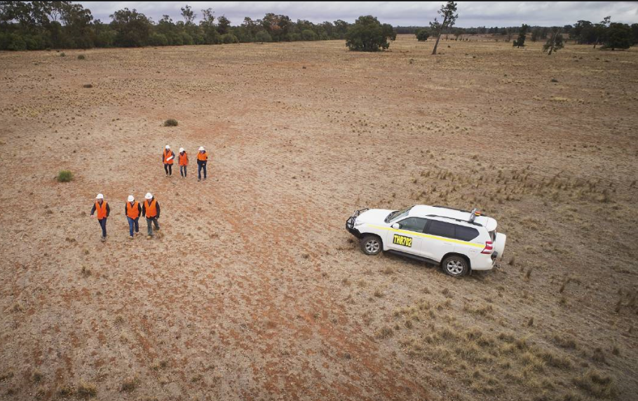
PARKES SHIRE COUNCIL
+ SUNRISE PROJECT
PSC has been a long term stakeholder in the Sunrise Project
Blackrange Minerals Syerston Nickel Cobalt Project Mid- 1990s to 2000
Clean TeQ Sunrise Nickel Cobalt Project 2001 to present

Slide 7
Council’s Interest in the Sunrise Project

Slide 8
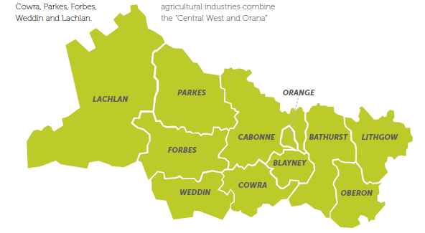
Adjoining Local Government Authority
Parkes Shire townships of Bogan Gate, Trundle and Tullamore that are in close proximity of the mine.

Slide 9
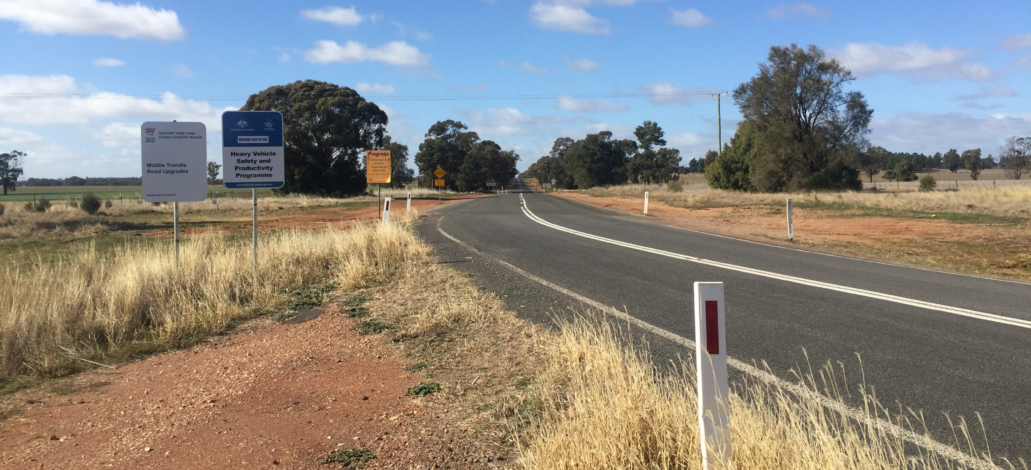
Local Road Network Impacts
Council is the manager of the local road network that will carry the mainstay of traffic.

Slide 10
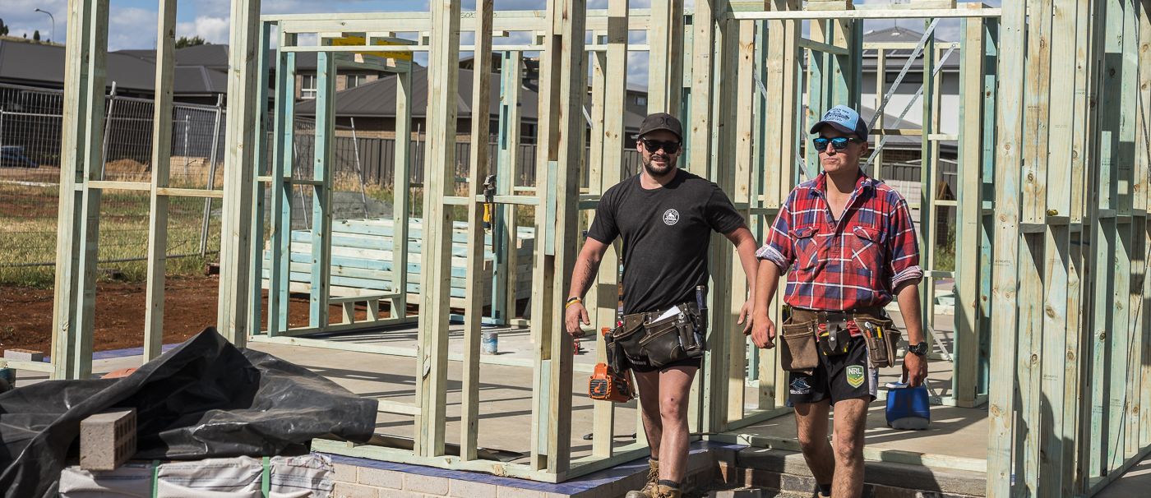
Regional Economic Impacts
Clean TeQ’s investment and operation will attract increased jobs, new residents and opportunities for local business, stimulating economic growth in our region.

Slide 11
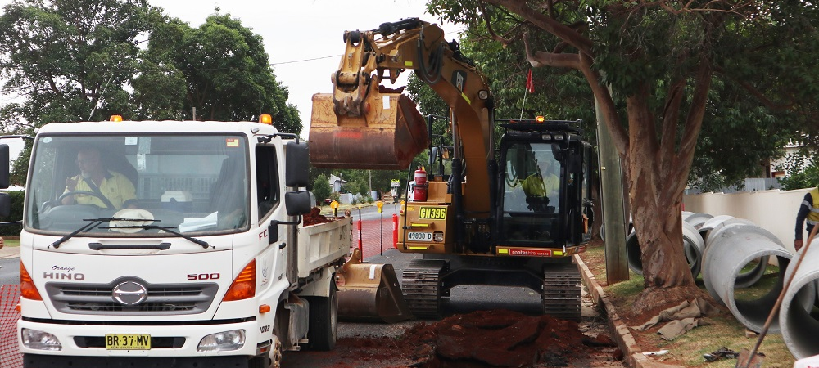
Enhance & upgrade infrastructure
The funds invested by Clean TeQ under the voluntary planning agreement will contribute to asset management and upgrades to essential community infrastructure.

Slide 12
Contribute to improved community facilities and services
Attraction of new residents and population growth will stimulate development of community facilities and trigger improved access to services.

Slide 13
Mid-Lachlan Alliance

Slide 14
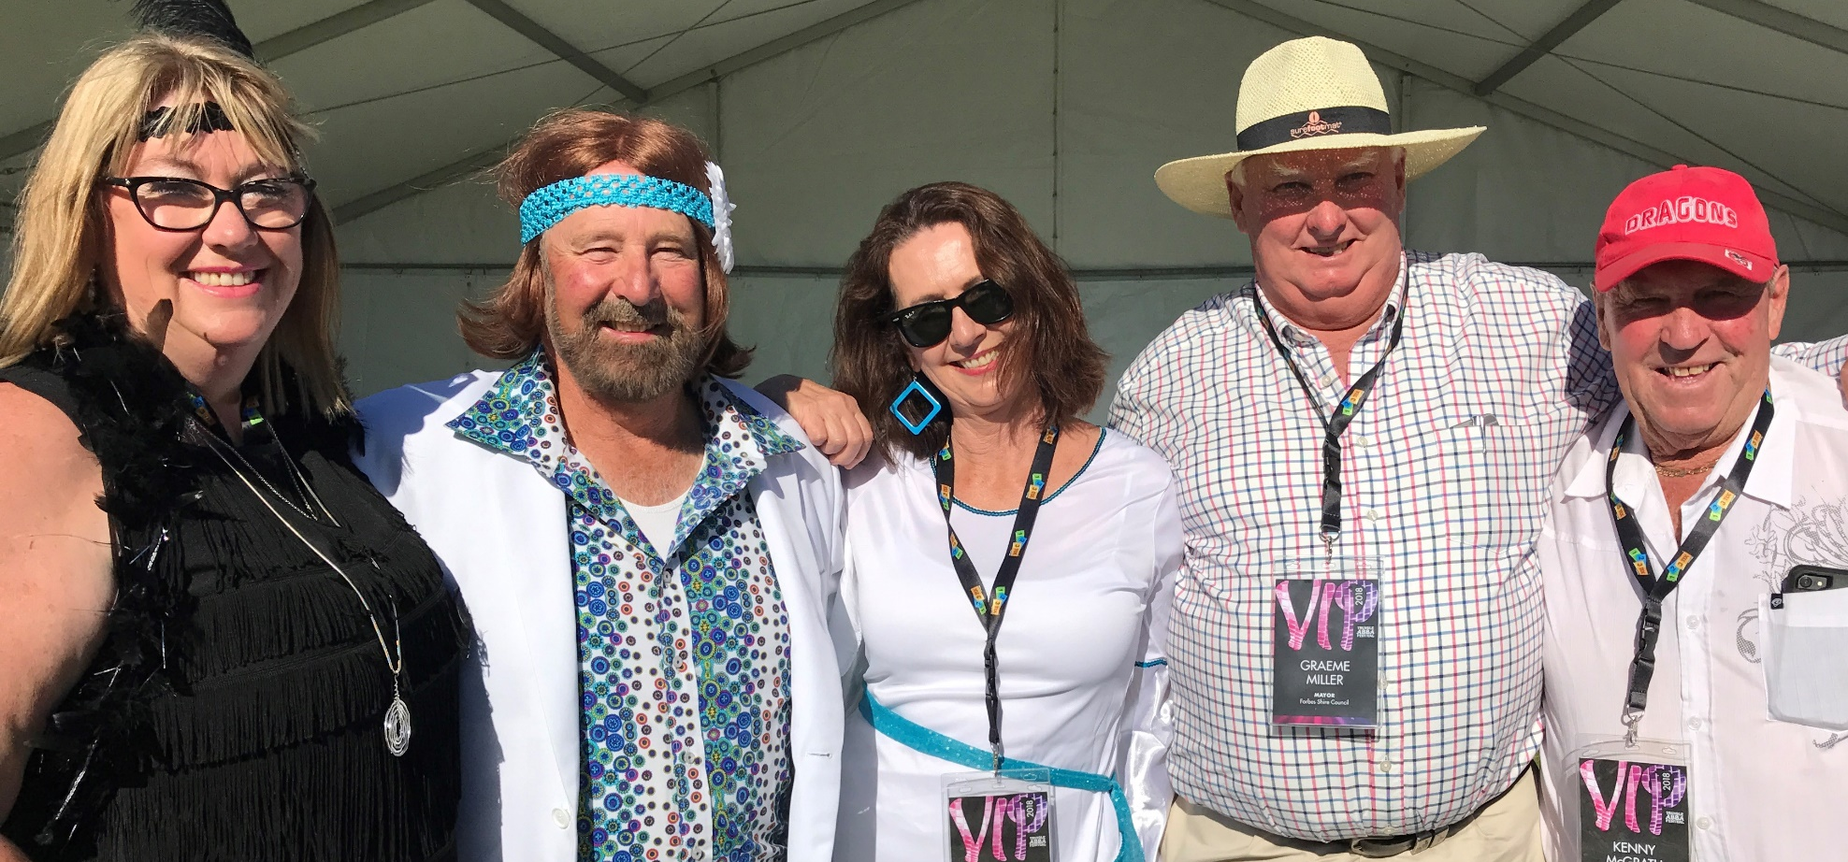
Reinvigorate the Mid-Lachlan Alliance
Lachlan, Forbes and Parkes have for many years worked together on regional initiatives including the establishment of the Mid Lachlan Alliance in early 2000’s.
The Clean TeQ project presents an opportunity to reinvigorate the alliance.

Slide 15
Stronger together
Councils have shared resources and knowledge on a wide range of interests, which has made the region stronger and given member councils a stronger voice at CENTROC and with other tiers of government

Slide 16
Long term prosperity for the region
The Clean TEQ VPA is another example of the merits of how the Lachlan, Forbes and Parkes Alliance could deliver long term prosperity and sustainability for Central NSW.

Slide 17
Council’s Aspirations for the Sunrise Project

Slide 18
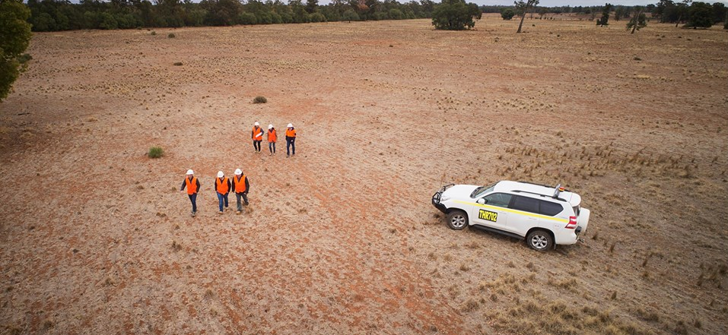
Clean TeQ’s approvals granted
Clean TeQ Sunrise Nickel Cobalt Project obtains all necessary approvals to commence operations at Fifield by their programmed construction start date in 2019.

Slide 19
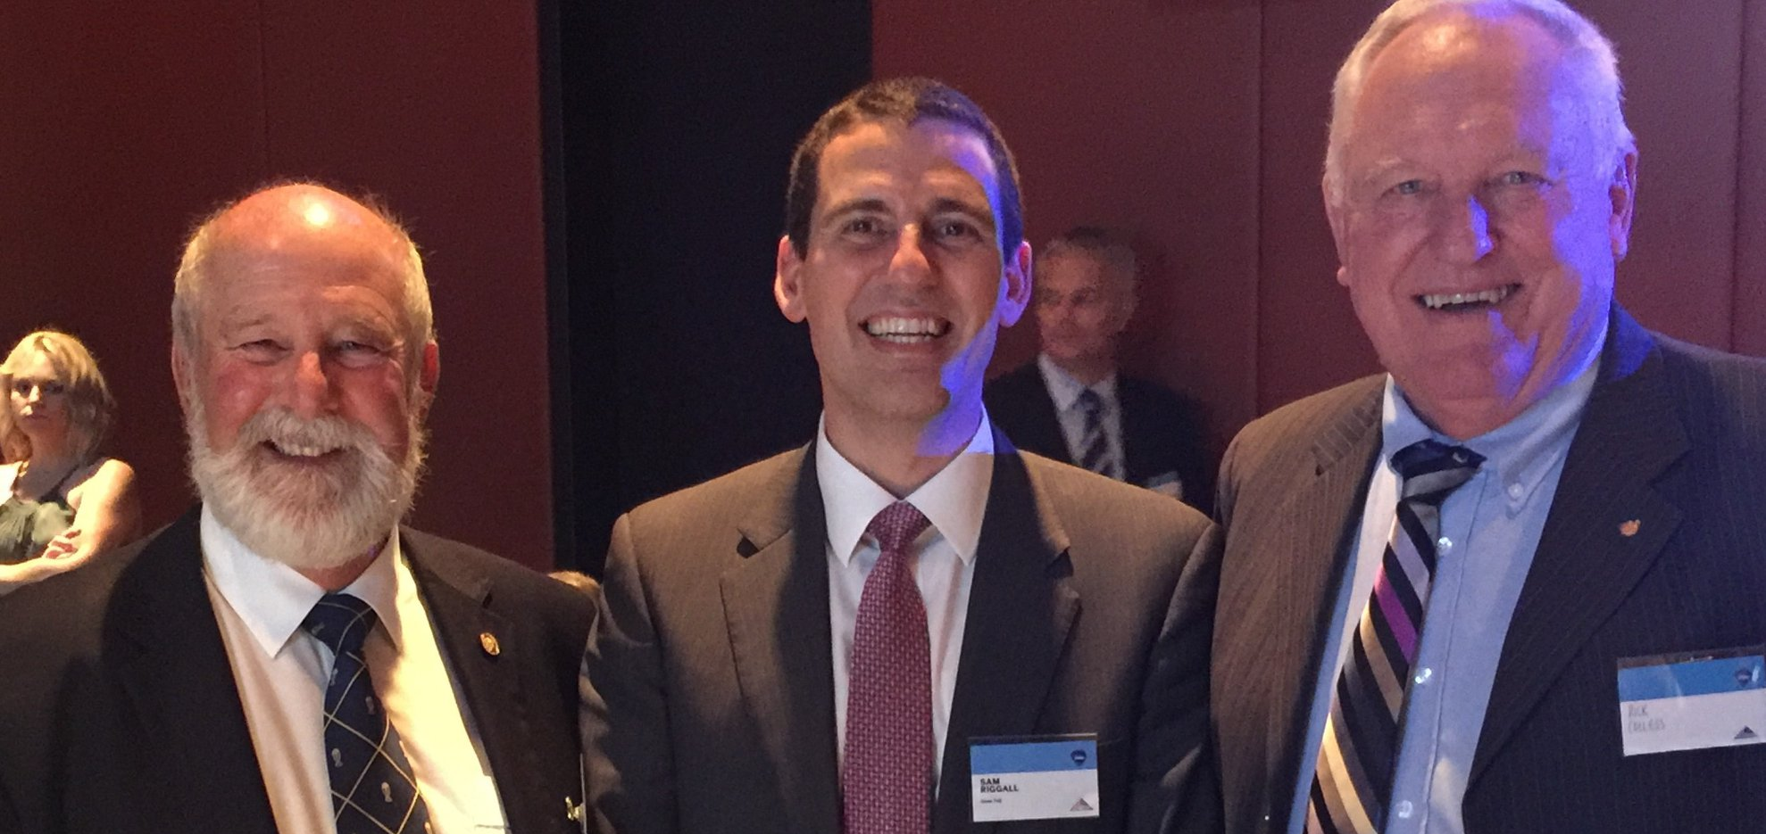
A positive partnership with Clean TeQ
That Parkes Shire Council and Clean TeQ continue to develop a mutually positive relationship

Slide 20
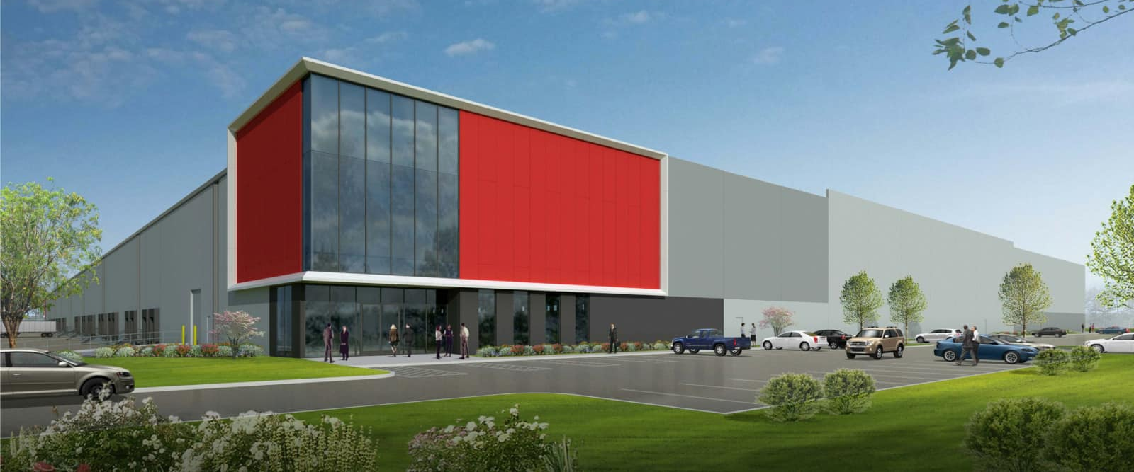
Clean TeQ Headquarters in Parkes
Clean TeQ establishes their main industry headquarters at Parkes to take advantage of the new opportunities being realised in Central NSW

Slide 21
Increased Business Investment
Other new projects establish in Central NSW, based on the ‘ready to do business’ attitudes of Lachlan, Forbes and Parkes Councils

Slide 22
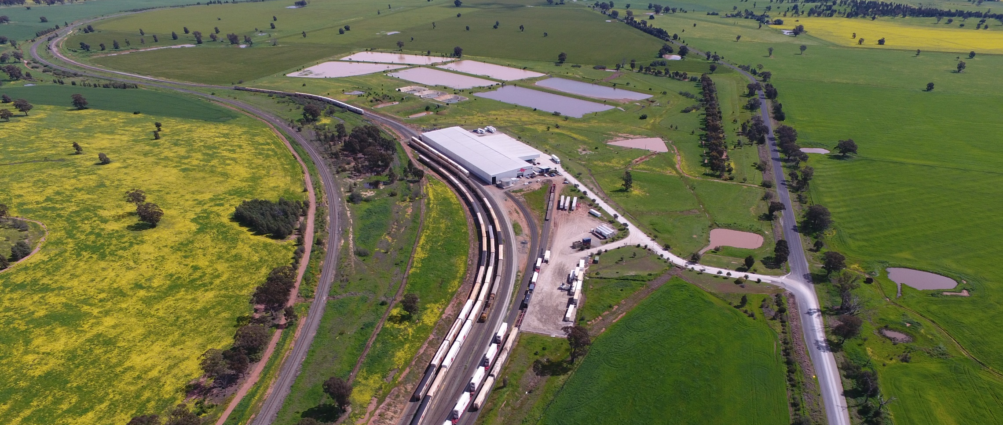
Logistics Hub will service operations
Parkes and its National Logistics Hub will provide logistics services & value-adding opportunities to the mine into the future.

Slide 23
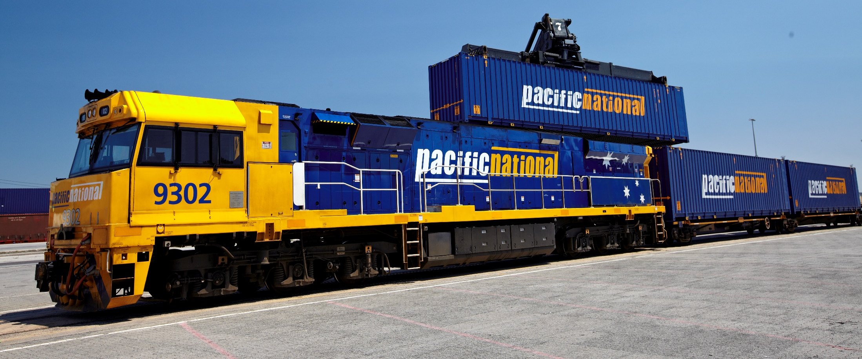
Leverage the benefits of Inland Rail
Clean TeQ’s operation will realise the benefits of accessing major ports on the eastern seaboard through the connectivity that Inland Rail will provide.

